Slide 1
Domestic Violence Residential State and Federal Funding Overview
Francine Garland Stark, Hanna Gregory
June 2025
Connecting people, creating frameworks for change.
mcedv.org

Slide 3
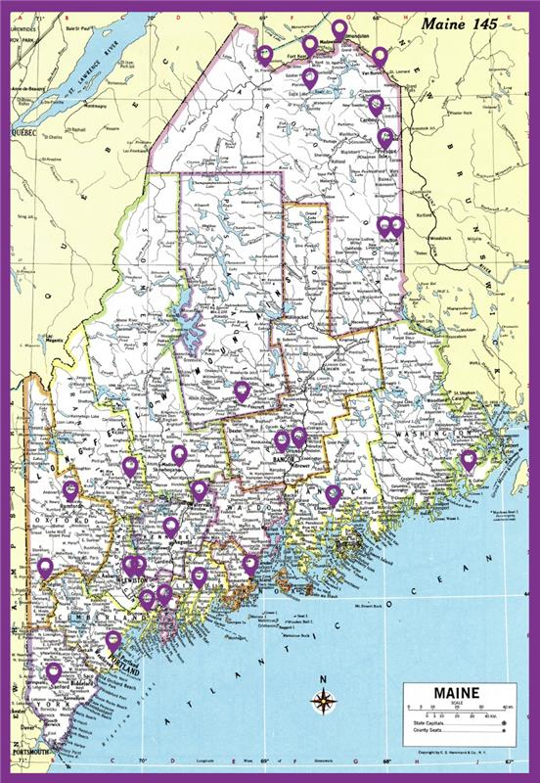
MCEDV’s Member Organizations
10 members
8 Domestic Violence Resource Centers
2 Culturally-Specific Victim Service Providers
24-hour toll-free helpline support
Safety Planning
One-on-one support & advocacy
Legal advocacy & representation or referrals
Support groups
Emergency sheltering
Transitional housing services
Community and school-based education
Information and access to public assistance
Children’s programs
Notes:
Note that only the 8 DVRCs are subrecipients in MCEDV’s contract with DHHS. IRCM contracts directly with DHHS, and HRS does not receive any DHHS contract funds.
More than just Residential Services…in fact, primarily non-residential services.

Slide 4
FY 2024 Individuals Served Statewide by DVRCs
Notes:
There were 324 households/adults as well as 218 children sheltered for a total of 542 people
1,402 people received assistance related to housing but were not residents in shelter, T Housing, or receiving RRH assistance.
In FY24, 3,758 survivors that the regional DVRCs helped were reached through Advocate Initiated Contact: 30% of all survivors served…outreach based on police reports, protection from abuse orders, child protective reports, and Certified Domestic Violence Intervention Program referrals.
Substantial time engaged in multi-disciplinary work to improve system recognition and response to DV along with training, education, and public awareness.

Slide 5
DVRC Emergency Shelters By County
Caring Unlimited
York County (1) (18 beds)
Through These Doors
Cumberland County (1) (22 beds)
New Hope Midcoast
Lincoln, Knox, Waldo, Sagadahoc *provides sheltering services via hotels (c. 6 beds)
Safe Voices
Androscoggin County (2) (17 beds + 6 trafficking)
Franklin County (1) (6 beds)
Hope and Justice Project
Aroostook County (3) (34 beds)
Family Violence Project
Kennebec County (1) (16 beds)
Somerset County (1) (18 beds)
Next Step Domestic Violence Project
Washington County (1) (12 beds)
Partners for Peace
Penobscot County (1) (17 beds)
Notes:
Number of FTE “outreach workers or case managers”? Our terminology is shelter advocate or housing navigator
C. 45 FTEs
Between 5 – 8 per program, in addition to regular duties are assisting with the helpline and supervision
Number of shelter beds
160 shelter beds (172 when including the 6 that are NHM's hotel beds and 6 that are trafficking)
Some of these beds are for children; DV shelters avoid doubling up in bedrooms, though sometimes two residents without children may be asked to share a room.

Slide 6
Maine’s Domestic Violence Resource Center Shelters
Provide services statewide and have 28 outreach locations, including 12 emergency shelters – 1 specific to trafficking
Are low-barrier: do not require criminal background checks, credit or income verification, program participation, sobriety, or identification
Serve both adult survivors and their children
Offer pet friendly sheltering options
Serve and shelter people of all genders
Encourage survivors to reach out to their DVRC helpline if they are seeking shelter, as capacity can change daily
Support and shelter survivors of sex trafficking and sexual exploitation

Slide 7
State & Federal Funding Sources (approx.)
MCEDV – DHHS consolidated Contract – (Shelter portion $1,345,000)
VOCA: $125,000 for shelter services + $425,000 for trafficking shelter
Family Violence Prevention Services: $600,000
State general funds: $195,000
Maine Housing
ESHAP + Performance share: $856,000
Dept. of Justice – Office on Violence Against Women (VAWA)
Transitional Housing Discretionary Grant Program: $682,039
Notes:
The total funds in the DHHS Consolidated Contract for DV services for FY25 is $9.6 million ($6 million state/$3.6 million federal) NOTE: $4 million of those state dollars are one-year funds

Slide 8
2024 MCoC HUD Rapid Rehousing Programs
MCEDV PH-RRH FY23 Renewal $1,969,475
TTD/NH DV Bonus Project Renewal 2024 $356,318
2023
MCEDV New Project FY23 $604,571
MCEDV Renewal FY2023 $1,198,424
Safe Voices Renewal $161,580
TTD/NHM DV Bonus Project Renewal 2024 $336,282
Notes:
Rental assistance, supportive services, housing navigation, outreach services

Slide 9
Other Funding Sources
MaineCare
Municipal Funding (TTD Only*)
Portland Social Services (GA- TTD Only*)
United Way
Private donations
Notes:
Community resources vary greatly across the state.

