Slide 1
Dynamic Prioritization

Slide 2
Agenda
What is it? Why do we need it?
Where we are headed

Slide 3
First:
This is not a revamp of prioritization (yet)
Prioritization is not a science, will never be perfect
(There is not always a right answer)

Slide 4
Current Prioritization Scheme
The Maine CoC will use the data collection through the CE assessment to prioritize people experiencing homelessness in the state of Maine for housing resources. Households will be prioritized based on the numeric score that is provided by the assessment tool. The score is based primarily on a household’s LOTH (days) in the last three years. The assessment tool also considers additional criteria that may further prioritize a household based on the following:
Household who have 6+ months of homelessness in the past year
People actively fleeing DV
People experiencing unsheltered homelessness
Barriers to accessing housing

Slide 5
Dynamic Prioritization
Outlines a prioritization process that reflects that:
Is not static/doesn’t put participants into inflexible buckets
Prioritization is meant to be guidance, not always black and white
Circumstances change
No single pathway out of homelessness
System needs to leverage what resources we have at any given time

Slide 6
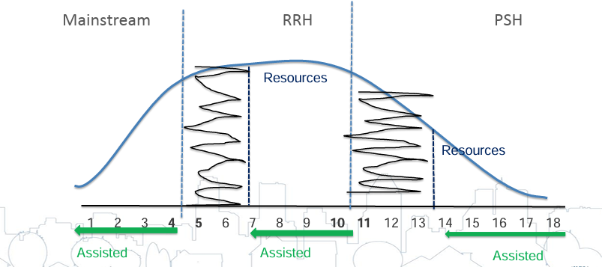
Results of Static Prioritization

Slide 7
Most Intensive Tier

Slide 8
Mid Level Intervention

Slide 9
Lowest Level of Intervention

Slide 10
Where are we?
Overall, working well
Some give and take – when lower level interventions take higher scores, there are system level impacts to this
Some tendencies to lean more on the black and white

Slide 11
New Resources coming online:
STEP
Home for Good units

