Slide 1
Point-in-Time (PIT) and Housing Inventory Count (HIC) Summary
2007-2024

Slide 2
HUD Required PIT Data Points
This is just to show the sheer volume of information now being collected, and this is just for the PIT. The number of elements collected for the HIC and other reports have also increased over the years.

Slide 3
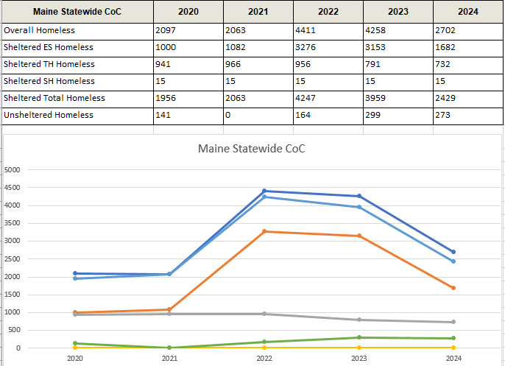
• Overall Homeless •Sheltered Total Homeless • Sheltered ES Homeless • Sheltered TH Homeless • Sheltered SH Homeless • Unsheltered Homeless
PIT Counts 2020-2024
PIT Counts take place in January each year. In January of 2020, the COVID 19 Pandemic had not yet hit. In January of 2021, COVID related funding was just arriving. By January of 2024, that funding was drying up.
Between 2021 and 2023, the spike in homelessness numbers was directly linked to the COVID-19 pandemic – and COVID related funding. During this time, hotels and motels served as extensions of emergency shelters, funded through GA, EHVs (Emergency Housing Vouchers), RRH vouchers, and other local financial support.

Slide 4
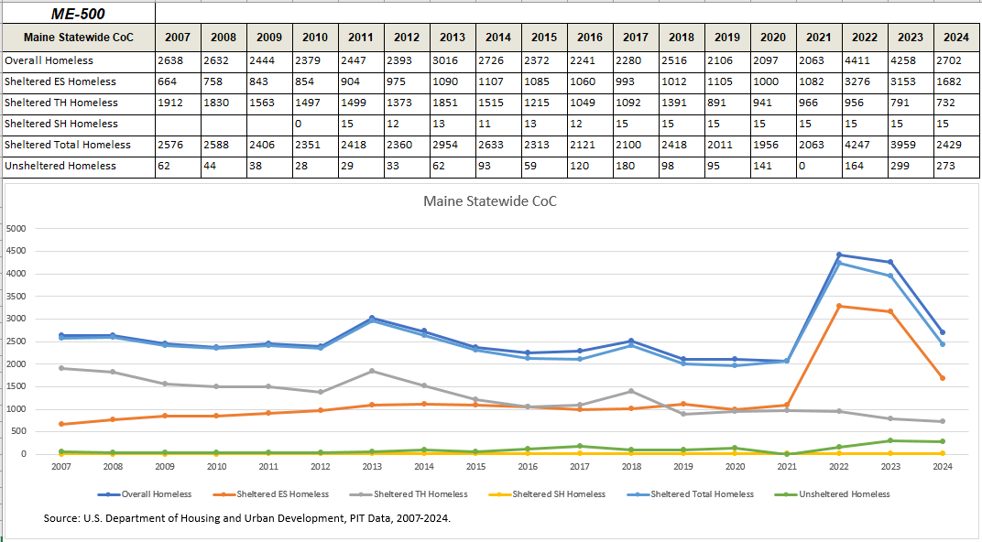
PIT Counts 2007-2024
This chart shows the Maine PIT Count numbers going all the way back to 2007. The previous slide only showed the portion to the right of the red line. As you can see, Pre-COVID, apart from some fluctuations in TH (the grey line), our PIT Counts for Emergency Shelter and Unsheltered situations had been fairly consistent and predictable year to year.

Slide 5
Maine Housing Inventory Chart – Emergency Shelter
While the general shape of this graph closely resembles the last one, this data is from the Maine Housing Inventory Charts from 2007 to 2024. The PIT counts people, and the HIC counts beds. This graph specifically shows just Emergency Shelter beds. The line at the top is the total number of ES beds, with the nearly parallel green line being Non-DV ES beds and the orange line showing ES beds in HMIS. Hotel/Motel ES beds were reported in the PIT for that night but those beds were not considered year round beds in HMIS. The pale blue line is beds for Households with Children (Families) and the pale green line is Households without Children (Individuals). The shorter lines near the bottom show beds for Child Only Households (black line), Dedicated Youth beds (brown) and dedicated Veteran beds (the dark green line).

Slide 6
Total Year-Round Beds Total Non-DV Year-Round Beds Total HMIS Year-Round Bed Total Beds for Households with Children Total Beds for Households without Children Total Beds for Households with Only Children Dedicated Veteran Beds Dedicated Youth Beds
These graphs are also based on Housing Inventory data. The one on the left shows the number of Transitional Housing beds. You can clearly see the general downward trend as HUD and MCoC moved away from the TH model. You can also see the spikes in 2013 and 2018 that we saw earlier in the TH line on the PIT graph, though they look more dramatic here because these charts are squished side by side. The graph on the right shows Rapid Re-Housing beds. It could be argued that RRH is intended to replace TH, but the scale of these two charts is not the same.

Slide 7
Total Year-Round Beds Total Non-DV Year-Round Beds
Total HMIS Year-Round Beds Total Beds for Households with Children Total Beds for Households without Children Total Beds for Households with Only Children Dedicated Veteran Beds Dedicated Youth Beds
There – now the scales line up. While RRH has ‘replaced’ some beds lost by reductions in TH, it is not enough. Also, TH was a mix of facility-based beds and vouchers. RRH is all voucher based. From 2007 to 2024, TH decreased by more than 1200 beds. Meanwhile, we have just over 500 RRH beds. Because the intent is for the client to stay in the unit, RRH depends on the availability of safe, affordable units in the community. The spikes in TH were mostly due to fluctuations in BRAP over time. In 2023 BRAP was reclassified, and removed from the HIC and HMIS, as it did not meet the HUD definition of TH. Also, many TH projects changed to Permanent Housing over the years. In addition to pandemic related fluctuations in RRH, HUD Data Standard changes, implemented in 2024, broke RRH into two subtypes: RRH- ‘Housing’ With or Without Services; and RRH – Services Only. The ‘Housing with or Without Services’ component includes bed inventories and those are still included in the PIT and HIC, whereas the RRH – Services Only projects, without beds, are no longer included. Due to these changes, ESHAP Navigator Service projects were included in our PIT/HIC numbers one year but not the next, contributing to a perceived “decline” in RRH beds.

Slide 8
Total Year-Round Beds Total Non-DV Year-Round Beds Total HMIS Year-Round Beds Total Beds for Households with Children Total Beds for Households without Children
Dedicated Chronic Homeless Beds Dedicated Veteran Beds
These charts show Permanent Supportive Housing beds, on the left, and ‘Other’ Permanent Housing, on the right. The top lines show the total number of beds in dark blue – largely overlapping with the total number of non-DV beds, in green, and the total number of HMIS beds, in yellow. The paler blue line shows beds for Households with Children (Families) and the paler green line shows beds for Households without Children (Individuals). The brown line near the bottom is the number of dedicated Chronically Homeless beds, and the shorter black line is for beds dedicated to Veterans. While MCoC has created many new PSH units over the years, the vast majority of Maine’s PSH beds are voucher based, relying on the availability of affordable units in the community. "Other Permanent Housing" is community-based housing where formerly homeless individuals and families live independently, without a set length of stay, and where supportive services may or may not be provided, depending on the specific project. OPH does not limit eligibility to those with disabilities, as PSH does. Maine’s OPH inventory consists of projects that were once PSH or TH, many of them originally developed to serve DV clients - but were converted to OPH over time for various reasons.

Slide 9
QUESTIONS on the
PIT and HIC
information?

Slide 10
System Performance Measures
A set of metrics used by CoCs to
track & evaluate progress in
making homelessness rare,
brief, and non-recurring.
These measures assess overall
system level information.

Slide 11
The blue lines show Average (dark blue) and Median (light blue) LOTH in ES and SH*. The yellow lines also include TH.
If the average and median are the same, it means both sets of data are evenly distributed. Think of the classic “Bell Curve”.
Here, the average is higher than the median. This means some very high numbers are pulling one end of that bell curve shape further away from the center.
Likely, this is due to SH and BRAP– which is now removed.

Slide 12
The tallest lines here show the total number of people exiting ES with a destination of some form of PH.
The shorter lines show how many of those people returned to ES with 6, 12, and 24 months. These are cumulative, so the 24 month total includes the 6 and 12 month numbers.
The thicker green line shows the percentage of people who exited to PH who returned to ES within 24 months of exiting.

Slide 13
Measure 2 also looks at exits to PH from TH and PH, and how many of the people who exit those projects for PH destinations end up back in ES - again with the goal being to reduce the number of returns to homelessness.
(and yes, I know these graphs are much too small to be able to read any of the details, but they still visually convey the relatively low number of people to who return to ES after exiting to PH destinations.)

Slide 14
Measure 3, on the left, looks at the total number of people in HMIS participating projects in a given year.
Measure 5, on the right, shows the number of people considered be experiencing homelessness for the first time, defined as having not been recorded in an HMIS participating project for at least the last 2 years. The scale of Measure 5 has been adjusted to match the scale of Measure 3.
While the overarching goal here is to reduce the number of people who experience homelessness, there are many factors that can impact these totals, one being the capacity of our shelter and housing resources. If people are not able to access HMIS participating projects, they will not show up in these numbers.

Slide 15
Measure 4 looks at increases in income. The graph on the left shows the total number of ‘Stayers’ in blue – people who were in PH and did not exit during the reporting period. The orange line indicates how many of them showed an increase in non-employment income, and the green line is how many had an increase in earned income in that period.
The graph on the right shows those same measures for ‘Leavers’ – people who were in PH but exited at some point during the reporting period.

Slide 16
Measure 7b1, on the left, looks at how many people exit from ES, TH, SH, and RRH, in orange, and how many of those people are exiting to a PH destination, in blue. Measure 7b2, on the right, shows how many people in PH either stay in PH, or exit to another PH destination during the reporting period. Again, the scales are adjusted to line up better.

Slide 17
QUESTIONS on the
System Performance Measure information?

Slide 18
Built for Zero Data
System Inflow & Outflow
Notes:
The BfZ reports help to track individuals'
movement through homelessness by identifying those that are:
1. Entering the system, as either newly identified or returning to homelessness,
2. Exiting the system to either housing or inactivity and,
3. Those who are actively homeless as of the last day of the reporting period.
We have not met the Built for Zero benchmark of a perfect scorecard for all singles and therefore cannot test for data reliability…. We are getting closer in all hubs and a couple are on the verge!
These reports do break down these data to the hub level based on reporting groups. Due to time allotted an the system level reports we have covered so far we felt it would make most sense
To talk about the built for zero data with the same statewide/system lens
The report has built-in logic to differentiate between an individual that is housed via a housing project and an individual
that is enrolled in a housing project, but not yet housed.
To determine when people return to homelessness, the inflow and outflow report uses a lookback
report to reference previous enrollments in literally homeless and housing projects. As is described
further in the inflow section, the difference between a newly identified entry and a return (either from inactive status or from permanent housing) is
determined by the lookback period.

Slide 19
“Actively homeless” are people who are actively experiencing homelessness during the reporting period. The aim of this report is to provide
community teams detailed information about people and households for the purpose of case conferencing and other care coordination practices.
These numbers include:
People who are enrolled in at least one project that serves individuals who are literally
homeless.
People who are enrolled in a housing project, but do not have a housing move-in date
recorded.
We have not met the QD thresholds for BfZ in any hubs yet….

Slide 20
The BFZ Inflow Report identifies all people in your homeless response system that entered your homeless response system in the reporting period. The aim of this report is to provide community teams detailed information to report, analyze, and monitor inflow into your homeless response system on a monthly basis
To determine when people return to homelessness, the inflow and outflow report uses a lookback report to reference previous enrollments in literally homeless and housing projects. As is described
further in the inflow section, the difference between a newly identified entry and a return is determined by the lookback period.

Slide 21
The BFZ Outflow Report v2024 identifies all people in the homeless response system that exited the homeless response system in the reporting period. The aim of this report is to provide community teams detailed information to report, analyze, and monitor outflow from the homeless response system on a monthly basis.
Housing Placements: identifies people who move into a permanent housing situation during the reporting period and/or have a recorded housing move-in-date (HMID) in a housing project.
Inactive: identifies people who do not move to a permanent housing situation during the reporting period.

Slide 22
This graph combines the data from the last two charts to provide a clearer visual comparison of the Inflow – the taller green bars – and the Outflow – with the yellow bars showing those who are exited to some form of Permanent Housing, and the pale blue bars showing those moved to Inactive status. At no point does the outflow match or exceed the inflow.

Slide 23
QUESTIONS on the
Built for Zero
information?

