Slide 1
New ESHAP Assessments
VI-SPDAT retirement and its replacements
Mike Shaughnessy
Homeless Initiatives Program Manager
November 2, 2021

Slide 2
Overview
Retirement of VI-SPDAT
New ESHAP Assessment
Coordinated Entry Assessments

Slide 3
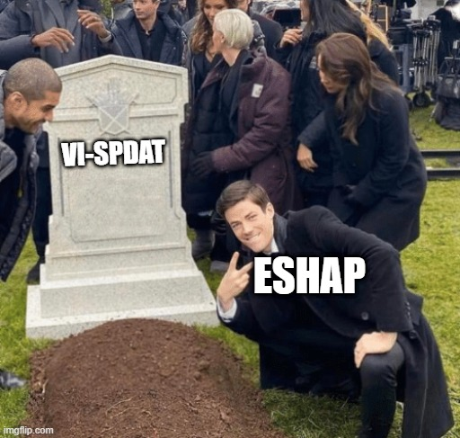
VI-SPDAT Retirement

Slide 4
VI-SPDAT Retirement
The VI-SPDAT will be retired by OrgCode at the end of this calendar year
Data showed that the VI-SPDAT led to unequal housing outcomes along racial lines
BIPOC populations experiencing homelessness were successfully housed at a much lower rate than white populations.

Slide 5
New Assessment for ESHAP
Homeless Solutions Rule requires the use of an assessment
Goals for new assessment
Simple
Determine eligibility for ESHAP
Compatible/ not conflicting with Coordinated Entry
Avoid racial inequity
Fulfil HUD and Maine regulatory requirements

Slide 6
The Maine Navigator Services Eligibility Assessment (Maine NavSEA)
Based on the HUD “But For” assessment for Rapid Rehousing
Determines eligibility for Navigator services (defined as Rapid Rehousing under HUD)
Asks for confirmation that homeless status has been verified
Verifies that client has been homeless for at least 15 out of the last 90 days (Homeless Solutions Rule requirement)

Slide 7
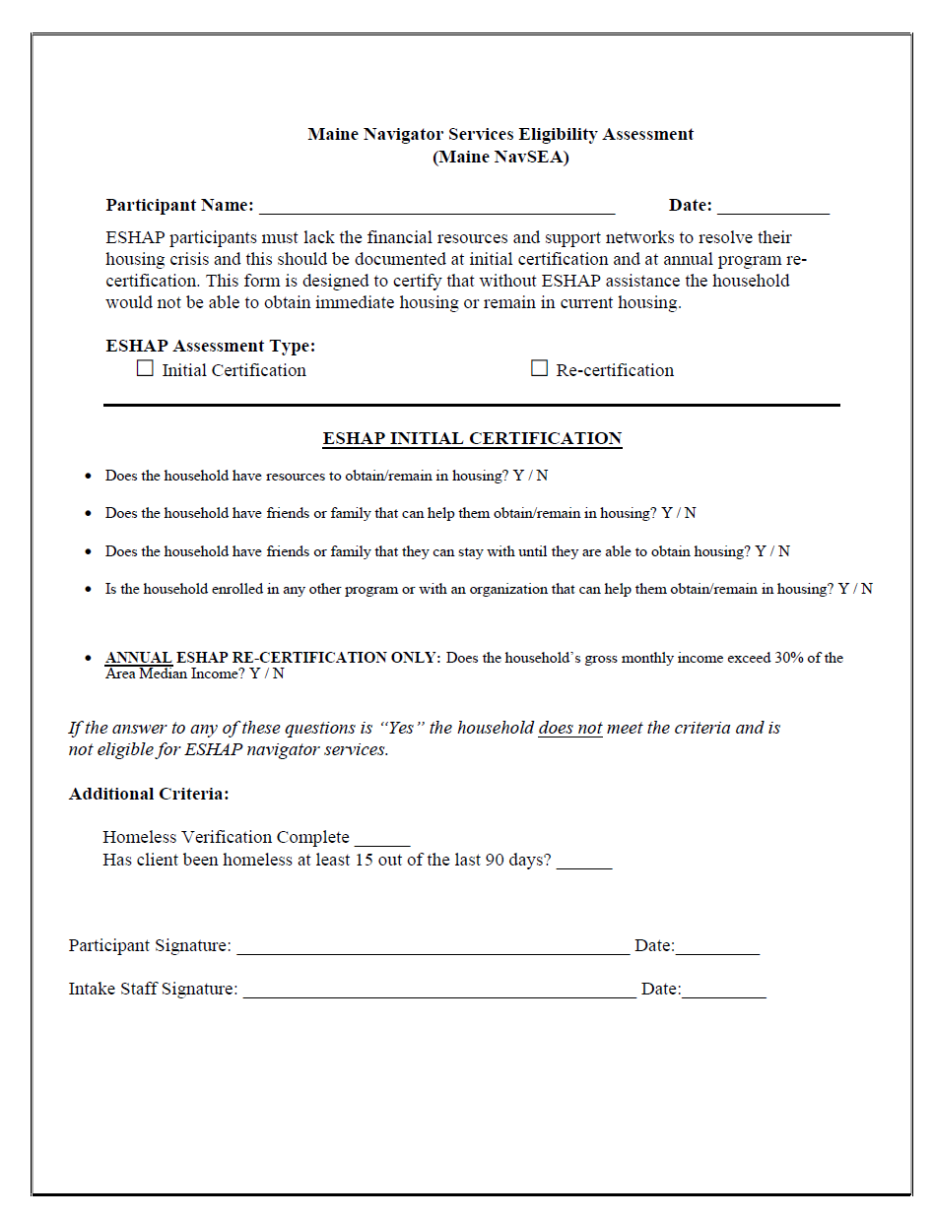
Maine NavSEA Form

Slide 8
Coordinated Entry Assessments
But wait… isn’t there supposed to be a new assessment for Coordinated Entry?
Yes. However, that assessment will be used for housing prioritization; this assesses for service eligibility
That being said, you can gather the data for most of the NavSEA from the questions on the proposed CE assessment

Slide 9
Questions?
Mike Shaughnessy
Homeless Initiatives Program Manager
mshaughnessy@mainehousing.org

