Slide 1
Maine Statewide Homeless System Re-Design Service Hub Brainstorm Meeting
Corporation for Supportive Housing
February 9, 2021
March 31, 2021

Slide 2
Today's Agenda
1. Introductions
2. Hub Structure and Kick-off Discussion
What should be consistent across the hubs?
What do you want to tailor locally?
3. Data Dashboards
What do you think should be in each data dashboard?
What is needed to support local By Name List
MOU—what needs to be in place?
4. Capacity Needs
Planning a kick-off agenda
What are the next steps regarding the CoC and Service Hubs?

Slide 3
Introductions
Name
Agency
Service Hub

Slide 4
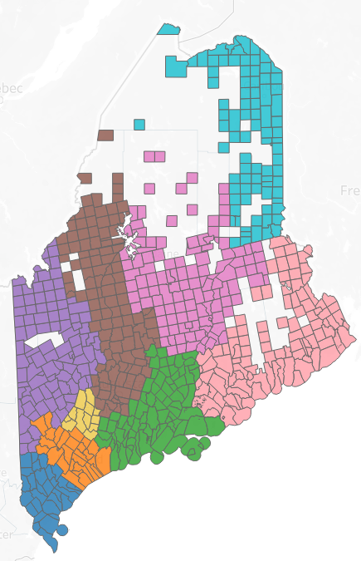
Beta Service Hub Structure
Hub 1: York
Hub 2: Cumberland
Hub 3: Midcoast: Sagadahoc, Knox, Lincoln, Waldo and Towns of Brunswick and Harpswell
Hub 4: Androscoggin
Hub 5: Western: Oxford, Franklin and Towns of Livermore and Livermore Falls
Hub 6: Central: Somerset and Kennebec
Hub 7: Penquis: Penobscot and Pisquataquis
Hub 8: Downeast: Washington and Hancock
Hub 9: Aroostook
Notes:
We has a special session to dive into the hub design
Creating a person centered design

Slide 8
Role of the Service Hubs
Provide the local foundation for the roll-out and operations of Coordinated Entry
Coordinated Entry Point of Access
Diversion, Triage and Assessment
Prioritization – maintain BNL
Referral - Housing matching and case conferencing
Support regional coordination and resource alignment
Community level dashboard to track data to improve performance

Slide 9
Three Levels of the System Design
Statewide Homeless Council and COC
Regional Homeless Councils
Program, advocacy and policy-level work
Local Service Hubs
Systems-level policy recommendations
Membership: Voting Members, EDs, State Agency Leadership, PWLE
Membership: Regional Reps and Senior/Executive Leadership, PWLE
Access, Assessment, Prioritization and Coordination for homeless response system; community level dashboards
Membership: Housing Navigators and Direct Service Staff

Slide 10
Hub Structure
What do you think should be consistent across the service hubs?
Assessment for CE
Data collection and tracking
Marketing: Seen from the outside as a single process.
Consistent single way to access across the state
What should any participant expect or receive, no matter where in the state?
Diversion efforts
What do you want to tailor locally to each Service Hub?
Leadership Structure. Should have an organizational entity. Bangor has community health leadership board.
Is leadership the convener? Will navigators be responsible for this and have the capacity?
What is the ask and the internal mechanism to make it happen?
By name lists for LTS
Notes:
There were three main categories of themes that surfaced.

Slide 11
Data and Metrics

Slide 12
Service Hub Dashboards

Slide 13
Data Dashboards: What do you think should be included?
Notes:
There were three main categories of themes that surfaced.

Slide 14
Capacity
Notes:
Envisioning that this group would get together to plan, go back to your community, implementation, and then coming back together
How would this happen? What would the timeline be? Would this group meet monthly?

Slide 15
Service Hubs: Who is at the Table?
Core Participants
Stakeholders
HUB Coordinator - TBD​
Shelter and Outreach Providers​
Local Administrative Agencies for BRAP/S+C​
Supportive Housing Providers​
Legal Assistance
General Assistance
CAP Agencies
Justice Discharge Planning
Hospitals and Health Centers
Mental Health Providers
Veteran's Affairs
Child and Family Welfare
Tribal Leaders
Faith Based Organizations
Soup Kitchens
Education
Cultural Broker Organizations
Notes:
Service Hubs will meet regularly to review the By-Name List and match clients to available housing resources. However, dependent on local circumstances, not all Referral Partners will need to attend every case conferencing meeting. Nonetheless, they are critical partners within the spectrum of Hub services and should participate as needed to provide guidance, feedback to improve overall Service Hub activities and coordination.

Slide 16
Capacity Needs
What would be needed to get started?
What resources/staff could be leveraged to contribute to the Service Hub tasks and function?
Diversion
Assessment Appointments
Coordination
Data Tracking
What are the next steps regarding the CoC and Service Hubs?
Notes:
There were three main categories of themes that surfaced.

Slide 17
Next Steps
Report Back to SHC
Meet locally to share progress and gather local input
Engage 211
Meet again in a month to continue to work on implementation
Other Items?

Slide 19
Thank you

