Slide 1
Maine Statewide Homeless Council
Corporation for Supportive Housing
Dec 8, 2020

Slide 2
Today's Agenda
Revisiting the project purpose and key deliverables
System Resource Mapping
Needs and Costs Analysis
Discussion: Organizing the work ahead

Slide 3
Identifying the Shared Problem
Shelter Work Group
Leadership Team
Unequal access due to resources and capacity, lack of single point of entry causes overreliance on shelter system and a need for engagement of mainstream systems in prevention and diversion opportunities.
People with Lived Expertise
Homelessness is not a choice, but rather the result of a system that has failed vulnerable people. People experiencing homelessness in Maine face discrimination in shelter, barriers to housing and necessary resources such as mental health, substance use and general assistance. Prevention resources are non-existent, and leaders do not understand the actual needs of people facing homelessness.
Persistent inequality and discrimination, limited shelter access, affordable and supportive housing; underfunded mental health, substance use and prevention services create overreliance on the shelter system. There is a need to engage mainstream systems such as General Assistance, Justice and Healthcare in equitable prevention, diversion and discharge planning.

Slide 4
Priorities from the Lived Expertise Focus Group
All providers should have a common housing application, universal policies/procedures and greater transparency in prioritization of beds and/or resources.
Better communication and coordination between providers.
More mobile crisis units and outreach efforts to unsheltered people.
Better discharge planning from medical institutions, particularly for those with disabilities.
Professionalization of shelter staff and common training in trauma-informed care and other best practices.
Better use of data and tools to support clients.
More representation of lived expertise on the CoC Board and SHC.

Slide 5
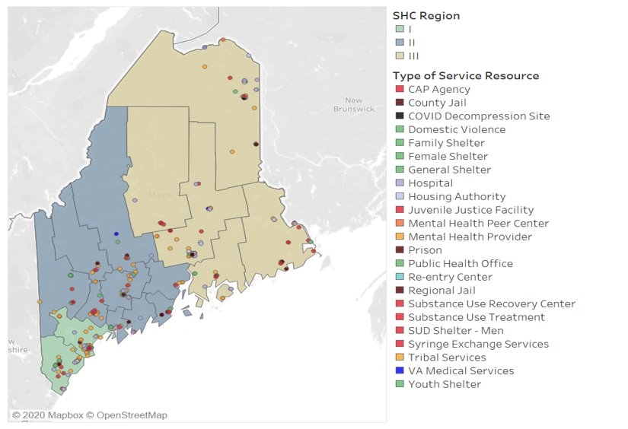
Key Deliverables
1. Interactive Resource Mapping
What resources are needed throughout Maine
2. Regional Systems Design
Alignment with CE
How do localities organize to best support people experiencing homelessness?
Accountability through SHC
3. Plan for Affordable and Supportive Housing Development
200 units of AH
40 units of SH

Slide 6
SYSTEM RESOURCE MAPPING
What have we learned?

Slide 7
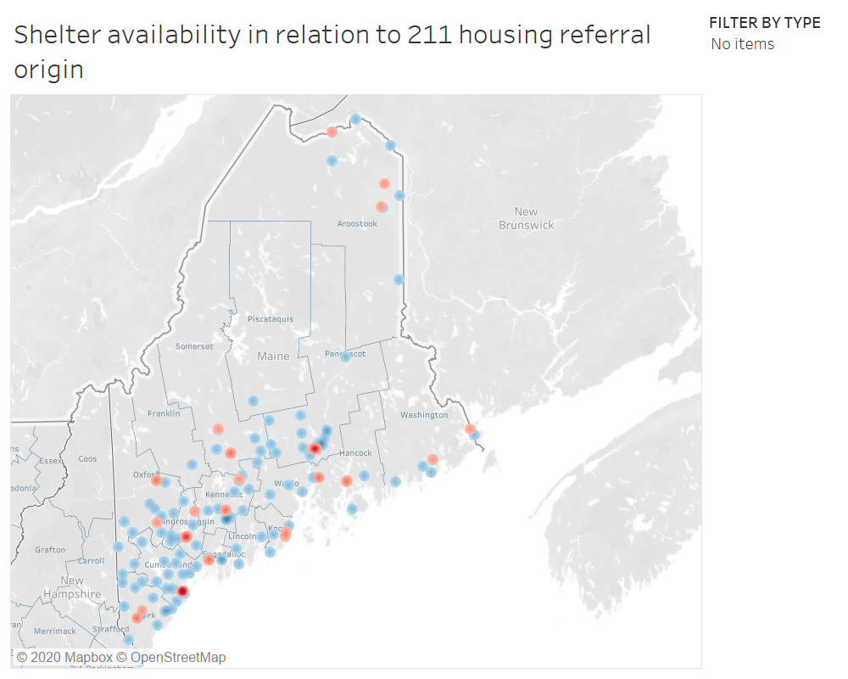
RED = Shelter concentration
BLUE = 211 housing referral origin

Slide 8
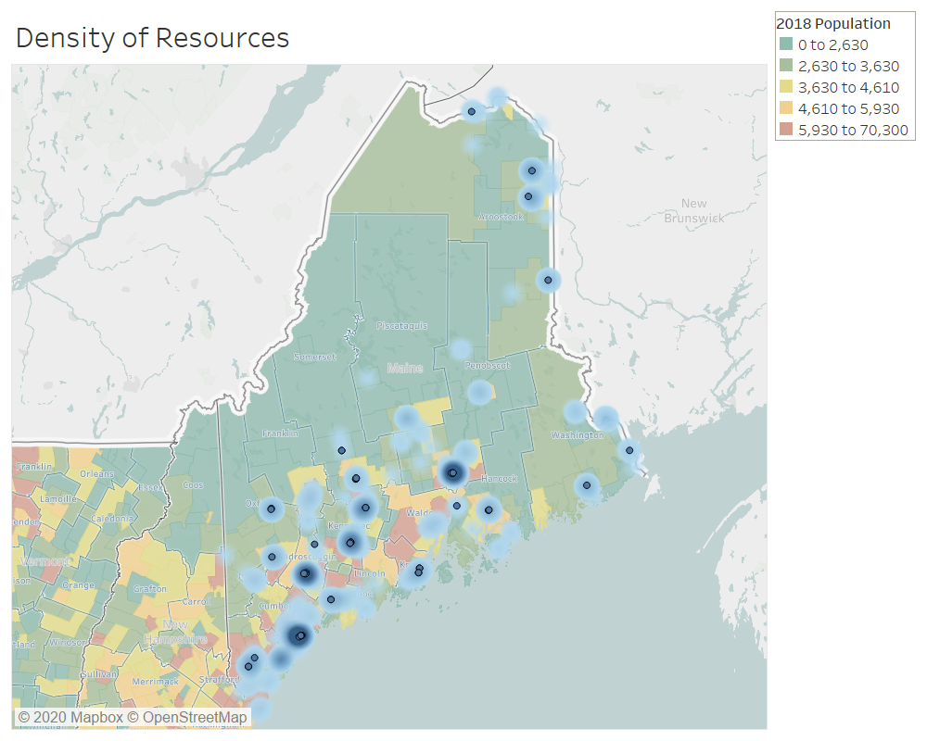
Population density and distribution of service resources.

Slide 9
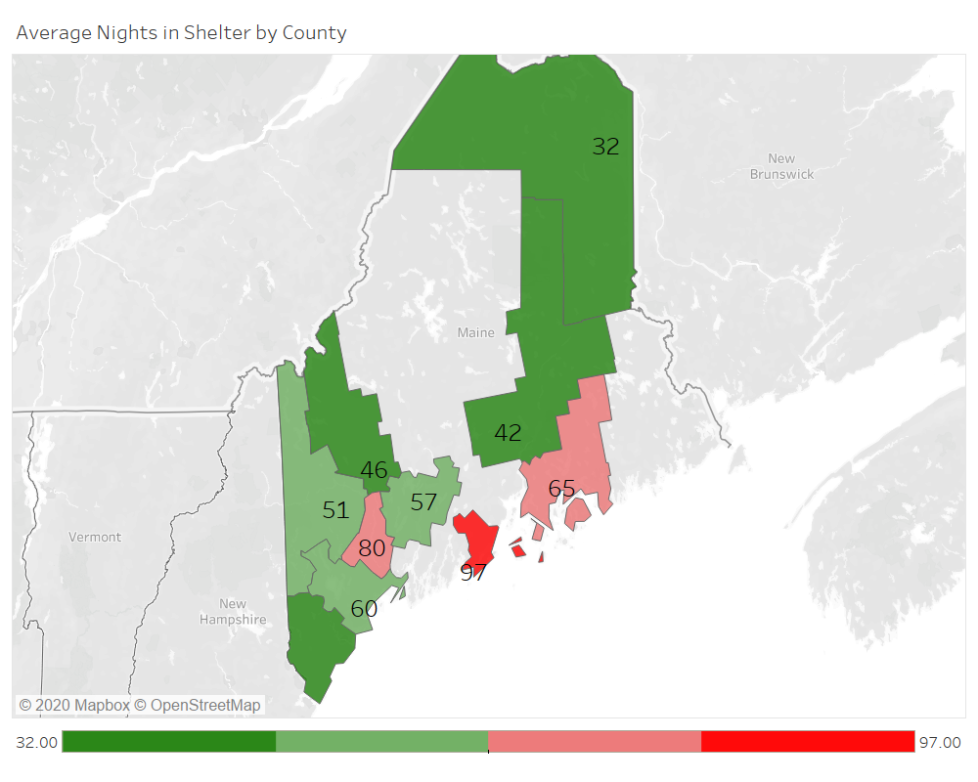
HUD PERFORMANCE MEASURE:
AVERAGE LENGTH OF STAY IN EMERGENCY SHELTER
TARGET GOAL: <30 Days in shelter
Notes:
HUD Priority Goal for FY19-20: Reduce the average length of homelessness in communities by an average of three days from FY18 to the end of FY20
KEY PERFORMANCE MEASURES AS INDICATED BY HUD
The national average length of homelessness is 142 days. The Northeast has the longest average time homeless in emergency shelters at 198 days.(Source: 2018 AHAR report Exhibit F3) https://www.huduser.gov/portal/sites/default/files/pdf/2018-AHAR-Part-2.pdf
Among all CoCs in the country, the average length of stay in emergency shelter is 127 days. In rural areas it is 60 days, in Suburban areas its 101.
Measure 1: Length of Time Persons Remain Homeless
▪ Population-level analysis:The AHAR reports the average number of persons served by a bed in a year, as well as cumulative number of days (reported in ranges) that individuals and families stay in ES and TH within each fiscal year. CoCs should use this information to explore various drivers of longer stays in homelessness. For example, families may have very long ES and TH stays relative to individuals. Discussions with providers serving families may reveal that procedures for accessing permanent housing reward long shelter stays (e.g., graduation from a service project), which discourages families from exiting on their own or accepting RRH assistance.
▪Project-level analysis: CoCs can use the APR and CAPER results to compare projects of the same type to determine which have longer lengths of stay. CoCs can then explore why clients are remaining in these projects instead of accessing permanent housing assistance. Is it because of providers’ policies and procedures? System bottlenecks? Or other factors that can be addressed?
▪ Patterns in populations: CoCs can analyze PIT count data and other local reporting such as master lists to begin to understand the experiences of those who are chronically homeless. CoCs may also consider additional ad hoc reporting using HMIS data to look at the cluster of long- and short-stayers in the system: What are the characteristics of people in each group, and what types of services are they using? Which providers are they working with? Can the community better target permanent housing interventions to long-stayers and diversion strategies to short-stayers?

Slide 10
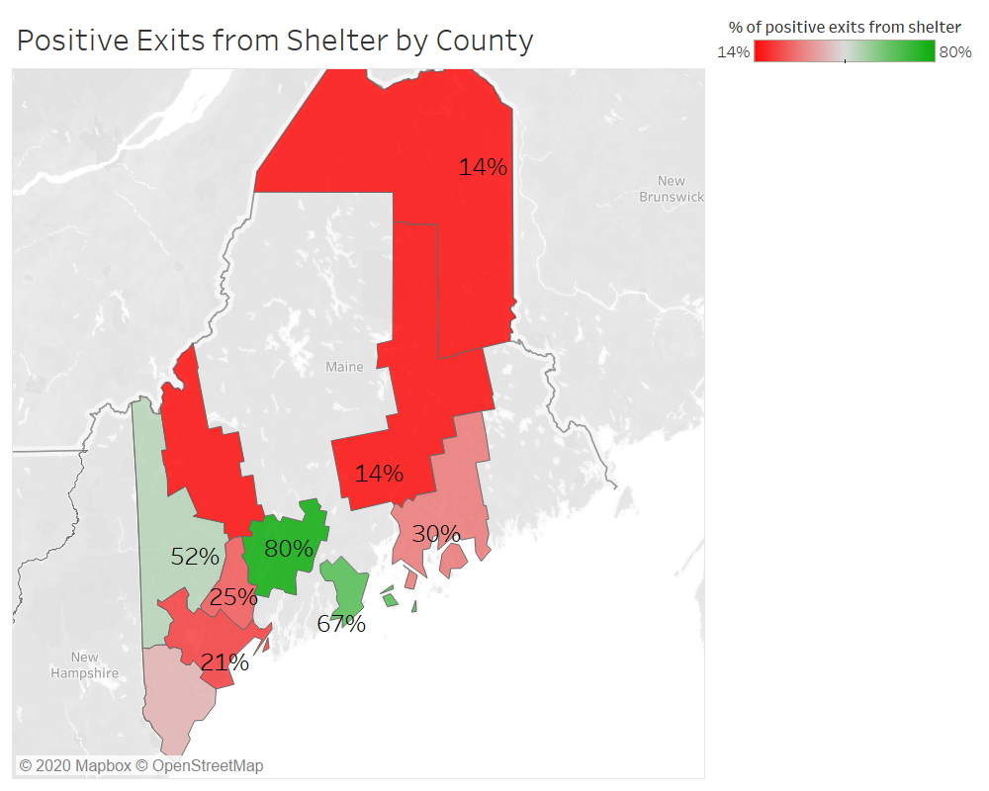
HUD PERFORMANCE MEASURE:
Average % of people with successful exits to permanent destinations from shelter
National Average= 42%
Northeast = 46%.
Only 2 counties in Maine meet this standard based on current HMIS data.
Source: 2018 AHAR Report to Congress
Notes:
Another key system performance measure is the percentage of people who exit emergency shelter, safe havens, or transitional housing to permanent housing -- rather than temporary or unknown destinations. Permanent housing placements can include permanent supportive housing, rapid re-housing, subsidized housing, and other permanent situations.
EXHIBIT F.6: Average Percent of People with Successful Exits to Permanent Destinations by Geographic Region. NORTHEAST = 46% NATIONAL = 42%

Slide 11
Needs and Costs
Crisis Response System

Slide 12
Before we get started
These are not final numbers and will change
We are testing our data sources, assumptions, results
Need and costs is best estimate based on available data, can be refined over time
Do not quote numbers until they are final and in the final report

Slide 13
Interventions Assessed
Rapid Rehousing
Supportive Housing
Shorter term rental assistance with services for average of 1 year
Long term rental subsidy and intensive services to support housing stability and community integration
Problem solving support and flexible financial assistance to avoid entry into the into homeless system
Diversion
Self Resolution
People who find housing on their own without services or supports

Slide 14
Need Assumptions
Diversion
Target people experiencing homelessness for the first time
70%of people calling 211
60% of people who show up at shelter
Self-Resolution
20% of people served in shelter self-resolve with assistance through shelter and community-based services
Calculated by percent of people in shelter <14 days
Rapid Rehousing
80% of clients in shelter 14 days or more
Supportive Housing
90% of chronically homeless population
10% of all people experiencing homelessness
Mainstream System Supportive Housing
10% - 80% of people in other systems depending on system

Slide 15
Cost Assumptions
Average Rent: $750
2018 Maine AMI: $55,425
Diversion Time Per Appt: 4.5 hours
Statewide DIV Staffing Need: 6.5 FTE
Avg DIV Finance Assistance: $1,300
RRH Timeframe: 1 – 12 months
Avg RRH Financial Assistance: $5,698
RRH Per Person Service Cost: $973

Slide 16
Statewide Costs (DIV and RRH only)
 | Number Served | Rental Assistance/Flex Fund | Staffing/Infrastructure | Total | Per Person Costs
Central Intake |  |  | $ 75,000
Diversion | 2,684 | $ 3,489,616 | $ 443,564 | $ 4,008,180 | $ 1,493 (includes CI)
Self-Resolve | 1,306 | $ - | $ - | $ - | $ -
Rapid Rehousing | 2,923 | $ 10,961,160 | $ 2,844,982 | $ 13,806,142 | $ 4,723

Slide 17
Supportive Housing Costs (at scale)
 | Number Served | Rental Assistance/Flex Fund | Staffing/Infrastructure | Capital | Total | Per Person Costs
PSH - Developed | 927 | $ 9,033,522 | $ 1,854,000 | $ 174,974,958 | $ 185,862,480 | $ 200,499
PSH - Scattered Site | 2,782 | $ 24,645,738 | $ 5,564,000 | $ - | $ 30,212,520 | $ 10,860
Homeless target (30% developed) | 582 | $ 5,155,938 | $ 1,164,000 | $ 32,956,448 | $ 39,276,968 | $ 67,486

Slide 18
Shelter Services by County
County | # of Shelters | Participating Shelters | Total ESG Shelter Beds | 2019 Clients Served in Shelter
York | 2 | YCSPI - Family Emergency Shelter and YCSPI - York County Adult Shelter; Caring Unlimited (DV) | 53 | 331
Cumberland | 7 | Oxford Street Shelter, Milesetone, City of Portland Family Shelter, Preble Street - Florence House SH, Preble Street - Joe Kreisler Teen Shelter, Tedford - Family Shelter, Preble Street - Florence House ES and Tedford - Adult Shelter (Brunswick); Through These Doors (DV) | 510 | 3748
Androscoggin | 2 | Rural Community Action Ministry and New Beginnings Inc; Safe Voices (DV) | 22 | 102
Franklin | 1 |  | 16 | 81
Oxford | 3 | RGH - Norway Family Center, RGH - Rumford Family Center Monier and RGH - Rumford Family Center Shelter | 44 | 227
Sagadahoc | 0 | New Hope for Women (DV no shelter) | - | -
Knox | 1 | Knox/Waldo Homeless Coalition - Hospitality House | 22 | 72
Lincoln | 0 |  | - | -
Waldo | 0 |  | - | -
Kennebec | 3 | Mid-Maine Homeless Shelter - Emergency Shelter, Bread of Life - Emergency Shelter and Bread of Life - HCHV/EH VA Contract Beds; Family Violence Project (DV) | 103 | 593
Somerset | 0 | Family Violence Project (DV)- Fairfield | - | -
Penobscot | 3 | PCHC Hope House - Emergency Shelter, Shaw House - Emergency Youth Shelter and BAHS - Emergency Shelter; Partners for Peace (DV) | 135 | 990
Piscataquis | 0 |  | - | -
Hancock | 4 | Home Inc - Dorr House Emergency Shelter, Home Inc - St Francis Inn, Home Inc - Emmaus Homeless Shelter (ES) and Home Inc - Sister Marie House Emergency; Next Step (DV) | 57 | 224
Washington | 0 |  | - | -
Aroostook | 2 | Sister Mary O'Donnell Shelter and Aroostook Bridge (ES); Hope and Justice Project (DV) | 47 | 162

Slide 19
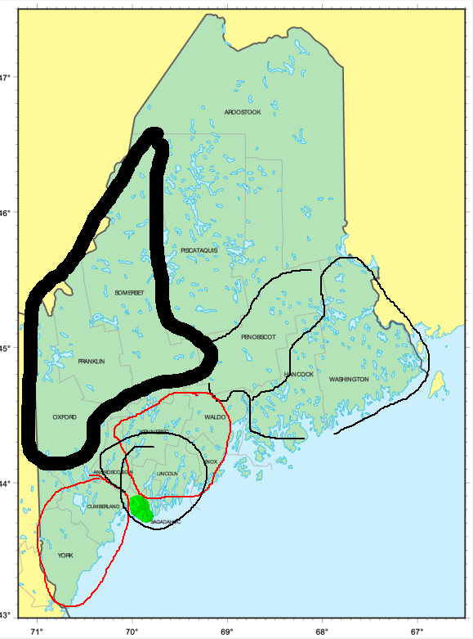
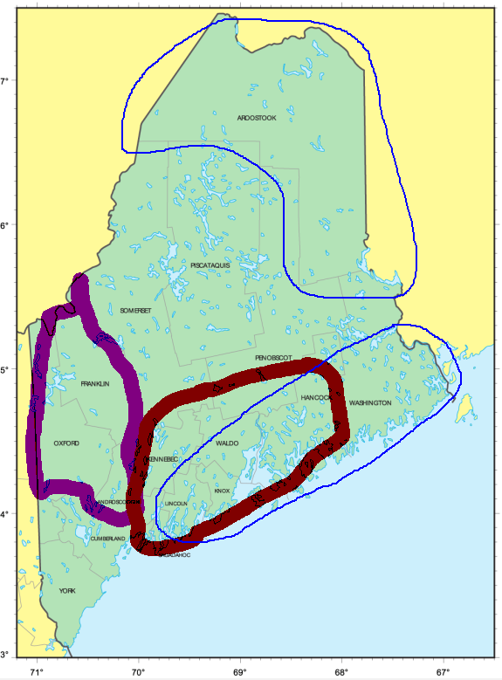
Service Hub brainstorm with focus groups

Slide 20
Local Service Hubs
Service Hub District | County | # of Shelters | Participating Shelters
District 1 | York | 2 | YCSPI - Family Emergency Shelter and YCSPI - York County Adult Shelter; Caring Unlimited (DV)
District 2 | Cumberland | 7 | Oxford Street Shelter, Milesetone, City of Portland Family Shelter, Preble Street - Florence House SH, Preble Street - Joe Kreisler Teen Shelter, Tedford - Family Shelter, Preble Street - Florence House ES and Tedford - Adult Shelter (Brunswick); Through These Doors (DV)
District 3 | Androscoggin | 2 | Rural Community Action Ministry and New Beginnings Inc; Safe Voices (DV)
District 3 | Franklin | 1
District 3 | Oxford | 3 | RGH - Norway Family Center, RGH - Rumford Family Center Monier and RGH - Rumford Family Center Shelter
District 4 | Sagadahoc | 0 | New Hope for Women- (DV no shelter)
District 5 | Knox | 1 | Knox/Waldo Homeless Coalition - Hospitality House
District 5 | Lincoln | 0
District 5 | Waldo | 0
District 6 | Kennebec | 3 | Mid-Maine Homeless Shelter - Emergency Shelter, Bread of Life - Emergency Shelter and Bread of Life - HCHV/EH VA Contract Beds; Family Violence Project (DV)
District 6 | Somerset | 0 | Family Violence Project (DV)
District 7 | Penobscot | 3 | PCHC Hope House - Emergency Shelter, Shaw House - Emergency Youth Shelter and BAHS - Emergency Shelter; Partners for Peace (DV)
District 7 | Piscataquis | 0
District 8 | Hancock | 4 | Home Inc - Dorr House Emergency Shelter, Home Inc - St Francis Inn, Home Inc - Emmaus Homeless Shelter (ES) and Home Inc - Sister Marie House Emergency; Next Step (DV)
District 8 | Washington | 0
District 9 | Aroostook | 2 | Sister Mary O'Donnell Shelter and Aroostook Bridge (ES); Hope and Justice Project (DV)

Slide 23
Organizing the Work Ahead
Can we define the Service Hub areas together?
Understanding the Role of the Services Hubs?
How can a service hub design support local COVD response?
Facilitating housing placements
Inflow
Other COVID Issues
Composition - Who should be at the table?

Slide 24
Role of the Service Hubs
Develop and maintain guides to local diversion/prevention options and resources.
Serve as a point of contact for 211, referrals originating in, or potentially relocating to the area.
Conduct/coordinate triage/intake assessments for referrals not connected to shelter/outreach.
Coordinate regular meetings of local outreach, shelter, and housing providers.
Review CE participants (including by-name/LTS lists) and available housing options.
Work to facilitate housing placements using CES prioritization and matching protocols.
Ensure all relevant and required data is being tracked in order to monitor the efficiency and effectiveness of the CES and make recommendations for continuous improvement.

Slide 25
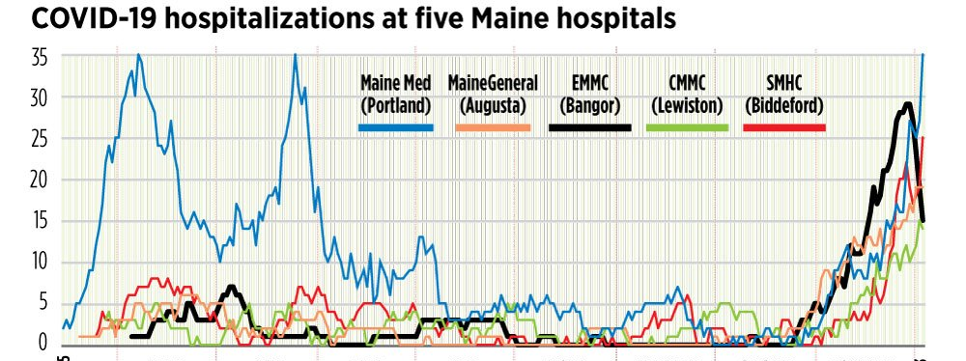
Can Service Hubs Support a Local COVID Response?
Facilitate housing placements for people who are currently homeless
Reducing Inflow into homelessness
Other COVID related issues to address?

Slide 26
Who should be at the table?
Shelter Providers
Outreach/Path Workers
Supportive Housing Providers
CAP Agencies
Hospital Social Workers
Jail Discharge Planners
Others...
-
-
-
-
-

Slide 27
Make adjustments based on today's feedback
Finalize Hub Model
Finalize with Leadership Committee
Which working groups would be helpful to develop Implementation Plan?
Shelter
Supportive Housing
Others?
Next Steps
27

Slide 28
Thank you

Slide 29
Housing Workgroup Structure
10-12 people, representing expertise in development, service provision, lived experience, and state/local officials. The scope is time-limited, with an aim of completing five 1.5 hour sessions with the following objectives:
To identify and leverage the necessary resources including capital, operating and service funding.
Coordination among funding streams.
Discuss current PSH programs. Identify and troubleshoot barriers.
Mechanisms to increase integrated SH
Target populations/AMIs
Evaluation Metrics
Build capacity.
Policy Considerations.
Session 1 | Discuss current PSH programs. Identify and troubleshoot barriers.
Session 2 | Identify and leverage the necessary resources including capital, operating and service funding. Discuss coordination among funding streams.
Session 3 | Building coordination capacity between developers and service providers.
Session 4 | Discussion of housing models and funding mechanisms for integrated PSH. The role of municipalities in development.
Session 5 | Targets, timelines and evaluation metrics. Integration with broader system re-design efforts.

Slide 30
Shelter Workgroup Structure
Comprised of 10 -12 people, representing front line programs and staff.
Outreach/Engagement/Triage
Addressing Shelter Capacity – are we using the beds we have?
Statewide Shelter Practices such as Housing First, Housing Navigation and Assertive Engagement
Coordinated Entry and Regional Coordination and Considerations
Improving access to mainstream resources and benefits
Goal setting, defining evaluation metrics
Policy Considerations and Resource Allocation
Impact of COVID 19
Session 1 | Level-setting around purpose, establishing goals and addressing shelter capacity, including COVID 19 concerns
Session 2 | Accessibility, outreach, engagement, triage and statewide shelter practices such as Housing First
Session 3 | Integration and access to mainstream resources.
Session 4 | Policy considerations, resource allocation and working toward a shared definition of evaluation metrics.
Session 5 | Coordinated Entry and service hub considerations. Draft final recommendations for consideration by the SHC.

