Slide 1
MAINE 2020 – Getting to Zero

Slide 2
Our Team
Sarah Gallagher
Eastern Region Managing Director
Jamie Blackburn
Program Manager
Anna Smith
Program Manager
Kim Keaton
Director of Data Analytics

Slide 4
OUR OBJECTIVES IN MAINE
Identify and establish a Regional Homeless Service Delivery Model that works for Maine using the Connecticut Coordinated Access Networks (CANs) as a starting template.
Begin to build a housing pipeline by creating 200 affordable housing units through innovative, flexible methods.
Provide ongoing support and technical assistance to ensure our collective goals are achieved.

Slide 5
Why this is the right time for change
Across the country, states are recognizing the significant impact of the COVID-19 pandemic and systemic vulnerabilities on people experiencing homelessness.
The disproportionate impact of the pandemic against communities of color, those with disabilities and those living in extreme poverty, has been made undeniably clear in public nursing homes, jails, prisons and shelters.
In the wake there is now an opportunity to create a homeless and housing system that is equitable, cross-sectional and generates the greatest impact.
Collaboration, relationships and connections across systems are needed now more than ever.

Slide 6
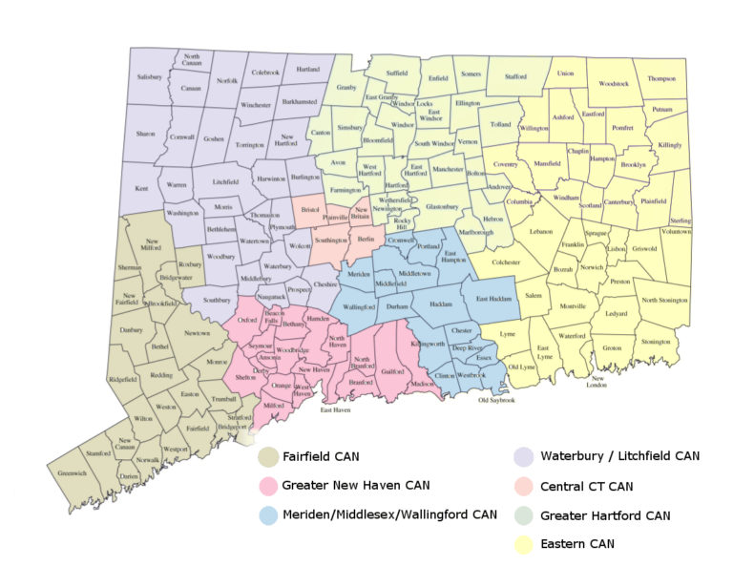
The CT Reaching Home Campaign and Coordinated Access Networks (CT CANs)
In 2014, homeless services (emergency shelters, housing providers, homeless outreach, etc.) in CT became organized into seven regional networks, known as ‘Coordinated Access Networks’ or ‘CANs.’
Central intake through 211 serves as the gateway to a streamlined process for helping clients facing homelessness.
Consolidated waitlists and consistent policies and procedures across the state ensure quality and facilitate shelter and housing placements.
Data-driven decision making culture to align stakeholders, stimulate discussion, and identify opportunities for improved service delivery.

Slide 7
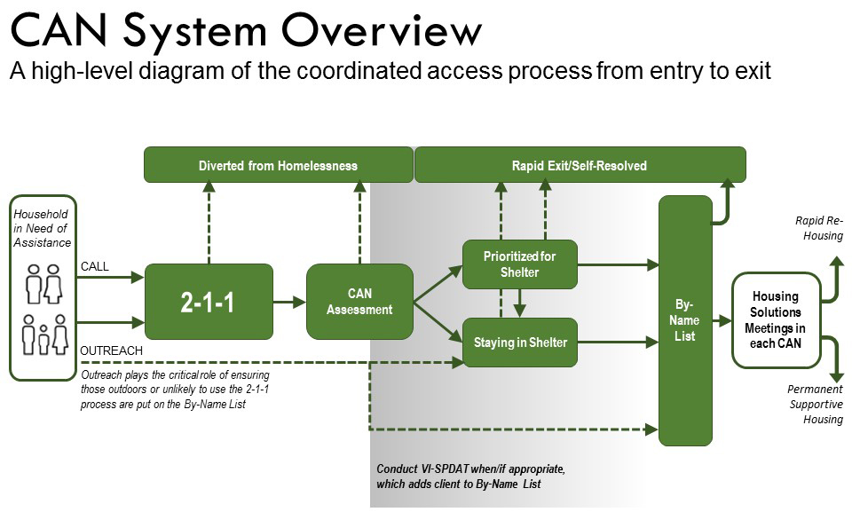
Notes:
Providers of service to people experiencing homelessness are coordinating their efforts to end homelessness in communities across Connecticut by developing Coordinated Access Networks (CANs).
Through these CANs, service providers work together to streamline and standardize the process for individuals and families to access assistance. Coordinated Access is required by the Federal HEARTH Act, which governs most of the federal funding communities receive to address homelessness, and supported by the State of Connecticut Department of Housing.
The primary goal is to help communities focus on rapidly ending each person’s homelessness by connecting them with appropriate housing and resources as quickly as possible.
What is Coordinated Access?
A standardized, assessment and referral process to access community resources within a geographic region for people experiencing a housing crisis or homelessness.
Individuals and Families call 2-1-1 from anywhere in the state to start the process.
2-1-1 refers anyone experiencing a housing crisis to the CAN in the caller’s community. The CAN accesses available resources to address the client’s needs.
Why implement Coordinated Access?
Create a streamlined way for people in need to access assistance.
Improve collaboration, communication, efficiency, and transparency between service providers.
Improve service to consumers through a client-focused, coordinated system. Characteristics of Coordinated Access
Accessible: easy to use and well-publicized to the homeless individuals and families who need it.
Standardized: same process to access resources across communities, one shared assessment process across communities to understand client need and eligibility.
Accountable: communities develop shared oversight mechanisms including policies, monitoring and improvement processes

Slide 8
Using Data to Drive Impact
Screenshot of the publicly available CAN Data Dashboard https://ctcandata.org/dashboards/

Slide 9
Impact of the CAN Approach in CT
Notes:
NEED TO ADD DATA ON THIS SLIDE

Slide 10
Impact of the CAN Approach in CT
First state in the country to end chronic homelessness among veterans; second to end veteran homelessness
CT’s participation in the Zero: 2016 campaign and 100-Day Challenges resulted in a 75% decrease in chronic homelessness since 2014
The Be Homeful Project has decreased family homelessness through diverting more than 900 children in families from shelter
HUD Youth Homelessness Demonstration Program has led to a coordinated approach and set of interventions to end youth homelessness; currently median time that youth experience homelessness is under 45 days
Notes:
NEED TO ADD DATA ON THIS SLIDE

Slide 11
Using Data to Create Solutions
The CSH “One Model” is an integrated supportive housing needs assessment and financial modeling tool that has been used in communities all over the country.
The OneModel tool was developed to walk communities through multi-sector needs assessments based on local data, and to drive conversations around what it means to meet the need for supportive housing across all vulnerable populations

Slide 12
Bringing it all together for Maine
Using the Connecticut Coordinated Access Networks and the PCHC WISH model as a starting point, let’s work together to create a data-driven regional approach to ending homelessness.
Notes:
Lead a process to identify resources for supportive housing (SH) development across the state.
Harness data and applying the use of CSH resources such as the One Mod Projection Tool to create innovative, flexible housing options.
Create a holistic approach to triage and assessment, strategic planning and policy recommendations, grounded in best practices, to end and prevent homelessness.

Slide 13
Bringing it all together for Maine
The Statewide Homeless Council will provide the vehicle for most of this work.
A “Leadership Bench” is being established to help steer the system redesign and ensure true cross-system collaboration.
Smaller working groups will assist in the more specific deliverables for the re-design.
Notes:
Lead a process to identify resources for supportive housing (SH) development across the state.
Harness data and applying the use of CSH resources such as the One Mod Projection Tool to create innovative, flexible housing options.
Create a holistic approach to triage and assessment, strategic planning and policy recommendations, grounded in best practices, to end and prevent homelessness.

Slide 16
Proposed Timeline
June-August 2020
Listening Sessions with Stakeholders
Leadership Bench is established
Data Gathering
August-December 2020
Working Groups are established
Deliverables are set for each group or topic
OneMod is completed and presented to the SHC.
January-May 2021
Using the results of the OneMod and working groups, a plan is drafted.
Feedback period for the Leadership Bench.
June 2021
Final System Re-design is presented to the SHC and stakeholders.
Notes:
Lead a process to identify resources for supportive housing (SH) development across the state.
Harness data and applying the use of CSH resources such as the One Mod Projection Tool to create innovative, flexible housing options.
Create a holistic approach to triage and assessment, strategic planning and policy recommendations, grounded in best practices, to end and prevent homelessness.

Slide 17
QUESTIONS?

