Slide 1

Maine Statewide Homeless Council
Homeless System Re-Design Update
Corporation for Supportive Housing
February 9, 2021

Slide 2
Today's Agenda
  Updates
    Engaging PWLE
    Shelter Workgroup
    Affordable and Supportive Housing Workgroup
  Service Hub Design
    Review of the Beta Hub Design
    Getting Started
      Identifying Stakeholders
      Call for Volunteers
      SHC Special Session
  Next Steps for the Work

Slide 3
Updates on Engaging People with Lived Expertise
16 people engaged so far....
Session 1: December 5 participants
Session 2: January 11 Participants
*An additional session was requested by the participants to be held in the coming weeks
"Folks have to 'cast off' social supports in order to display enough vulnerability to actually gain services. That is the disfunction of the entire system. We only deliver value and services to folks who have nothing left." - Participant

Slide 4
PWLE Themes for the Re-Design
Accessing the System
Improve access though use of technology
Common housing application, universal policies/procedures and greater transparency in prioritization of beds and/or resources.
More mobile crisis units and outreach efforts to unsheltered people.
Better discharge planning from medical institutions, particularly for those with disabilities.
Service Hub Design
Better communication and coordination between providers.
Representation of people with lived expertise in the Hubs, on the CoC Board and SHC.
Include funded peer navigator/support specialist as part of the service hubs
Services Improvement
Increase landlord engagement and community education to end stigma around homelessness and vouchers
Better use of data to track outcomes and progress
Professionalization of shelter staff and training in trauma-informed care and other best practices.
Notes:
"Folks have to 'cast off' social supports in order to display enough vulnerability to actually gain services. That is the disfunction of the entire system. We only deliver value and services to folks who have nothing left." - Participant

Slide 5
Shelter Work Group Updates
Concluded its final session on 1/29/21
Engaged in Peer-to-Peer Learning with Alaska and Connecticut Systems
Conversation centered broadly around four categories
Training
Funding
Policy
Coordination
Notes:
Professionalization and standardization of core competencies for shelter and outreach staff on low-barrier shelter, trauma informed care, harm reduction, recovery coaching and others. Continuity of training across the state that is transferable among agencies.
Using existing on-boarding and training process from PCHC or other organizations as the base for standard practice for all shelters.
Develop collective outreach efforts through Service Hubs.
Develop process and agreements for release of information for organizations participating in Hubs
Review and revise diversion funding requirements from MaineHousing to increase flexibility of funds and serve more clients
Expanding the Rapid Re-Housing program.
Making recent funding increases from MaineHousing to shelter permanent.
Increased, consistent operations funding to reduce pressure and need for private fundraising
Support and coordinate with state IAP Health Home and other statewide initiatives such as FUSE
Develop strategies or policy solutions to prevent discharges to homelessness.
Align with other stakeholders such as Maine Equal Justice to develop strategies or policy solutions to reform General Assistance and increase its role in homelessness prevention and response.
Address the role of Recovery Residences around homelessness and participation within Service Hubs.

Slide 6

Housing Workgroup Updates
Three sessions completed with 2 additional in March and April
Attendance includes mix of Developers, Municipal and State Leaders, Potential Funders/Investors and Service Providers
Discussions have centered on:
    Financial Modeling for 200 AH/ 40 SH units
    Tax-incentives for development
    Identification of funding sources
    Maximizing existing output of affordable and supportive housing
    Performance/outcomes-based funding models.

Slide 7
Service Hub Design
Beta Version

Slide 8
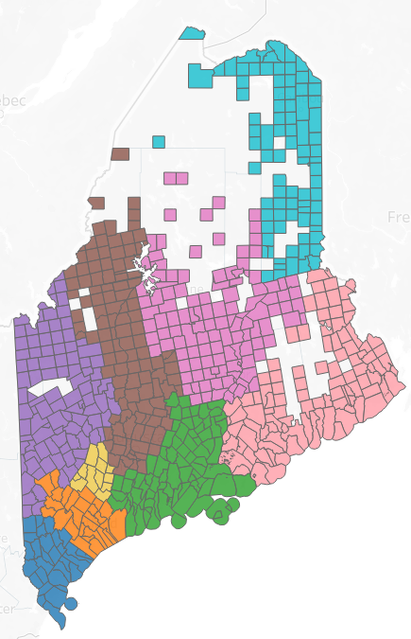
Beta Service Hub Structure
Hub 1: York
Hub 2: Cumberland
Hub 3: Midcoast: Sagadahoc, Knox, Lincoln, Waldo and Towns of Brunswick and Harpswell
Hub 4: Androscoggin
Hub 5: Western: Oxford, Franklin and Towns of Livermore and Livermore Falls
Hub 6: Central: Somerset and Kennebec
Hub 7: Penquis: Penobscot and Pisquataquis
Hub 8: Downeast: Washington and Hancock
Hub 9: Aroostook
Notes:
We has a special session to dive into the hub design
Creating a person centered design

Slide 9
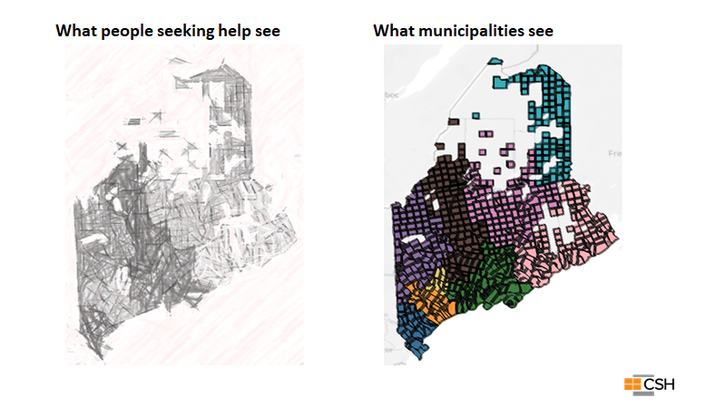

Slide 10
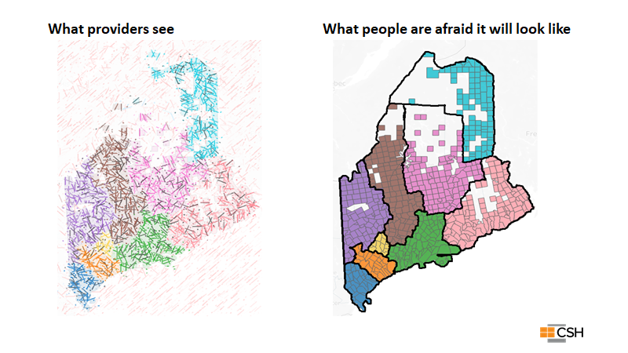

Slide 11
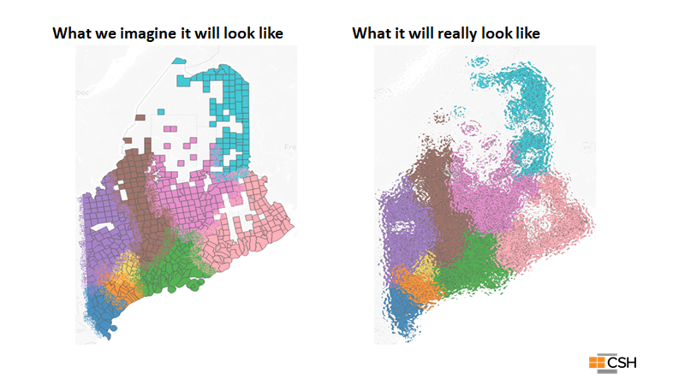

Slide 12
Role of the Service Hubs
Provide the local foundation for the roll-out and operations of Coordinated Entry
  Coordinated Access
  Triage and Assessment
  Prioritization – maintain BNL
  Referral - Housing matching and case conferencing
Support regional coordination and resource alignment
Community level dashboard to track data to improve performance

Slide 13
Three Levels of the System Design
Statewide Homeless Council and COC
Regional Homeless Councils
Program, advocacy and policy-level work
Local Service Hubs
Systems-level policy recommendations
Membership: Voting Members, EDs, State Agency Leadership, PWLE
Membership: Regional Reps and Senior/Executive Leadership, PWLE
Access, Assessment, Prioritization and Coordination for homeless response system; community level dashboards
Membership: Housing Navigators and Direct Service Staff

Slide 14
Service Hubs: Who is at the Table?
Core Participants
Stakeholders
HUB Coordinator​
Shelter and Outreach Providers​
Local Administrative Agencies for BRAP/S+C​
Supportive Housing Providers​
Legal Assistance
General Assistance
CAP Agencies
Justice Discharge Planning
Hospitals and Health Centers
Mental Health Providers
Veteran's Affairs
Child and Family Welfare
Tribal Leaders
Faith Based Organizations
Soup Kitchens
Education
Cultural Broker Organizatins
Notes:
Service Hubs will meet regularly to review the By-Name List and match clients to available housing resources. However, dependent on local circumstances, not all Referral Partners will need to attend every case conferencing meeting. Nonetheless, they are critical partners within the spectrum of Hub services and should participate as needed to provide guidance, feedback to improve overall Service Hub activities and coordination.

Slide 15
Getting Started!
HUB | Current Collaboration to Build Upon | Key Initial Partners
Hub 1: York | Stakeholders Group, Bridges of Hope (Wes Phinney) | Caring Unlimited, York County Shelter, CAP Agency, FQHC, Justice,
Hub 2: Cumberland | LTS Group (Cullen Ryan) | 16 Orgs involved
Hub 3: Midcoast | Southern Mid-coast Housing, Ecumenical Council for Homeless Prevention, Waldo County Homeless Coalition, Community Services Group (Waldo), (Steph, Donna, Rota) | The gathering room, Healthcare, Community Resource Council (Lincoln), Waldo Community Action Partners, Greater Bay Area Ministerium - GBAM
Hub 4: Androscoggin | Lewiston/Auburn Alliance for Supporting Homelessness | Sean Yardley, New Beginnings, Municipal Leaders, Community Concepts, Safe Voices, Trinity Jubilee, Tri-County Mental Health, Common Ties.
Hub 5: Western | Bill Crandall | CCI, Western Maine Community Action, FAME Thea Kornelius rotheak@gmail.com, Rumford Group Homes, Safe Voices, Common Ties, New Beginnings
Hub 6: Central | Affordable Housing Taskforce (Katie and Tracey) | GA, Justice, Churches, Municipal Leaders, Starfish Ministry, Bread of Life
Hub 7: Penquis | Bangor Region Housing Response, LTS, Community Health Leadership Board, CHCS Acadia Huddle (Josh D.) | Shaw House (youth)
Hub 8: Downeast | CHCS, Downeast Community Partners (potential lead?), Health Acadia, Hancock County Jail Volunteers (Tracey Hair) | Next Step Domestic Violence, Families First Community Center, Community Compass, Eastern Maine Development Corporation, Healthy Peninsula, Faith groups.
Hub 9: Aroostook | Homeless Stakeholders Group (Heidi R.) | Community Action Agency, Social workers, Justice, Legal Assistance, shelter, housing providers
Notes:
Next step is a small group to plan the launch and agenda. Rep from each hub ideally.

Slide 16

Next Step...
Call for volunteers to organize Hub Kick-Off
Small, statewide workgroup representing each hub
Set agenda for kick off
  Governance
  BNL
  Asset mapping
Developed shared vision across Hubs
Identify and outreach to potential attendees
Review data and metrics
Notes:
Have people add their names in the chat to volunteer!
What will be covered during the Service Hub Kick-off?
-- Imapct of Roles and Responsibilities
- Begin building consensus on governance or organizing structure
- Discuss MOUs and data sharing agreements
- Setting the stage for Coordinated Entry roll-out

Slide 17
SHC Special Session
  Two Goals:
  Peer to Peer to learn about Service Hub implementation in CT and Alaska
  Learn about and begin discussion on how people will access the system and Hub with a Focus on the Front Door with CT 211
  Potential dates are March 2nd at 11:00 or 1:00 or March 4th at 9:00 or 10:00

Slide 18
Outline of Next Steps for Initiative
  Develop Implementation Strategy for Service Hubs, Align with Coordinated Entry and Begin Launch
    Feb 2020
  Present Interim Data Analysis and System Needs to SHC for feedback and comment
    March 2020
  Develop Financial Model for Affordable and Supportive Housing Needs
    April 2020
  Develop Strategy to Engage Broader Systems and other Stakeholders
    April – May 2020
  Present System Design, Best Practice and Policy Recommendations and Sustainability Plan
    May- June 2020

Slide 20
Thank you

Slide 21
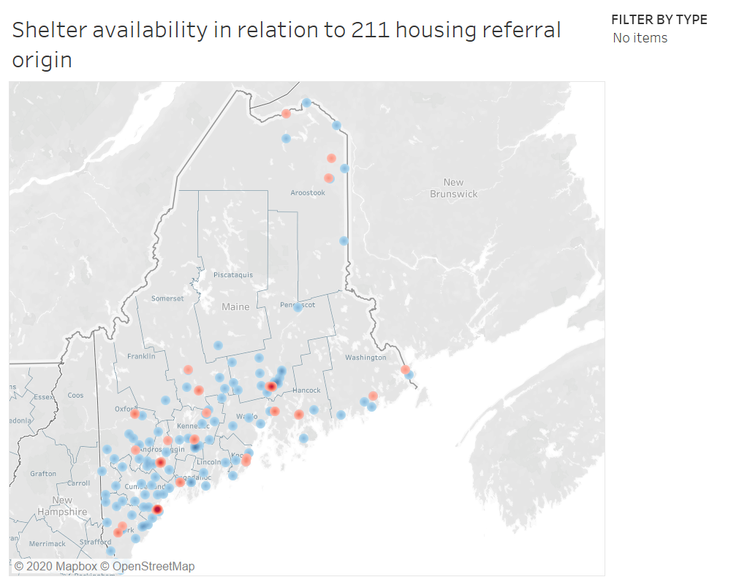
RED = Shelter concentration
BLUE = 211 housing referral origin

Slide 22
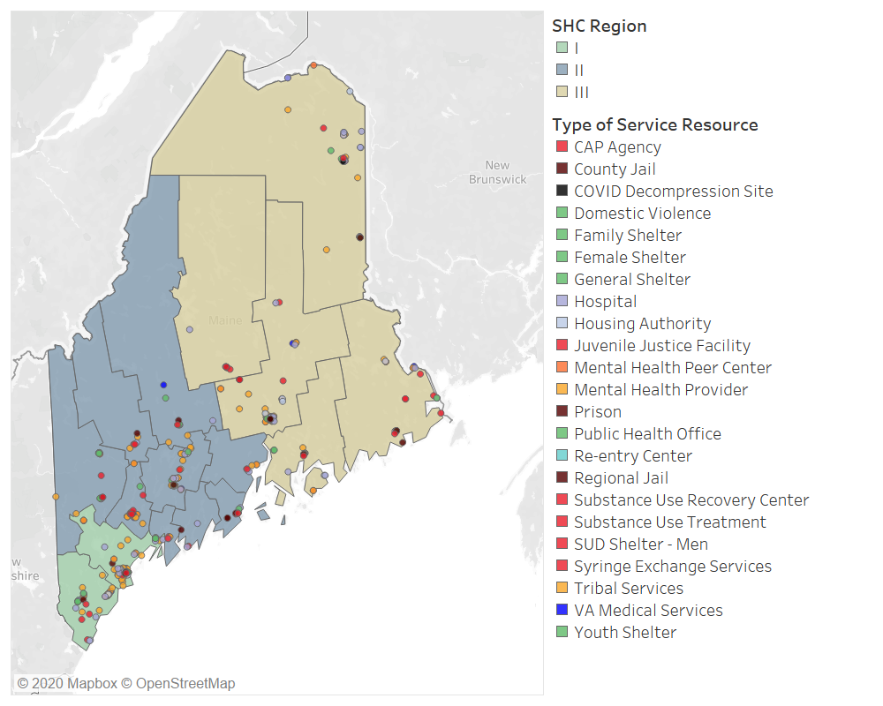
Resource Map

Slide 23
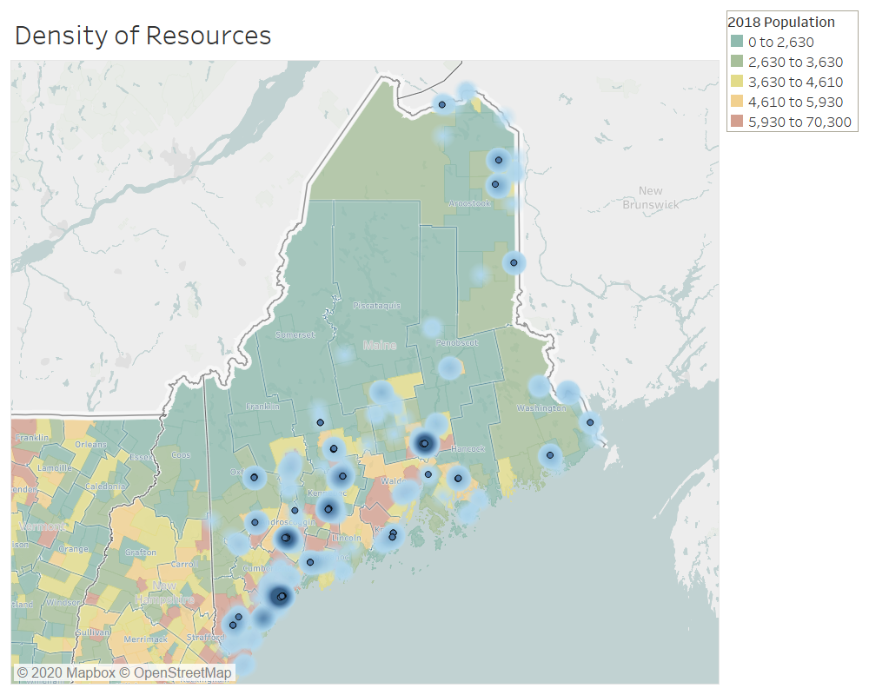
Population density and distribution of service resources.

