Slide 1
Maine Statewide Homeless Council
Corporation for Supportive Housing
January 12, 2021

Slide 2
Revisiting the Shared Problem…
Shelter Work Group
Leadership Team
Unequal access due to resources and capacity, lack of single point of entry causes overreliance on shelter system and a need for engagement of mainstream systems in prevention and diversion opportunities.
People with Lived Expertise
Homelessness is not a choice, but rather the result of a system that has failed vulnerable people. People experiencing homelessness in Maine face discrimination in shelter, barriers to housing and necessary resources such as mental health, substance use and general assistance. Prevention resources are non-existent, and leaders do not understand the actual needs of people facing homelessness.
Persistent inequality and discrimination, limited shelter access, affordable and supportive housing; underfunded mental health, substance use and prevention services create overreliance on the shelter system. There is a need to engage mainstream systems such as General Assistance, Justice and Healthcare in equitable prevention, diversion and discharge planning.

Slide 3
Looking Ahead in 2021...
Our goal for today is to reach consensus on establishing Service Hubs across Maine.
Let's discuss:
-Defining and understanding the Role of the Service Hubs
- Geography: Determining locations of service hubs
- Integration with Coordinated Entry policies/procedures
-Composition: Who should be at the table?

Slide 4
Proposed Priority Areas What can be achieved using the Service Hubs?
Priority Areas Identified by the Lived Expertise Focus Group:
All providers should have a common housing application, universal policies/procedures and greater transparency in prioritization of beds and/or resources.
Better communication and coordination between providers.
More mobile crisis units and outreach efforts to unsheltered people.
Better discharge planning from medical institutions, particularly for those with disabilities.
Professionalization of shelter staff and common training in trauma-informed care and other best practices.
Better use of data and tools to support clients.
More representation of lived expertise on the CoC Board and SHC.

Slide 5
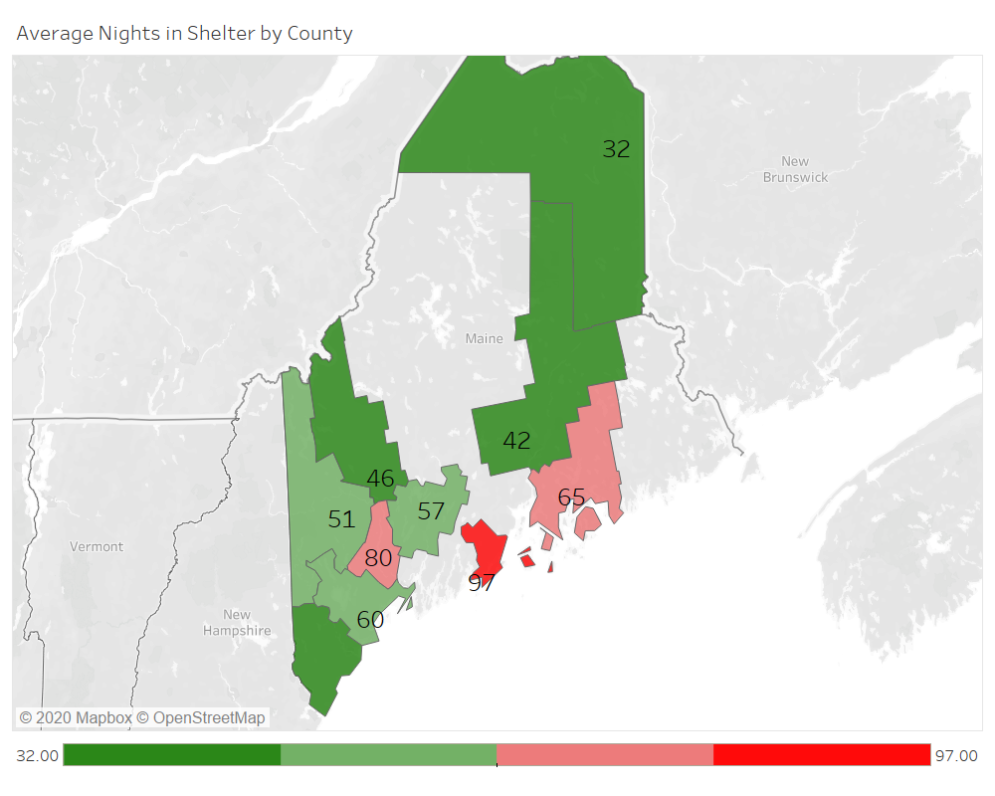
HUD PERFORMANCE MEASURE:
AVERAGE LENGTH OF STAY IN EMERGENCY SHELTER
TARGET GOAL: <30 Days in shelter
Notes:
HUD Priority Goal for FY19-20: Reduce the average length of homelessness in communities by an average of three days from FY18 to the end of FY20
KEY PERFORMANCE MEASURES AS INDICATED BY HUD
The national average length of homelessness is 142 days. The Northeast has the longest average time homeless in emergency shelters at 198 days.(Source: 2018 AHAR report Exhibit F3) https://www.huduser.gov/portal/sites/default/files/pdf/2018-AHAR-Part-2.pdf
Among all CoCs in the country, the average length of stay in emergency shelter is 127 days. In rural areas it is 60 days, in Suburban areas its 101.
Measure 1: Length of Time Persons Remain Homeless
▪ Population-level analysis:The AHAR reports the average number of persons served by a bed in a year, as well as cumulative number of days (reported in ranges) that individuals and families stay in ES and TH within each fiscal year. CoCs should use this information to explore various drivers of longer stays in homelessness. For example, families may have very long ES and TH stays relative to individuals. Discussions with providers serving families may reveal that procedures for accessing permanent housing reward long shelter stays (e.g., graduation from a service project), which discourages families from exiting on their own or accepting RRH assistance.
▪Project-level analysis: CoCs can use the APR and CAPER results to compare projects of the same type to determine which have longer lengths of stay. CoCs can then explore why clients are remaining in these projects instead of accessing permanent housing assistance. Is it because of providers’ policies and procedures? System bottlenecks? Or other factors that can be addressed?
▪ Patterns in populations: CoCs can analyze PIT count data and other local reporting such as master lists to begin to understand the experiences of those who are chronically homeless. CoCs may also consider additional ad hoc reporting using HMIS data to look at the cluster of long- and short-stayers in the system: What are the characteristics of people in each group, and what types of services are they using? Which providers are they working with? Can the community better target permanent housing interventions to long-stayers and diversion strategies to short-stayers?

Slide 6
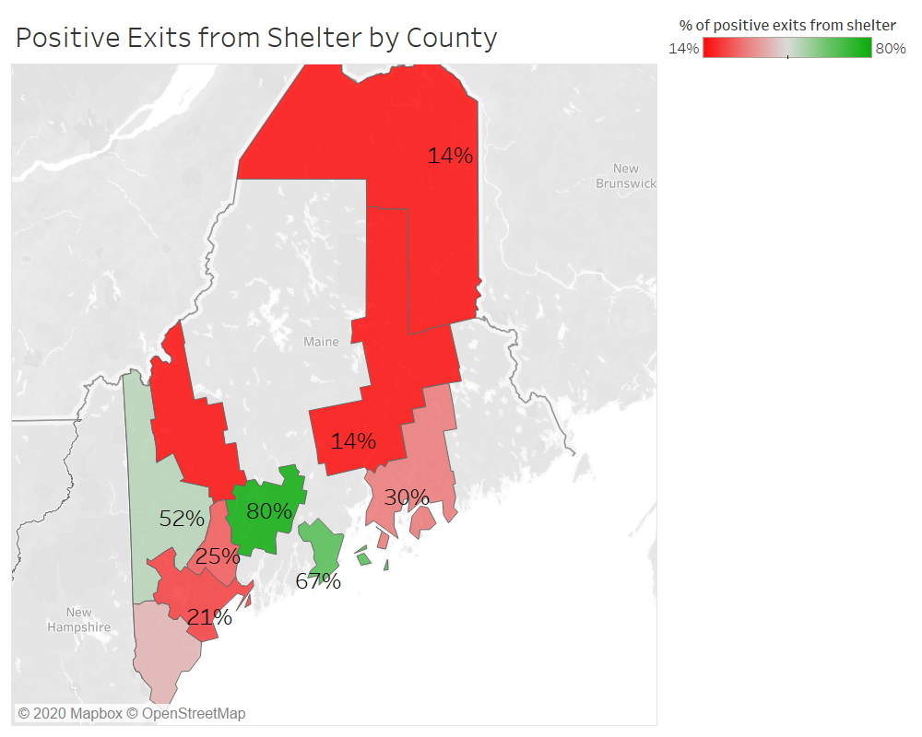
HUD PERFORMANCE MEASURE:
Average % of people with successful exits to permanent destinations from shelter
National Average= 42%
Northeast = 46%.
Only 3 counties in Maine meet this standard based on current HMIS data.
Source: 2018 AHAR Report to Congress
Notes:
Another key system performance measure is the percentage of people who exit emergency shelter, safe havens, or transitional housing to permanent housing -- rather than temporary or unknown destinations. Permanent housing placements can include permanent supportive housing, rapid re-housing, subsidized housing, and other permanent situations.
EXHIBIT F.6: Average Percent of People with Successful Exits to Permanent Destinations by Geographic Region. NORTHEAST = 46% NATIONAL = 42%

Slide 7
Proposed Role of the Service Hubs
Service Hubs will provide the local foundation for the roll-out and on-going operations of homeless prevention/response and Coordinated Entry, including case conferencing meetings, management of the prioritization list and matching to housing resources. Service hubs will have at least one Access Point in addition to Referral Partners.
Primary Responsibilities of each HUB:
Select a governance structure
Conduct Case Conferencing meetings for purposes of Coordinated Entry.
Develop and maintain guides to local diversion/prevention options and resources.
Serve as a point of contact for referrals originating in, or potentially relocating to the area.
Manage the CE prioritization list and participants.
Work to facilitate housing placements using CES prioritization and matching protocols.
Ensure all relevant and required data is being tracked in order to monitor the efficiency and effectiveness of the CES and make recommendations for continuous improvement.

Slide 8
Map of all incorporated townships in Maine
RED = Density of Shelter
SOURCE: Maine GeoLibrary Data Catalogue
https://www.maine.gov/geolib/catalog.html

Slide 9
Townships in Maine highlighted by 16 counties
Townships in Maine highlighted by 8 Public Health Districts
RED = Density of Shelter

Slide 10
Example Option for Service Hub Geographic Structure
Hub #1: York
Hub #2: Cumberland
Hub #3: Sagadahoc, Lincoln, Knox, Waldo + Town of Brunswick
Hub #4: Androscoggin, Kennebec
Hub #5: Hancock
Hub #6: Penobscot, Pisquataquis
Hub #7: Washington
Hub #8: Aroostook
Hub #9: Oxford, Franklin
Hub #10: Somerset
RED = Density of Shelter

Slide 11
Who should be at the table in each HUB?
Shelters
Outreach/PATH
Supportive Housing Providers
CAP Agencies
Hospital/Healthcare Community Care Teams
County Jail and Prison Discharge Planners
Others?

Slide 12
Learning From Other States
Connecticut Peer to Peer Discussion Takeaways
Defining the hubs
Understanding who the leads are for each hub
The governance structure at the hub level
Creating the bi-laws for each hub
Future Peer to Peer call with Alaska
To learn how the Alaska Balance of State CoC implemented the "referral zone" model and navigated some of these challenges

Slide 13
Next Steps
13

Slide 14
Thank you

Slide 15
SYSTEM RESOURCE MAPPING
What have we learned?

Slide 16
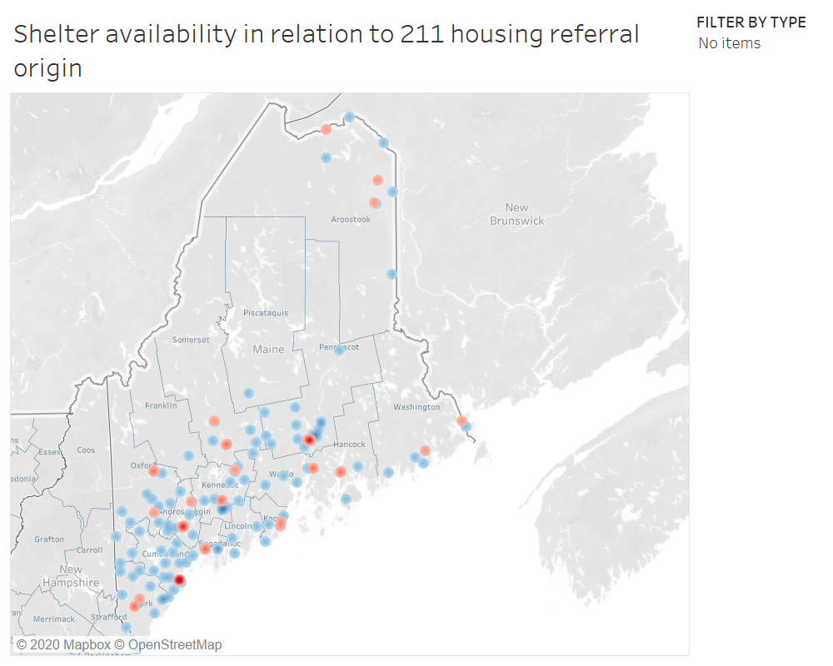
RED = Shelter concentration
BLUE = 211 housing referral origin

Slide 17
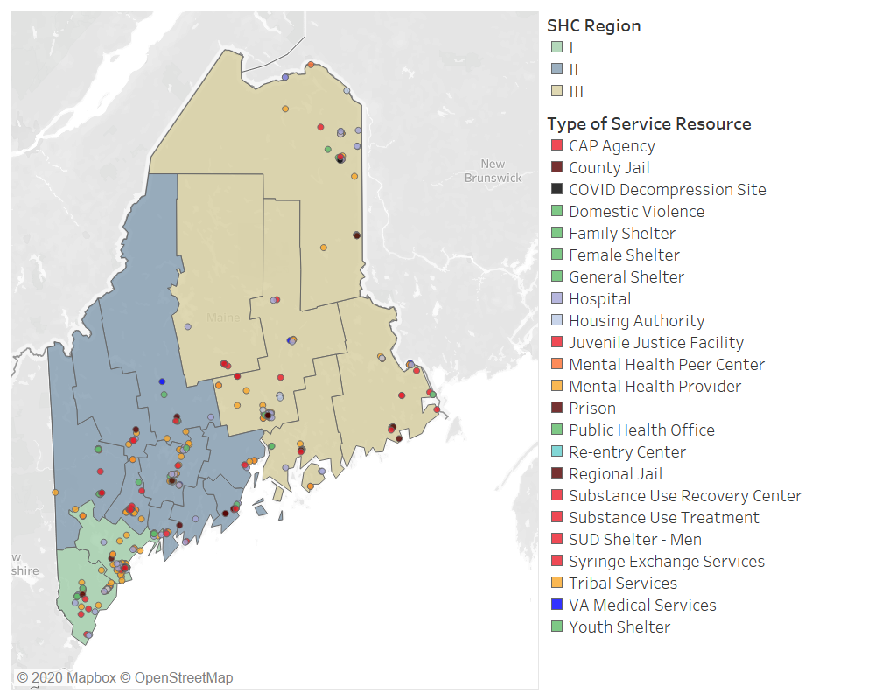
Deliverable 1: Interactive Map

Slide 18
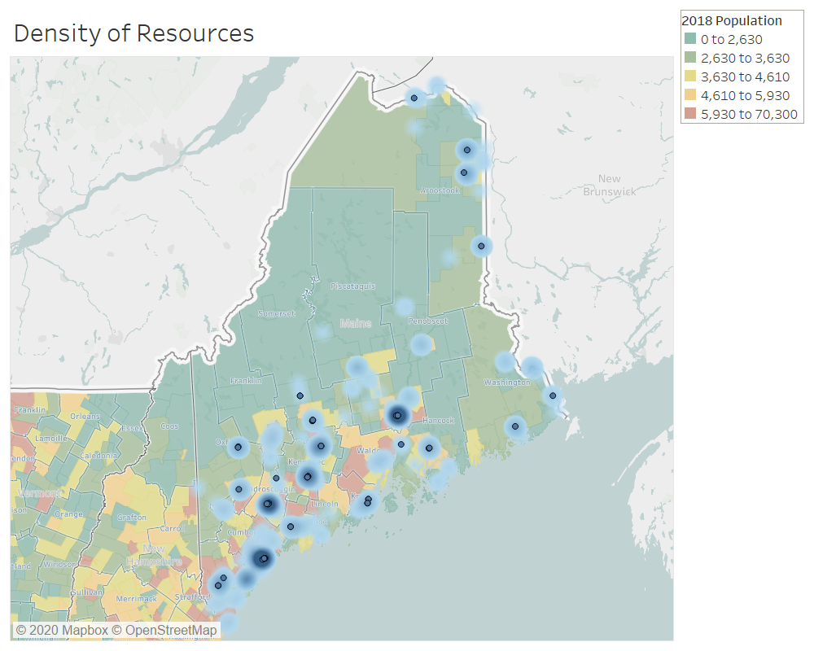
Population density and distribution of service resources.

Slide 19
Deliverable 2: “Regional Systems Design”
Who needs to be at the table?
What issues will they address?
Integration with CE
Prioritization and Matching
Housing navigation and landlord engagement
Where will the accountability for housing placements and prioritization lay?
When and how often will they meet?
How will decisions be made?

Slide 20
Deliverable 3: Plan for Affordable and SH Housing Development
Technical Assistance and recommendations for resource allocation to develop 200 new units of affordable and 40 units of supportive housing.
Use results of the needs assessment and financial modeling to determine target population(s), geographic focus and key partners.

Slide 21
Housing Workgroup Structure
10-12 people, representing expertise in development, service provision, lived experience, and state/local officials. The scope is time-limited, with an aim of completing five 1.5 hour sessions with the following objectives:
To identify and leverage the necessary resources including capital, operating and service funding.
Coordination among funding streams.
Discuss current PSH programs. Identify and troubleshoot barriers.
Mechanisms to increase integrated SH
Target populations/AMIs
Evaluation Metrics
Build capacity.
Policy Considerations.
Session 1 | Discuss current PSH programs. Identify and troubleshoot barriers.
Session 2 | Identify and leverage the necessary resources including capital, operating and service funding. Discuss coordination among funding streams.
Session 3 | Building coordination capacity between developers and service providers.
Session 4 | Discussion of housing models and funding mechanisms for integrated PSH. The role of municipalities in development.
Session 5 | Targets, timelines and evaluation metrics. Integration with broader system re-design efforts.

Slide 22
Shelter Workgroup Structure
Comprised of 10 -12 people, representing front line programs and staff.
Outreach/Engagement/Triage
Addressing Shelter Capacity – are we using the beds we have?
Statewide Shelter Practices such as Housing First, Housing Navigation and Assertive Engagement
Coordinated Entry and Regional Coordination and Considerations
Improving access to mainstream resources and benefits
Goal setting, defining evaluation metrics
Policy Considerations and Resource Allocation
Impact of COVID 19
Session 1 | Level-setting around purpose, establishing goals and addressing shelter capacity, including COVID 19 concerns
Session 2 | Accessibility, outreach, engagement, triage and statewide shelter practices such as Housing First
Session 3 | Integration and access to mainstream resources.
Session 4 | Policy considerations, resource allocation and working toward a shared definition of evaluation metrics.
Session 5 | Coordinated Entry and service hub considerations. Draft final recommendations for consideration by the SHC.

Slide 23
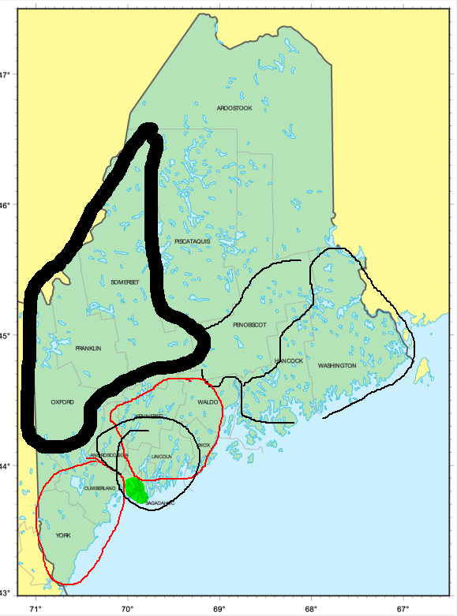
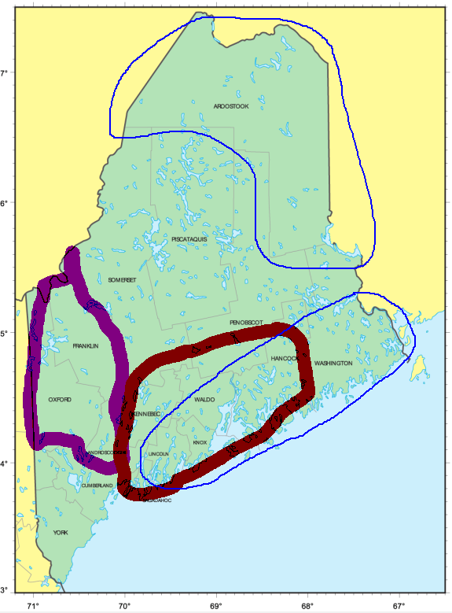
Service Hub brainstorm with focus groups

