Slide 1
Reflections and Discussion: Service Hub Peer to Peer
20 minutes

Slide 2
Maine Homelessness System Re-Design
Initial Data Analysis
3/9/2021

Slide 3
Before we get started…
This is preliminary data… numbers may change.
Goal is to test data assumptions, sources and results with you.
Needs and costs are based on current available data…
they can and should be refined over time.
Do not quote numbers until the are finalized in the report.

Slide 4
Contents of this Presentation
Assessment Questions and Goals
Background and Overview of Maine Homeless System
Understanding the needs of people experiencing homelessness
Inventory of current interventions
Current System Performance Assessment
Recommendations for the System Redesign
Financial Model and Timeline

Slide 5
Assessment Goals and Key Questions
Goal: To determine the inventory and resources needed to support the goal of homelessness as rare, brief and one time in Maine
How is the system currently performing toward goals?
What mix of interventions and resources are needed to meet system goals?
What is the cost to implement the new system?

Slide 6
Homelessness in Maine

Slide 7
Maine Homelessness Point in Time Count
Total Homeless Population 2,106
Total Family Households Experiencing Homelessness 283
Veterans Experiencing Homelessness 116
Persons Experiencing Chronic Homelessness 226
Unaccompanied Young Adults (Aged 18-24) Experiencing Homelessness 125
Total Number of Homeless Students 2,443
Total Number of Unaccompanied Homeless Students 420
Nighttime Residence: Unsheltered 74
Nighttime Residence: Shelters 596
Nighttime Residence: Hotels/motels 295
Nighttime Residence: Doubled up 1,478
Source: https://www.usich.gov/homelessness-statistics/me/

Slide 8
Demographics 2019 Source: ACS 2019 Source: COC Homeless Assistance Programs Homeless Populations and Subpopulations Report

Slide 9
Homelessness Through a Race Equity Lens While overall homelessness is declining, it is on the rise for Black, Indigenous, People of Color.
Source: 2019 HUD COC Housing Inventory Report

Slide 10
Deep Dive
2019 ESG Utilization Report
6530 people served in shelter annually
50% were first time homeless
Length of Time Homelessness: HMIS Data 8/1/2020 – 9/1/2020
41% people were in shelter <14 days
50% people were in shelter between 15 and 180 days
9% were in shelter between 180 and 730 days
28% exited to a positive destination
Notes:
50% first time homeless presents opportunity for diversion and eviction prevention.

Slide 11
Maine Homeless Subpopulations
2019-point-in-time-survey.pdf (mainehousing.org)
Notes:
A study by the National Institute of Mental Health found that approximately 6% of Americans are severely mentally ill, compared to the 20-25% of the homeless population that suffers from severe mental illness. Furthermore, 45% of the homeless population shows history of mental illness diagnoses.

Slide 12
People enter homelessness from a variety of situations
Top 5 Residence Prior to Entry:
33% Place not meant for human habitation
24% Emergency shelter, incl. hotel or motel
20% doubled up with family or friends
7% Self paid hotel or motel
4% Hospital or other non-psychiatric medical facility
Diversion
RRH/SH/AH
Notes:
57% from a homeless situation need RRH or SH
32% from other is rental housing, home ownership, self paid hotel/motel – these folks are a target for diversion!

Slide 13
Assessing the Current System’s Performance
Rare…Brief…One Time

Slide 14
Interventions Assessed
Rapid Rehousing
Supportive Housing
Shorter term rental assistance with services for average of 1 year
Long term rental assistance with intensive services to support housing stability and community integration
Problem solving support and flexible financial assistance to avoid entry into the homeless system
Diversion
Transitional Housing
Facility based programs that offer housing and services for up to two years
Emergency Shelter
Short term, crisis beds for individuals, youth & families
Affordable Housing
Housing where rent is subsidized via tenant or unit subsidy

Slide 15
Maine’s Current Inventory
ES Breakdown:
556 bed for HH w/children
650 beds for HH w/out children
16 beds for HH children only
TH Breakdown:
54 for Vets
42 for Youth
115 for DV
667 BRAP
81 for SPMI and/or SUD
133 for general population
RRH
There are an additional 200 one time RRH available through MaineHousing

Slide 16
Distribution of PSH Units by County
Source: 2020 HIC Report
Notes:
Total = 1,317 vouchers with location data.
Please note this data does not include the 1079 tenant-based vouchers and 8 DV specific vouchers with no location data provided within the HIC Report.

Slide 17
Distribution of TH Units by County
Source: 2020 HIC Report
Notes:
Total = 414 TH Units with location data
Please note this data does not include the 667 tenant-based vouchers and 11 DV specific vouchers in this category with no location data provided within the HIC Report.

Slide 18
Performance Metrics homelessness should be rare…brief…one time
Rare…
Brief…
Mean length of episode of homeless (in days) for permanently housed exits
One time…
Number and percent of people exiting homelessness to permanent housing destinations
Number of people experiencing homelessness relative to the general population disaggregated by race and ethnicity
Number and percent of people entering homelessness for the first time
Mean and median total length of time homeless
Number and percent of people returning to homelessness within 2 years after a permanently housed exit
Notes:
Inflow
rare…
Prevention of referral to homeless system
#/% people diverted from homelessness
Wait time for assessment
Entries into shelter
During Homelessness
brief…
Length of time Homeless
Positive exits
Outflow
non reoccurring…
Time to acceptance and lease up
Permanent Housing Placements
Returns to homelessness
Connection to mainstream resources
Income

Slide 19
HUD STELLA P
4

Slide 20
Inflow and PH Exits by Intervention Source: HUD Stella P
Emergency Shelter
78%
18% exit to PH
RRH
3%
76% exit to PH
TH
13%
65% exit to PH
SH
80% remained housed or exit to PH
6%
Diversion
N/A
0
Notes:
The interventions that receive the most referrals have the poorest outcomes.

Slide 21
Key Performance Indicators By County Source: HMIS Data Pull 8/1/20 – 9/1/20
Rapid Rehousing
County | Average Length of Stay | Average Shelter Utilization | Percent homeless >14 days | % exit to positive destination (8/1/2020 - 9/1/2020)
Aroostook | 32 | 31 % | 74% | 14%
Penobscot | 42 | 84 % | 72% | 14%
Franklin | 46 | 65 % | - | -
York | 48 | 77 % | 82% | 40%
Oxford | 51 | 72 % | 80% | 52%
Kennebec | 57 | 93 % | 76% | 80%
Cumberland | 60 | 84 % | 43% | 21%
Hancock | 65 | 65 % | 72% | 30%
Androscoggin | 80 | 68 % | 71% | 25%
Knox | 97 | 87 % | 100% | 67%
No data for Lincoln, Sagadahoc, Waldo, Somerset, Piscataquis or Washington
Notes:
Don't need much shelter as there are currently empty beds.

Slide 22
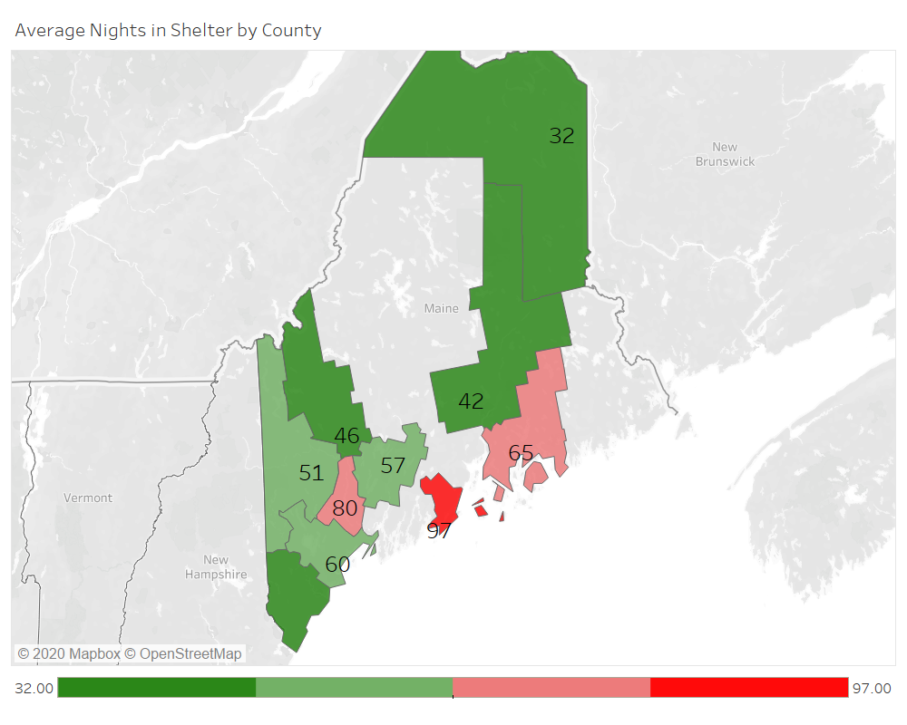
System Performance Measure: Average Length of Stay in Shelter
Source: 2019 ESG Report
Goal: < 30 days

Slide 23
System Performance Measure: Exits to permanent housing
Source: 2018 AHAR Report
National Average: 42%
Northeast Average: 46%

Slide 24
Key Take-Aways Informing Re-Design
Reliance on shelter as the initial front door
Most people enter from a setting where a short term intervention could prevent or end homelessness
Low number of long term stayers across the system
Over use of interventions with the poorest outcomes (ES and TH)
There is a lack of permanent housing options on the back end … but once in housing, returns to homelessness is low
Notes:
Reliance on shelter as the initial front door
78% of people enter directly to shelter
Most people enter from a setting where a short term intervention could prevent or end homelessness
57% of people enter from a homeless situation (RHH)
32% enter from rental housing, home ownership, self paid hotel/motel or other situation (DIV)
Low number of long term stayers across the system
Over use of interventions with the poorest outcomes (ES and TH)
There is a lack of permanent housing options on the back end … but once in housing, returns to homelessness is low
7% within first 6 months

Slide 25
Homeless System Re-Design

Slide 26
Key Components of the Redesign
Data Driven and Accountable
Person Centered Design
Grounded in Housing First
Balances statewide standards with a tailored, localized response
Move from “Models” to “Systems” with the right array of interventions
Build Thriving Communities that Foster Educational Connections, Build Career Pathways, Integrate Healthcare and Ensure Food Security
Addresses Race Equity

Slide 27
Assumptions
Diversion
Target people experiencing homelessness for the first time
40%of people calling 211
60% of people who show up at shelter
Self Resolution
20% of people served in shelter self resolve with assistance through shelter and community based services
Calculated by percent of people in shelter <14 days
Transitional Housing
Improve outcomes
Target subset of people exiting SU tx, prison, CW involved families and youth
Emergency Shelter
Functioning at 50% capacity since COVID 19
Greater use of hotels ad diversion options
Need to address public health and safety needs related to congregate settings
Rapid Rehousing
Target 80% of clients in shelter > 14 days
Supportive Housing - Homeless
90% of chronically homeless population
20% of all people experiencing homelessness
Current turnover rate is 28%. Reduce to 9%.
Supportive Housing – Mainstream
Not included in redesign numbers

Slide 28
Statewide Re-Design System Summary
Intervention | Current Annual Inventory (2019 HUD AHAR) | Re-Design | Change
Diversion | 0 | 2,392 | 2,392
Shelter | 1,222 | 1,245 | 23
Rapid Rehousing | 331 | 2,923 | 2,592
Supportive Housing- Homeless | 593 (based on 9% turnover) | 1,470 | 877
Supportive Housing - Mainstream | 0 | 3.027 | 3,027
Transitional Housing | 1,013 | 684 | -329
Affordable Housing | TBD | TBD | TBD

Slide 29
Statewide Diversion Need
Target people experiencing homelessness for the first time
70%of people calling 211
40% of people who show up at shelter
20% of people served in shelter self-resolve with assistance through shelter and community-based services. (Calculated by percent of people in shelter less than 14 days).
Annualized # of First Time Homeless | 3268
Annual housing related calls to 211 | 2584
70% of 211 calls diverted | 1809
Show up at shelter (= FTH – 211 DIV) | 1459
40% diverted at shelter | 584
Total Diverted = (211 DIV) + (shelter DIV) | 2392
Current Diversion Resources | 0
New Diversion Need | 2392

Slide 30
Statewide Crisis Services Need
Population | Existing Stock | Average Turnover Rate | # Available Annually | Annual Need | Unsheltered 2019 PIT | Diversion | 50% RRH | Total New Need
Families (inc. children only) | 572 | 1.30 | 744 | 502 | 3
Individuals | 650 | 2.89 | 1,879 | 6,028 | 92
Total | 1,222 |  | 2,622 | 6,530 | 95 | 2,684 | 1,296 | 23

Slide 31
Statewide Rapid Rehousing Need
Annual Number of Clients in Shelter (2019) | 6,530 | Current RRH Portfolio | New RRH Need
In shelter 14 days or more | 3,654
80% of those in shelter 14 days or more | 2,923 | 331 | 2,592

Slide 32
New Need for Supportive Housing
Housing Intervention | Existing Stock | Annual Turnover Rate | # Available Annually | Annual Need | Homeless New Need | Mainstream New Need | Total New Need
PSH (Families) | 1029 | 0.07 | 141 | 987 | 846 |  | 846
PSH (Individuals) | 1507 | 0.09 | 452 | 3510 | 31 | 3027 | 3058
 |  |  |  |  | 877 | 3027 | 3904

Slide 33
Quantifying Cross System SH Need: Total Need = 4497
Notes:
we use PIT because we're looking at so many different systems at the same time. the idea there is that we know people are going to touch multiple systems over the course of a year, so by taking a snapshot of data from the wide variety of systems we're including, we can avoid double-counting and get a pretty good sense of the total scale of need

Slide 34
Statewide Transitional Housing Need
Population | Existing Stock | # Available Annually | Annual Need | New Need
Families | 536 | 536 | 372 | -164
Individuals | 477 | 477 | 312 | -165
Total | 1013 | 1013 | 684 | -329

Slide 35
Re-Design Ramp Up

Slide 36
Next Steps
Confirm assumptions and refine and finalize model
Begin design and launch of local Service Hubs
Identify strategies to leverage existing and/or acquiring new resources
Work with Leadership Committee to develop strategies to address mainstream supportive housing need = 3027 units

Slide 37
Opportunities to Enhance Housing Placements
Open Discussion

Slide 38
Exits to Permanent Housing
 | Total Heads of Household | HH Groups | Individuals HOH | # exit to Permanent Housing | # Exit to NonPermanent Setting | % exit to Permanent Housing
Jan-20 | 1174 | 123 | 1060 | 267 | 931 | 22.68%
Feb-20 | 1130 | 116 | 1017 | 262 | 893 | 23.12%
Jan-21 | 819 | 90 | 730 | 48 | 782 | 5.85%
Feb-21 | 607 | 74 | 532 | 45 | 569 | 7.40%
Could we developed shared goals to increase placement into permanent housing?
What would be a appropriate timeframe (90, 120 days)?
How could the Service Hubs support these goals?
What resources can be leveraged to support housing placements?

Slide 39
Service Hub Design Planning Session
Planning meeting on March 31, 2021
Goal is to set agenda for local Service Hub planning
Development of BNL
Local coordination and leadership
Explore Opportunities to Enhance Housing Placements

