Slide 1
Authentic Youth Collaboration.
Created in collaboration with the
National Youth Forum on Homelessness

Slide 2
Objectives.
Explain the Authentic Youth Collaboration Philosophy and why it’s important to our work to end youth homelessness
Provide a list of best practices for authentically engaging young people
Provide concepts and ideas to consider when building a framework of how to work with youth and young adults
Provide concrete examples to address adultism as an adult
Provide an index of related resources to supplement your learning
Provide a framework for collaborating with youth participants who are engaging in services or programs

Slide 3
What does authentic partnership look like for youth?
Notes:
The ways in which youth are invited to participate are important. It’s up to the adults working with them to be intentional, communicative, and aware as these partnerships are formed. Historically, youth experiencing homelessness may have been taken advantage of and tokenized in multiple ways, even by organizations and practices intending to support them. Youth are often asked to share their stories on panels, in the media, or at fundraising events. Though well-intentioned, these kinds of opportunities are limiting. They rarely include the young person’s ideas for impacting change and the young person may be re-traumatized by these experiences, particularly when the value of their lived experience is profited from without an exchange of information or services. Authentic youth collaboration is about more than inviting a young person to share the stories of their past; it’s also about providing the space for them to share their vision for the future.
Authentic youth collaboration is sometimes hindered by adultism. This happens when youth and young people are presumed to lack knowledge or experience because of their age and their ideas are dismissed. Engaging youth authentically and effectively requires one to flip this idea on its head.
One example of this is through language. Consider the times you’ve heard the phrase, “They’re just kids.” Referring to young people as “kids” can sometimes dismiss and undermine the knowledge and experience young people bring. The term “kids” inherently diminishes the experiences of a person rather than referring to someone as a young adult or a young person which sets a different tone.

Slide 4
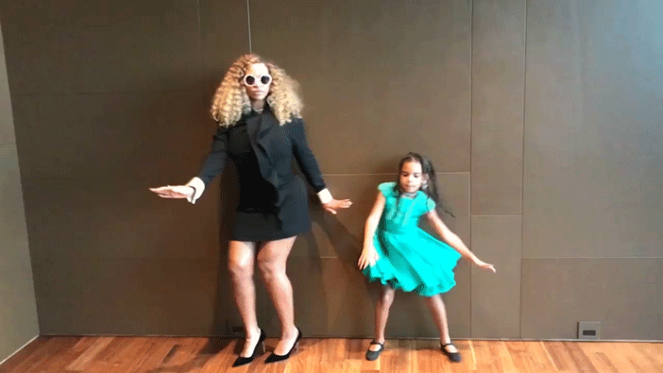
Authentic Partnership with Youth/Young Adults.
Be intentional about the decision-making power that youth have in your work.
Youth are the experts of their own truth.
When asking young people to be involved in your work, hear them out and build a reciprocal relationship where you honor their experiences, allowing their experiences and ideas to inform the process.
Notes:
Asking questions such as, “In what ways do youth directly impact decisions in my organization?” or “In what ways are youth a part of generating solutions?” and “How are youth in my organization benefiting from the value of their lived experience?” can keep you accountable to the young people you are working with.
As an adult partner, it is your responsibility not to speak for a young person, rather to elevate their voice in a way that is empowering.

Slide 5
Introduction to Adultism.
What is adultism?
Adultism describes the systems of privileged attitudes and behaviors that adults have over those of young people.
Adultism is driven by behaviors and attitudes that are based on the assumption that adults are better than young people and therefore entitles them to act upon or on behalf of young people without their agreement.

Slide 6
Introduction to Adultism.
What is ageism?
Stereotyping and discriminating against people on the basis of age.
What is the difference between ageism and adultism?
Ageism describes the systems of privileged attitudes and behaviors that younger people have over elders.

Slide 7
Adultism in common language.
Respect your elders -- they know better.
Older & wiser
Childish
Immature
Too young/Not old enough
Children should be seen, not heard
Stay in a child’s place
The more you live, the more you know

Slide 8
Avoiding Barriers to Authentic Youth Collaboration.
Building Trust
Establishing and building trust is essential in any effective working relationship. Once positive rapport is established, genuine collaboration can begin.

Slide 9
Avoiding Barriers to Authentic Youth Collaboration.
Meaningful Engagement
An issue that often gets in the way of effective collaboration between youth and service providers is showy engagement, in which young people are invited to participate simply to create the impression of inclusion and diversity.

Slide 10
Avoiding Barriers to Authentic Youth Collaboration.
Autonomy
Young adults should have the freedom and agency to be the leaders of their own lives. Their autonomy should be promoted as they make decisions about the issues that impact their lives.

Slide 11
Avoiding Barriers to Authentic Youth Collaboration.
Sharing Power
Young adults need to know that they have power but this should also be reinforced by our systems. Ensure that youth serving systems are informed by YYA by reserving space for YYA to have voting, hiring, and decision making power.

Slide 12
Avoiding Barriers to Authentic Youth Collaboration.
Introductions
Working agreements
Collaborative curriculum (educational spaces)
Thank you’s
Peer empowerment (youth to youth)
Skillshare (and compensation)
Housekeeping

Slide 13
Avoiding Adultism When Collaborating With Youth & Young Adults
Collaborating on Tasks
Allowing young people to collaborate directly on tasks that involve or impact them and/or performing tasks that have traditionally been carried out by Older Adult Partners in youth spaces has been proven to create and promote authentic collaboration, thus removing intentional adultist behaviors.

Slide 14
Avoiding Adultism When Collaborating With Youth & Young Adults
Online Platforms
Connecting online comes with many pros & cons; that for many can be challenging, while others thrive. Currently, during COVID-19 remote work has become commonplace. Reflect on what challenges exist for older adults and young people & how these may manifest when communicating in an online platform. Engage young people in determining what supports are needed.

Slide 15
Avoiding Adultism When Collaborating With Youth & Young Adults
Online Platforms
Collaborate with young people to navigate expectations online. Allow young people to determine what platform(s) work best for them & what it means to show up in a meaningful way. Consider technological accessibility, tech knowledge and capacity for young people; develop a contingency plan to meet needs.

Slide 16
Avoiding Adultism When Collaborating With Youth & Young Adults
What ways can young people safely discuss adultism & discuss solutions with adult partners? How does this currently look? What ways can we begin to change culture to center collaboration & remove adultist behaviors? What should be put in place to combat adultism when it shows up among adult partners?

Slide 17
Input and Feedback from Youth and Young Adults.
Set youth and young adult leaders up for success.
Create a collaborative environment for input and feedback.
Set deadlines.
Uplift the impact of their work.
Notes:
1.Set youth and young adult leaders up for success.
a.Before asking for input or feedback, it’s essential to collaborate on tools and training. Consider creating a list of acronyms for local, state, and federal agencies, including their names and the work they do. Create a list of system terms and definitions as well as organization programs and purposes (ex. transitional living, housing first, rapid rehousing, etc.)
2.Create a collaborative environment for input and feedback .
a.Give various options to for youth and young adult leaders to give their input and feedback. Be open to printing and distributing materials for written responses, to emails with attachments, and even to working together on a shared drive or document online, like a Google Doc.
3.Set deadlines.
a.Set clear and realistic deadlines. Be mindful that youth and young adults have personal lives outside of this work but also work together on accountability by scheduling milestone dates together.
4.Uplift the impact of their work.
a.Give clear examples of how youth and young adults input and feedback was influential in the final decision or product. Think of both local and national impact.

Slide 18
The Listening Session.
Listening sessions are facilitated conversations where youth and young adults’ ideas and suggestions are uplifted in an essential way. Adult partners in the room are asked to remain silent throughout the process, centering the perspectives of young people with lived experience toward several goals
5 Tips for a successful Listening Session:
Build Trust
Have an open mind
Identify and reframe adultism
Engage in active listening
Be Specific

Slide 19
Q&A.
Resources: https://learn.truecolorsunited.org/catalog/
https://truecolorsunited.org/index/maine/

Slide 20
dee@truecolorsunited.org

