Slide 1
State of Maine Overdose Response and Prevention: OPTIONS
Sybil R. Mazerolle
SUD Program Manager

Slide 2
OPTIONS
What it Means:
What it is:
O: Overdose
P: Prevention
T:Through
I: Intensive
O: Outreach
N: Naloxone &
S: Safety
SUD Clinical Co-responder embedded within a First Responder agency
Community-based Recovery Support Partner
Public Messaging Campaign
Good Samaritan Law
Anti-stigma
Harm reduction and overdose prevention strategies

Slide 3
Programmatic Elements
SUD Clinician:
Community-based Recovery Partner:
Embedded in First Responder Agency
Co-responds to overdose and SUD-related Emergencies
Proactive Referrals
Connection to Recovery Coach
Required TA participation
Community low-barrier access points (Syringe Service Programs, Recovery Centers, Clubhouses)
Education and Connection to local Harm Reduction services
Recovery Capital gains

Slide 4
OPTIONS Co-Responder: Primary Responsibilities
Post-overdose follow-up
Cont. engagement in the community
ODMAP Notifications
Cross-position referrals and social service supports
MaineMOM Connection
Data Tracking
Naloxone Distribution
Community Anti-stigma education
MaineCare application
Connection to FQHC or other provider for HIV/Hep testing
Harm Reduction support

Slide 5
OPTIONS: Co-responder
OPTIONS Co-responder Provider | Counties of Coverage
Aroostook Mental Health Center | Aroostook, Hancock, Washington
Community Health and Counseling Services | Penobscot, Piscataquis
Crisis & Counseling | Kennebec, Somerset
Sweetser | Cumberland, Franklin, Knox, Lincoln, Oxford, Sagadahoc, Waldo, York
Tri-County Mental Health Services | Androscoggin

Slide 6
OPTIONS: Co-responder
OPTIONS Co-responder Provider | Counties of Coverage | Co-responder Hiring Status
Aroostook Mental Health Center | Aroostook (Caribou PD), Hancock (determining linkage), Washington (Washington Sheriff’s Office) | Aroostook- Hired, starting end of Month (Kayley)
 |  | Hancock-Recruitment Phase
 |  | Washington-Hired and onboarding (Robin)
Community Health and Counseling Services | Penobscot (Penobscot Sheriff’s Office), Piscataquis (Piscataquis Sheriff’s Office) | Penobscot- Hired, onboarding (Adam Perkins)
 |  | Piscataquis- Recruitment Phase
Crisis & Counseling | Kennebec (Augusta PD), Somerset (Somerset Sheriff’s Office) | Kennebec- Hired and started 1/5 (Jasmine)
 |  | Somerset- Recruiting (ca
Sweetser | Cumberland (Brunswick PD, Franklin (Farmington PD), Knox (Knox Sheriff’s Office), Lincoln (Sheriff’s Office), Oxford (Rumford PD), Sagadahoc (Bath PD), Waldo (Sheriff’s Office), York (Kennebunk PD) | Cumberland-Hired, onboarding
 |  | Franklin- Recruitment phase
 |  | Knox- in interview process
 |  | Lincoln- in interview process
 |  | Oxford- Hired and started
 |  | Sagadahoc- Hired and Started 12/28
 |  | Waldo- Recruitment Phase
 |  | York- Hired and Started 12/28
Tri-County Mental Health Services | Androscoggin (Lewiston PD) | Previously hired and now in full-time capacity

Slide 7
Overdose Detection Mapping Application Program (ODMAP)
“Provides near real-time suspected overdose surveillance data … to support public safety and public health efforts to mobilize an immediate response to a sudden increase, or spike in overdose events.”
Developed by Washington/Baltimore HIDTA
Free to use
Overdose data entered by Emergency Responders
Spike alerts and Overdose alerts for your county or State-level
For more information and a list of Maine’s participating law enforcement agency to be signed up for alerts: www.odmap.org

Slide 8
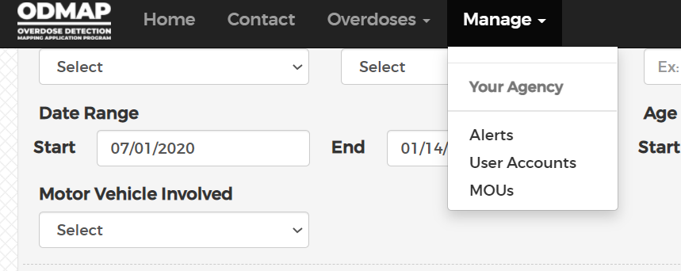
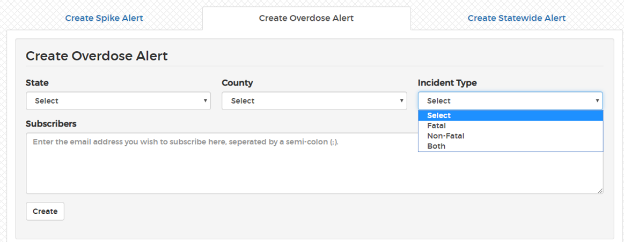
OPTIONS: ODMAP Overdose Alerts

Slide 9
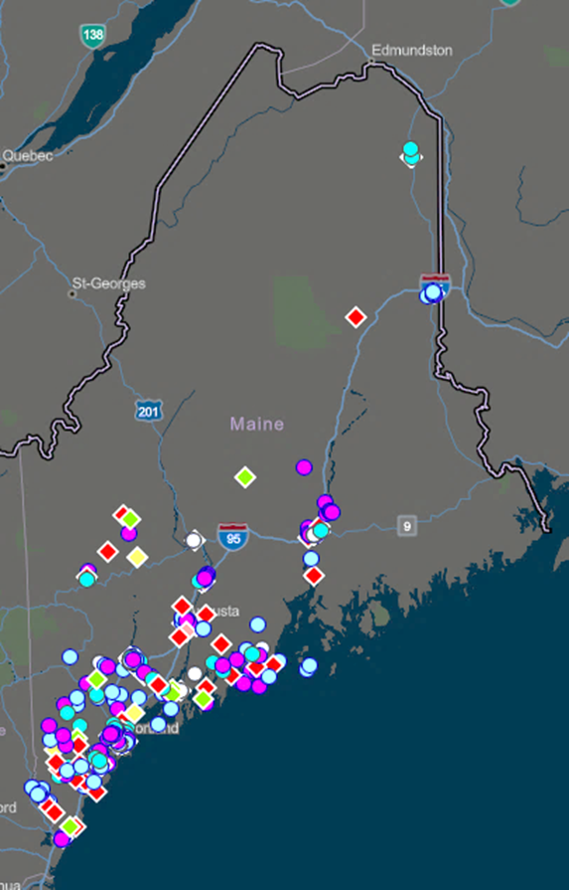
OPTIONS: ODMAP Level 2

Slide 10
OPTIONS Contact Information
For more information about ODMAP and the OPTIONS Co-responder Implementation:
SUD Program Manager
Sybil.Mazerolle@maine.gov
For more information about OPTIONS Public Messaging Campaign:
Opioid Response Project Manager
Rowland.Robinson@maine.gov

Slide 11
OPTIONS Contact Information
For more information about ODMAP and the OPTIONS Co-responder Technical Assistance:
Amy Carter:
acarter@mainemed.com
Eric Haram:
eharam@gmail.com

