Slide 1
Part I: Introduction to Sexual Orientation and Gender Identity and Expression
September 13, 2019
Augusta, Maine

Slide 2
Welcome!
Ophelia Hu Kinney
she/her/hers
Scarborough, Maine
Communications Specialist
Reconciling Ministries Network
Please share with one or two neighbors:
Your name
Your pronouns (they/them, she/her, he/him, etc.)
Where home is for you
Your role relevant to this presentation
Notes:
Give 2 min. for intros
TOTAL 4:00

Slide 3
How many of us know an LGBTQ person?
Notes:
Don’t assume that there are no LGBTQ persons in your life or with whom you work

Slide 4
Why are we here?
People matter
Language matters
Behavior matters
Learning matters
Notes:
TOTAL 7:00

Slide 5
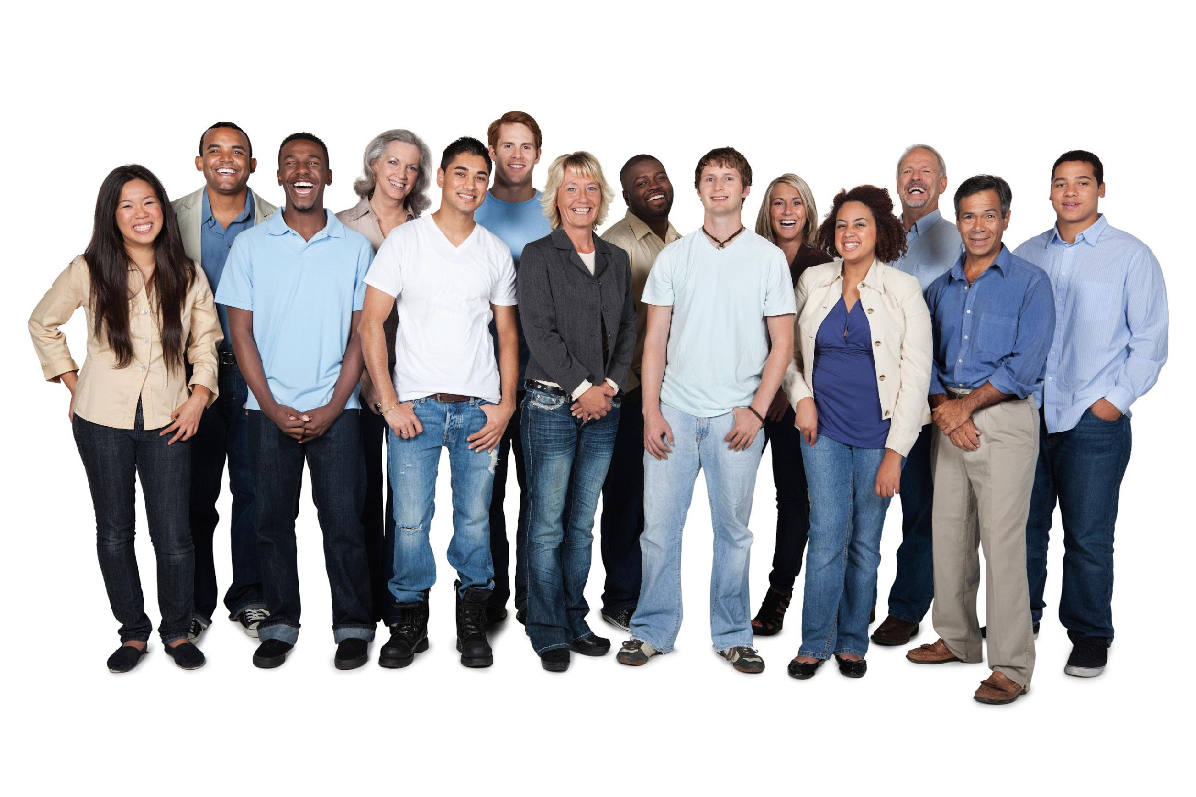
gay
lesbian
bisexual
queer
trans*
Notes:
Often times when we talk about sexual orientation and gender identity, people feel more prepared and somewhat practiced at using terms like gay and lesbian but other terminology may feel like a soup of sorts – confusing or complicated. Sometimes, people are afraid to say the wrong thing. Sometimes, folks aren’t sure why it’s important to use the language that others use to describe themselves. It may seem like some people have a sexual orientation or a gender identity and other people are the default.
In reality, we all have a sexual orientation and a gender identity.
In the work that you do, you value people. This is about hearing each other’s stories instead of trying to fit what we hear or who we meet into the box of a definition.
You will not leave here today an expert on SOGIE but we do hope you’ll leave with a deepened understanding and expanded ability to welcome people of all sexual orientations and gender identities and expressions.

Slide 6
Use language that describes people accurately and with dignity.
Treat people equitably, even and especially if equitable and equal treatment are not the same.

Slide 7
Curiosity Continuum
hospitable
intrusive
Notes:
Often times when we have conversations about SOGI there is a continuum of curiosity that we’re all on
and it ranges from [CLICK] hospitable to [CLICK] intrusive
Some examples of this continuum include:
hospitality – building relationships, asking questions about who a person is, why they came to your church, what they’re passionate about
intrusive/offensive/rude – asking deeply personal questions like asking about how someone has sex, if they’ve had “the surgery”, what their other name was.
One way we can keep ourselves toward the hospitable side is to ask ourselves…

Slide 8
Will this question help me to know this person more deeply as a fellow human being?
Would this question be appropriate to ask someone else?
How would I feel if someone asked me this question?
Notes:
We’re all curious and if there are touchier questions you’re really interested in there’s a plethora of information on the internet.
Good intentions are not enough to ensure the safety and comfort of others.
Finally, these conversations might be new for many of us. This is about sharing and exploring parts of who ALL of us are as humans, so as much as possible, I encourage you to be courageous and vulnerable in our conversation.

Slide 9
**
**
**sex assigned at birth is constructed, not inherent.

Slide 11
Commonly used gender identity vocabulary:
Agender: a person who does not have a gender
Assigned gender/sex assigned at birth: the gender a person was assigned at the time of birth
Cisgender: an adjective used to describe someone whose sex assigned at birth matches their gender identity
Nonbinary: an umbrella term for people who do not identify as strictly female or male, man or woman
Gender fluid: an experience of gender as malleable
Genderqueer: an umbrella term for people who are non-normative in gender
Gender neutral: a term used to describe objects normally designated for specific genders, i.e., bathrooms, clothes, policies, language
Gender non-conforming: an adjective used to describe someone whose gender expression do not conform with the gender binary
Transgender: an adjective and umbrella term used to describe someone whose sex assigned at birth is different from their gender identity
Transitioning: a process that some but not all trans people go through to begin living as the gender with which they identify rather than the sex assigned at birth. Transitioning sometimes involves but does not require medical treatment.

Slide 12
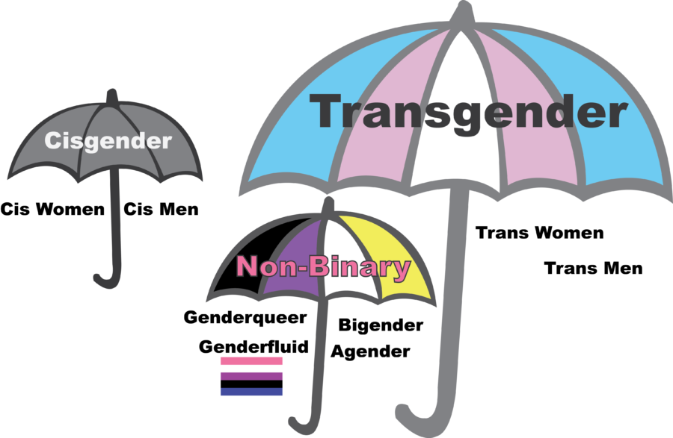
From “Gayta Science”

Slide 13
Notes:
Can be any gender, and expression can be any of these, regardless of your identity.
Remember that across cultures, feminine and masculine gender expression can look very different. In some Pacific Islander cultures, it’s common for masculine-presenting people to wear skirts because of the heat. In the U.S., wearing a skirt is considered a feminine way to present.

Slide 14
IMPORTANT: Sex Assigned at Birth (SAAB) is NOT “biological” or “inherent” sex. People are assigned sex based loosely on visible external genitalia and sometimes on chromosomes, though neither of those are conclusive or binary.
Some people are born with chromosomal variations besides XX and XY.
Some people have external genitalia that don’t ”match” the criteria for “female” or “male” sex assigned at birth.

Slide 15
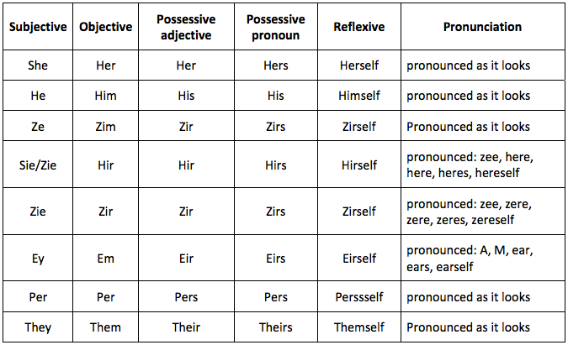
Pronouns
Notes:
http://thebodyisnotanapology.com/magazine/pronoun-round-etiquette/
1. Indifference to pronouns: “I don’t care what pronouns you use for me.”
2. Minimizing the issue: “Why is this important?”
3. Terminology issues: “Male pronouns” and “Female pronouns”
4. Unequal treatment: The concept of “preferred pronouns”
5. Being unaware of privilege: “Am I not allowed to experiment with pronouns?”

Slide 17
Some vocabulary around sexual orientation include…
Asexual: a person of any gender not sexually attracted to people of any gender
Bisexual: a person of any gender attracted to people of various genders
Gay: a man who is sexually attracted to men; also an umbrella term sometimes used for LGBQ people
Heterosexual: someone who is sexually attracted only to people of a different gender identity from their own
Lesbian: a woman who is sexually attracted to women
Pansexual: a person of any gender attracted to people of any gender
Queer: an umbrella term used to describe people of any gender who are not heterosexual

Slide 18
Aromantic: a person of any gender not romantically or emotionally attracted to people of any gender
Notes:
Applies to all of us! A good accessible point for all people.

Slide 19
**
**
**sex assigned at birth is constructed, not inherent.

Slide 20
Take-Aways on the Gender Unicorn
Sex assigned at birth, gender identity, gender expression, and sexual orientation are different, and don’t determine each other
There is a multiplicity of sex, gender identities, sexual orientations, and gender expressions
We all have gender identity and sexual orientation, not just LGBTQ people

Slide 21
Stretch Break!
One minute

Slide 22
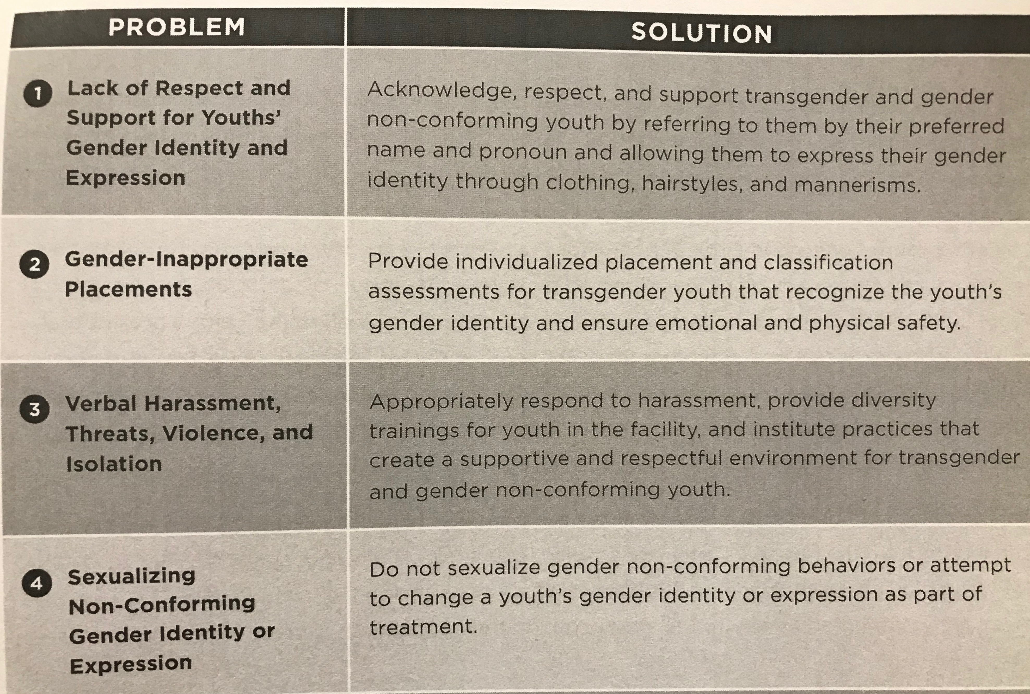
A Place of Respect by Jody Marksamer from the National Center for Lesbian Rights

Slide 23
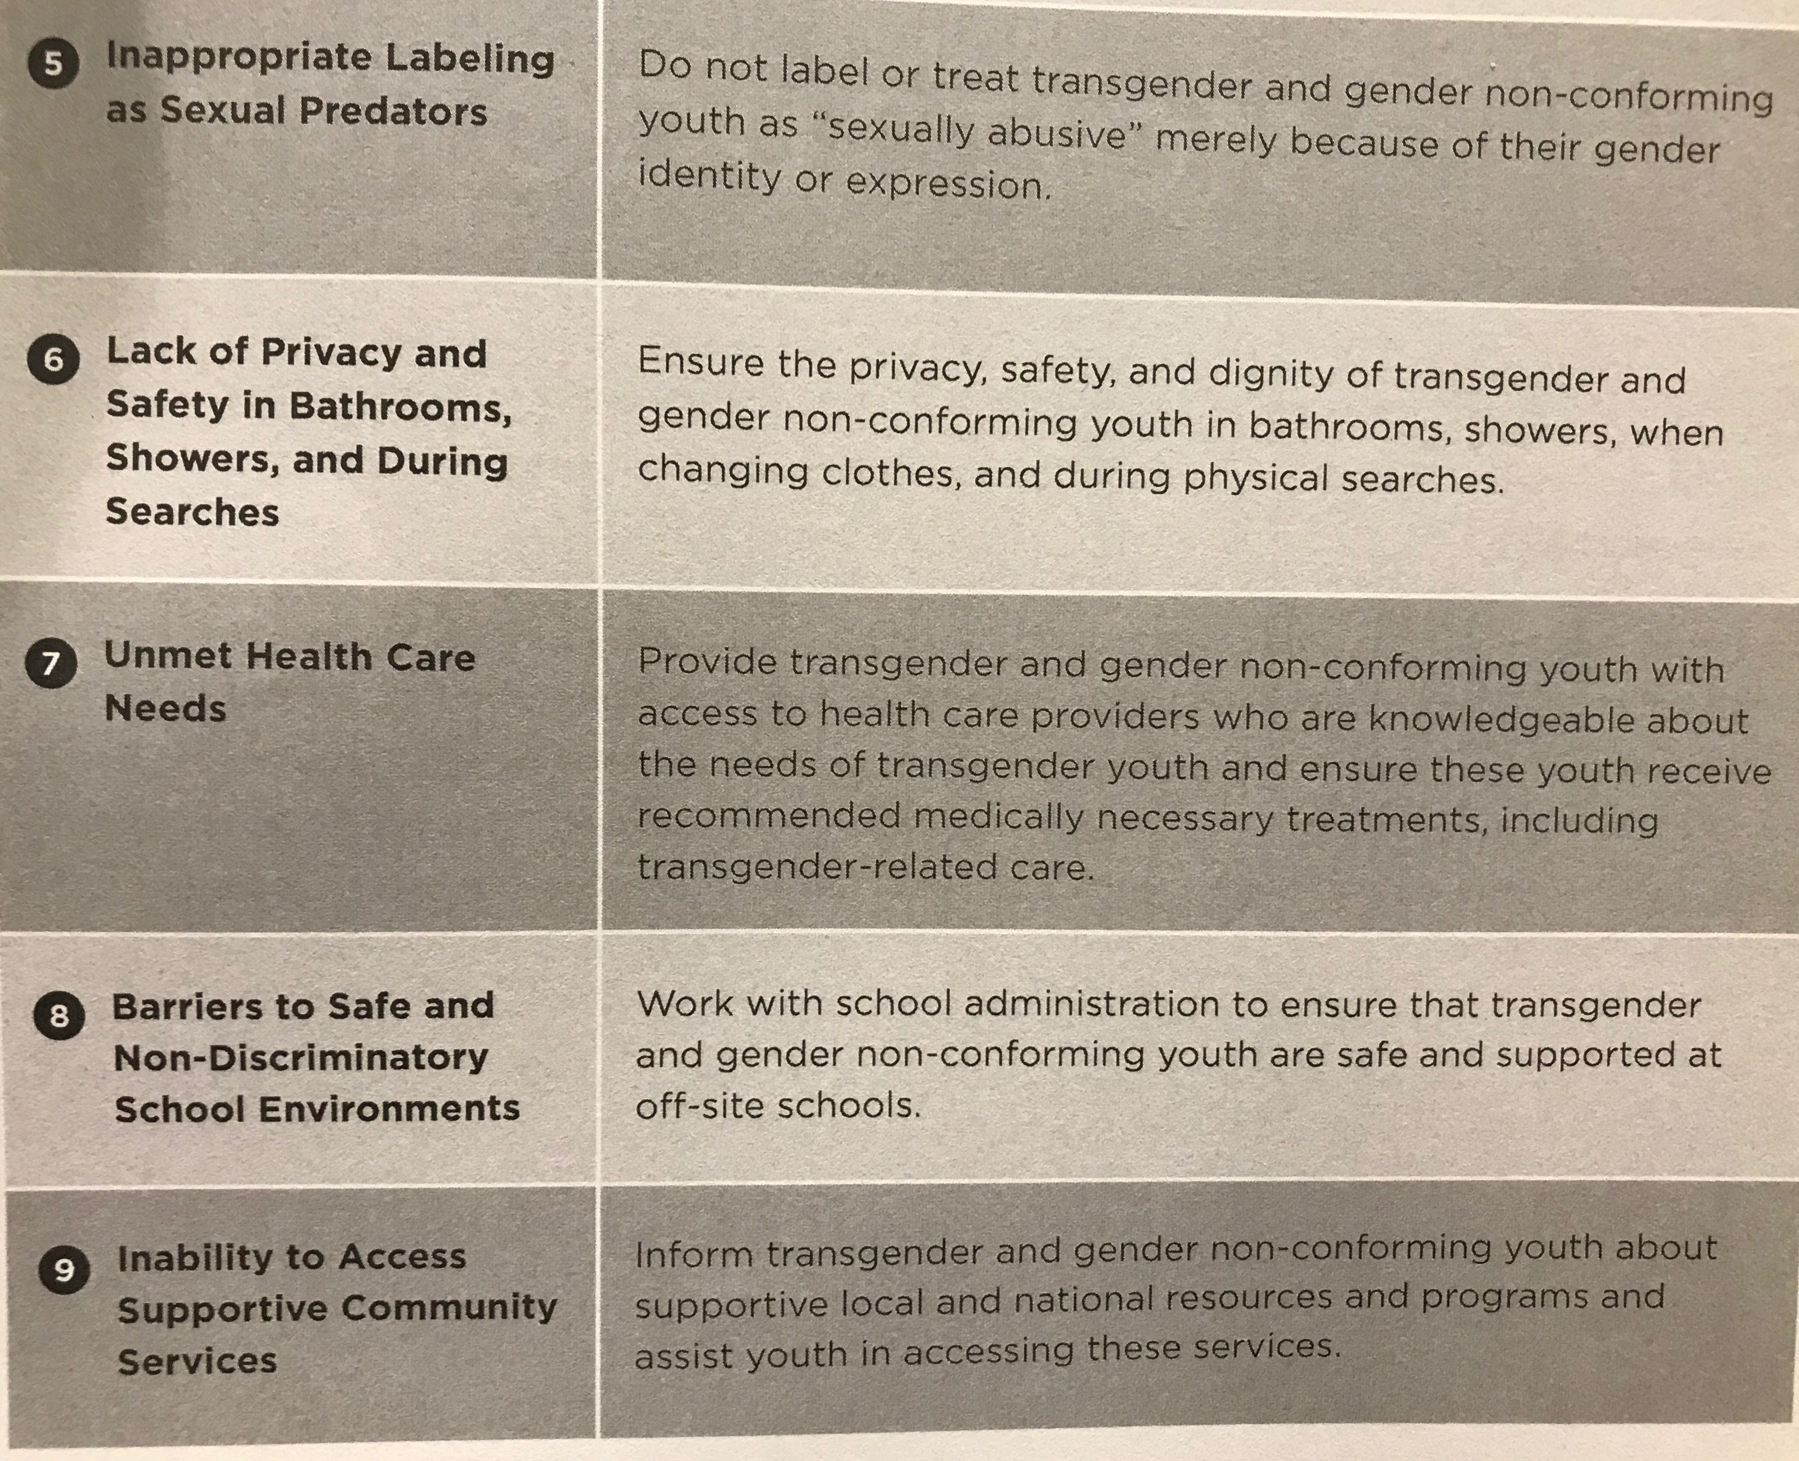

Slide 24
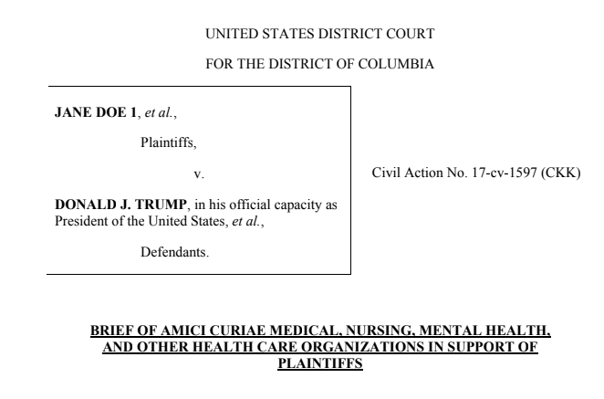
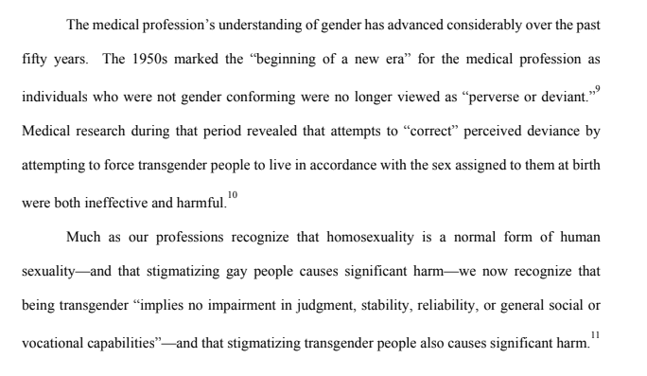
Emphasis on Trans Inclusion & Safety
Gender is something that each of us have, like eye color or height
Gender is something prescribed to us
Gender dysphoria is not gender identity.
Trans identity is healthy, just like cis identity
Notes:
Unfortunately, stereotypes do exist that trans identity is somehow pathological. As we saw on the Gender Unicorn, people are assigned gender at birth based on things like chromosomes and external genitalia. People are then treated socially like the gender marker that appears on a person’s birth certificate.
There is a phenomenon called “gender dysphoria,” which is a sense of deep discomfort and anxiety around a person’s gender identity and its mismatch with gender expression or perceived gender.
Every major psychological and medical association affirms that trans identity is valid and healthy and does not involve any pathology.
What we do see is that trans people, along with lesbian, gay, bisexual, and other queer people, do experience mental distress and homelessness at higher rates than cisgender, heterosexual people. This is not because trans and queer identities are unhealthy but because trans and queer people experience higher rates of bullying, abuse, harassment, and ostracism, inadequate medical support, inappropriate support services, and very little protection against discrimination by employers. Under these circumstances,

Slide 25
Principles
LGBTQ persons are entitled to equitable services and resources
Understanding LGBTQ persons is a core competency for anyone working with them in a caregiving, professional, or volunteer capacity
LGBTQ persons are the experts of their own lives

Slide 26
Policies
Let people identify themselves as LGBTQ without attempts to change their identity
Uphold the right of LGBTQ persons to access equitable services, care, and treatment so that they enjoy the same quality of life as cisgender, heterosexual counterparts
Allow LGBTQ persons to dress consistently with their gender identity
Adapted from the Center for Children & Youth Justice eQuality Project. Oakley, Nicholas, JD

Slide 27
Policies, continued…
Acknowledge and respect LGBTQ persons to designate the appropriate name for themselves, and refer to them by that name
Acknowledge, respect, and use the pronouns that someone deems appropriate for themselves
Allow LGBTQ persons to not disclose
Allow LGBTQ persons to use appropriate facilities, including sex-segregated facilities like bathrooms and locker rooms, consistent with their gender identity

Slide 28
Ophelia Hu Kinney
ophelia@rmnetwork.org
Communications Specialist
Reconciling Ministries Network
Next, Mary Bonauto from GLAD (Gay & Lesbian Advocates & Defenders)

