Slide 1
Introduction to SOAR
Applying for Social Security Disability and SSI

Slide 2
Two Types of Benefit
SSI | SSDI
Stands for Supplemental Security Income Needs-based eligibility Federal Benefit Rate (FBR) in 2019: $771 monthly Recipients eligible for Medicaid | Stands for Social Security Disability Insurance Eligibility based on amount paid into Social Security from earnings Recipients eligible for Medicare after 2 years

Slide 3
Definition of Disability
According to the Social Security Administration (SSA), an individual is considered to be disabled if:
Their mental and/or physical impairments can be determined by a medical professional
The impairment can be expected to last at least 12 months or end in death
They are unable to achieve substantial gainful activity (SGA) because of the impairment

Slide 4
Substantial Gainful Activity
2018 SGA: $1,180 2019 SGA: $1,220

Slide 5
What Makes a Successful Application?
SSA and Disability Determination Services (DDS) need to see a clear connection between the applicant’s disability and how it relates to functioning.
4 Categories of Mental Functioning
1. Understand, remember, or apply information
2. Interact with others
3. Concentrate, persist, or maintain pace
4. Adapt or manage oneself

Slide 6
SSI/SSDI Eligibility SSA’s Definition of Disability
Medical Condition(s) cause
Functional Impairment(s)
Diagnosis
Documentation
Duration
Severity
Work
SGA

Slide 7
What is SOAR?
A model for assisting eligible individuals to apply for Social Security Disability Insurance(SSDI) and/or Supplemental Security Income (SSI)
For individuals who are experiencing homelessness or are at risk of homelessness and have a serious mental illness, co-occurring substance use disorder, or other disabilities
All 50 states and the District of Columbia currently participate

Slide 8
Why SOAR?
28 percent of applications are approved the first time for the general population
For individuals experiencing or at risk of homelessness, the percentage is less than half of that
Applying the SOAR model has resulted in an approval rate of 64 percent in an average of 96 days (2017 stats)

Slide 9
Critical Components of SOAR
Serving as the applicant’s representative
Collecting and submitting medical records
Writing and submitting a Medical Summary Report (MSR)
Obtaining a co-signature on the MSR by an acceptable medical source
Completing a quality review of applications prior to submission

Slide 10
What is the Medical Summary Report?
SOAR’s signature tool and key to a successful application
Provides a succinct, comprehensive summary of the applicant’s personal and treatment history and its impact on his or her life
Clearly describes the factors affecting functioning and ability to work
Critical to a faster decision

Slide 11
The Sobriety Myth: Understanding Substance Use Disorder & SSA Benefits
Myth: clients must be in recovery to be found eligible
Fact: the issue is whether or not substance use is material to the disability
Test: would the applicant still be disabled without the substance use disorder?
If yes, then the applicant is potentially eligible for benefits
If no, then substance use is material and the person would not be eligible
Substance use can lead to potentially disabling conditions (cirrhosis, damage to other organs, brain injury) which would continue to exist whether the client continued the substance use or not. With these conditions, substance use is not material to the disability.

Slide 12
The SOAR process in Maine
All 9 SSA offices in Maine expedite claims that are properly filed using the SOAR model
SOAR providers have designated SSA contacts in each office to communicate with about claims
SSA and DDS are supportive of the initiative
The State Team Lead and SOAR Technical Assistance Liaison provide support to case managers utilizing SOAR

Slide 13
How Do States & Communities Benefit?
SSI/SSDI and Medicaid/Medicare bring federal dollars into states, localities and community programs:
Health providers can recoup the cost of uncompensated care
States and localities can recoup the cost of public assistance
Cash benefits and back payments received by individuals are spent in the local community (2017: $356 million)

Slide 14
How Do States & Communities Benefit?
Cost Savings for State/Local Government: Reimbursement of general assistance spending (average $3,562 per eligible beneficiary) Reduced shelter stays | Cost Savings for Hospitals: Average Medicaid reimbursement in 2017 was $5,929 per eligible beneficiary | Increased Income for Individuals Monthly SSI/SSDI income supports housing goals Using a non-attorney representative (SOAR provider) allows individual to keep all back pay (average $5,520 in 2017)

Slide 15
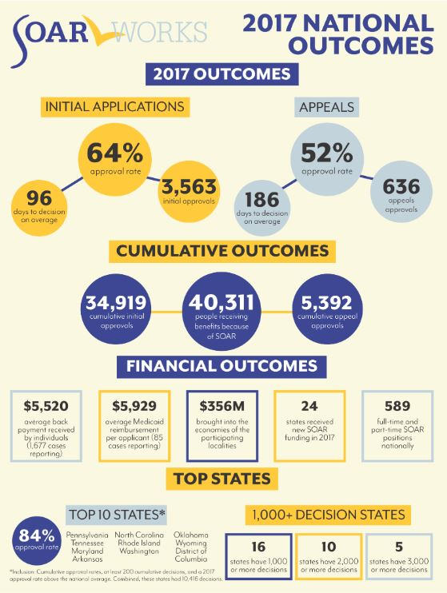
SOAR Works!

Slide 16
Benefits of the SOAR Online Course
Standardized training across all geographic areas
Allows SOAR Leaders to coordinate follow-up training and support
20 NASW CEUs
FREE and all online – work at your own pace
Can be self-guided or part of a cohort for support

Slide 17
Next Steps
Learn more about SOAR
Contact your SOAR State Team Lead (pro tem): Kristin Lupfer
Email: klupfer@prainc.com
Phone: (518) 439-7415 x5262
Register for the SOAR Online Course

