Slide 1
Maine CoC Coordinated Entry
Introductory Training For CoC, ESG, and other CE participating projects

Slide 2
What is Coordinated Entry
An approach to the coordination and management of a crisis response system’s resources that allows users to make consistent decisions from available information to efficiently and effectively connect people to interventions that will rapidly end their homelessness. *
*HUD Coordinated Entry Core Elements Handbook

Slide 3
What is Coordinated Entry
Access: Engaging individuals experiencing housing crisis, assessing emergency needs and triage to emergency shelter services when necessary.
Assessment: Uniform, person centered assessment of individuals vulnerability and needs.
Prioritization: Determining an individuals priority for housing and supportive services.
Housing Intervention and Referral: Connecting individuals to the housing intervention best suited to resolve their housing crisis and consistent with community prioritization goals

Slide 4
Why Coordinated Entry
HUD requires that CoC’s establish and operate a coordinated entry process and that CoC and ESG funded projects participate in that process
Efficient use of limited resources
Strong community collaboration
End current homelessness and ensure that future homelessness is rare, brief, and non-recurring

Slide 5
Coordinated Entry in Maine
Oct 2015 – MCoC/PCoC Publish CE Written Standards
May 2017: Region 3 Pilot rolled out using SocialServ software to facilitate access and triage referrals
Limited ability to utilize CE data
Not compatible with HMIS
Increased price point
November 2017: Switch to HMIS to facilitate Access and triage referrals
January 2018: MCoC Implementation Committee established to finalize Policy and Procedures and fine tune HMIS work flows

Slide 6
CE Working for the MCoC Veteran Committee
1.Access & Engagement
Outreach
Self referral
COC Coordinate Entry
HMIS Data Sharing
Community Provider Engagement
2. Assessment
Address immediate needs
UCAP
VI-SPDAT
Interim Housing Plan
3. Housing Intervention
Prioritization based on Vulnerability
Meets client need using progressive engagement
Consistent with client choice
Flexible based on history and experience
4. Housing Placement
By Name List Updates
Case Consultation
Review Referrals
Progressive Engagement Referrals
Collaborate on difficult cases

Slide 7
CE Working for the MCoC Veteran Committee
Prior to Coordinated Entry:
Veterans completing intakes and screenings multiple times and regular movement between programs
Veterans receiving duplicative services from more than one program at a time
All programs serving veterans of varying vulnerability
Under/over utilized programs
Limited communication between programs

Slide 8
CE Working for the MCoC Veteran Committee
What was implemented:
Universal Coordinated Assessment
Each veteran provider asks the same questions when first meeting a veteran
Vulnerability Index tool, VI-SPDAT) uses evidenced based practice to identify those with the greatest risk
Each veteran provider designated to work with veterans with specific vulnerability index
Referrals to appropriate program made immediately at time of screening

Slide 9
CE Working for the MCoC Veteran Committee
Post Coordinated Entry
Veterans no longer bouncing between programs
Veteran providers meet weekly to discuss new or difficult cases
Most vulnerable veterans have quick access to Permanent Supported Housing Programs
Less vulnerable veterans have quick access to Rapid Re-Housing Programs
Transitional housing available with limited waitlists

Slide 10
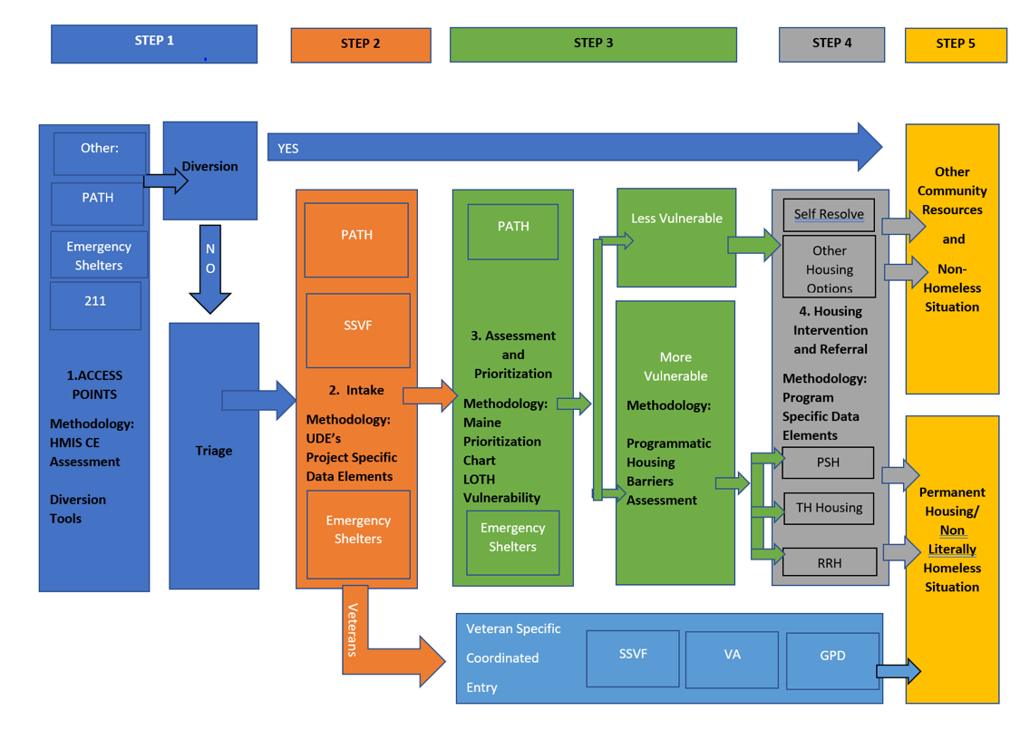
The MCoC CE 5 Step Process

Slide 11
Step 1: ACCESS
Access Points: Individuals experiencing homelessness, or who are at risk of homelessness, can easily access the MCoC CES by calling 211, showing up at their local Emergency Shelter, or engaging with a PATH or other local outreach provider .

Slide 12
ACCESS: Core Elements
Diversion: Diversion is itself an important part of coordinated entry, helping potential program participants to explore all safe and appropriate alternative housing options and only enroll in crisis housing projects such as emergency shelter after all other alternatives have been exhausted.
Triage: Individuals unable to be diverted will be referred to an appropriate emergency services include their local General Assistance office, Emergency Shelters and Outreach providers.

Slide 13
ACCESS: Tools
CES Initial Triage and Diversion Assessment: Assessment built in Service Point will be utilized by CES Access points including 211, Emergency Shelters, PATH and others as applicable.
CES Triage Referral Module: Will be utilized by 211 for clients unable to be diverted. Will also available to Emergency Shelter and Outreach projects if needed.
Referrals will be made to Emergency Shelters, Outreach Projects including PATH and SSVF and be based on clients geographical location, household composition, age, gender and veteran status.
211 will facilitate referrals via warm hand-off phone call and HMIS generated email

Slide 14
ACCESS Procedure: Via 211
If an individual accesses CES via 211 Maine, the caller will be asked a series of question utilizing the standardized CES Initial Triage and Diversion Assessment in HMIS .
Individuals identified as literally homeless and/or individuals whose needs cannot be met through the Diversion Assessment, will be referred to the appropriate emergency shelter based on household composition, age, gender and geographic preference.
The referral will be facilitated via a warm hand-off telephone call to the shelter and client information will be directly entered into HMIS by 211 via the Coordinated Entry Initial Triage and Diversion Assessment.

Slide 15
ACCESS Procedure: Via 211
When referral to Emergency Shelter is not accepted by the individual, the individual will be offered a Services Only referral to a PATH or SSVF (veterans only) provider. The referral will be facilitated via a warm hand-off telephone call, and an email that will be generated in HMIS.
All individuals who access the Coordinated Entry System will receive additional referrals to General Assistance and 2-1-1 to maximize client choice.
All diversion and homeless prevention referrals will be processed by 211 Maine utilizing their internal system for tracking and reporting .

Slide 16
ACCESS: Individuals Fleeing DV
Prior to accessing the Coordinated Entry Triage and Diversion Assessment questionin HMIS, 211 will determine if a caller is fleeing a domestic violence (DV) situation and in need of DV specific resources. Callers needing this service will be given the immediate option to be referred to the State’s DV crisis line and personal identifying information will not be collected or shared. No participant who is, or has been, a victim of domestic violence, dating violence, sexual assault or stalking will be denied access to the Coordinated Entry process.

Slide 17
ACCESS: Data Sharing Permissions
Individuals who do not identify as needing specific DV resources will be asked if they consent to the collecting and sharing of information via HMIS for the purposes of coordinating resources through the CES process . Individuals who do not consent to HMIS data sharing and collection will be referred to resources utilizing the 211 internal system and personal information will not be collected or shared using HMIS. Regardless, all individuals will have the same access to resources as individuals who elect to enter and share data .

Slide 18
ACCESS Procedure: Via Emergency Shelter, PATH Provider or other Outreach Provider
Individuals presenting directly at an emergency shelter, or with an outreach provider in the community, will be asked a series of triage and diversion questions utilizing the CES Initial Triage and Diversion Assessment with data collection occurring in HMIS. Individuals whose needs cannot be met through the Diversion Assessment will proceed directly to Step 2 of the CES, Intake .
In accordance with training, any person conducting the Initial Triage and Diversion Assessment will make every effort to understand the sensitivity of a client’s lived experiences in every aspect of the process to minimize risk and harm.

Slide 19
The MCoC CE 5 Step Process

Slide 20
Step 2: INTAKE Procedure
INTAKE: Once an individual has entered the CES, the Emergency Shelter, PATH, SSVF or other provider now connected with the individual will proceed with the specific project’s intake procedure. Project Specific Data Elements and Universal Data Elements will be entered in HMIS is accordance with MCoC Data Standards.
Veterans Procedure: SSVF or other Veteran providers engaged with veterans will proceed with the Veteran Specific Coordinated Entry System.

Slide 21
The MCoC CE 5 Step Process

Slide 22
Step 3: ASSESSMENT AND PRIORITIZATION (in development)
Assessment: Uniform, person centered assessment of individuals vulnerability and needs.

Slide 23
ASSESSMENT AND PRIORITIZATION: Tools (in development)
VI-SPDAT
Maine Ending Homelessness Prioritization Chart
Length of Time Homeless (LOTH)

Slide 24
ASSESSMENT AND PRIORITIZATION: Procedure (in development)
The provider will assess for vulnerability utilizing program specific vulnerability assessments as applicable, length of time homeless, and the Maine Prioritization Chart as the common assessment methodology used to screen any individual, family, or youth experiencing homelessness.
Individuals will be assessed as either Less Vulnerable or More Vulnerable

Slide 25
ASSESSMENT AND PRIORITIZATION: Procedure in development
Less Vulnerable - Individuals who are assessed as Less Vulnerable will proceed to step 4, Housing Intervention and Referral
More Vulnerable- Individuals who are assessed as More Vulnerable will be connected with program staff to complete a housing barriers assessment prior to proceeding to step 4 .

Slide 26
The MCoC CE 5 Step Process

Slide 27
Step 4: Housing Intervention and Referral(in development)
Housing Intervention and Referral: Connecting individuals to the housing intervention best suited to resolve their housing crisis and consistent with community prioritization goals

Slide 28
Housing Intervention and Referral: Less Vulnerable Procedure (in development)
Individuals identified as Less Vulnerable in Step 3 will be referred to other community resources if they cannot self-resolve their housing crisis with little to no assistance.

Slide 29
Housing Intervention and Referral: More Vulnerable Procedure (in development)
Program staff will connect individuals identified as More Vulnerable, during Step 3, to appropriate housing resources, including but not limited to
Permanent Supported Housing (PSH),
Transitional Housing (TH)
Rapid Re-Housing (RRH) projects.
Prioritization Standards for PH, TH, RRH and other housing interventions are outlined in Appendix E, Maine’s 2017 Ending Homelessness Prioritization Chart.

Slide 30
Housing Intervention and Referral: More Vulnerable Procedure (in development)
If a housing project accepts a referral and there is immediate availability, the client will be enrolled in the project and their Project Specific Data Elements will be entered into HMIS.
If a housing project accepts a referral, but it cannot be immediately accessed due to a lack of availability, due to project capacity or due to client’s choice to reject the referral, the client will be placed on appropriate waitlists as applicable.
Program staff will continue to work with clients to monitor waitlist activity and make connections with other community resources.

