Slide 1
Maine’s Coordinated Entry System (CES)

Slide 2
Messaging from The CoC Board
We believe homelessness is a community issue that requires a community response.
We believe that by working together we can improve the system and create a better experience for members in our community experiencing homelessness.
We believe that together we can combat homelessness and lead the state in Coordinated Entry.

Slide 3
Evolution of CES
HEARTH Act of 2009 establishes new system-wide performance measures for homeless Continuums of Care
2011 ESG program interim rule requires CoC to establish a CES
2013/2014 CES implementation included in CoC scoring criteria
2014-2015 HUD releases guidance on implementing a Coordinated Entry System (CES)
HUD releases the 2016 Prioritization Notice
Each CoC must establish its coordinated entry process by January 23, 2018.

Slide 4
Community Benefits
For those experiencing homelessness | For housing resource providers | For Public and Private Funders | For CoC or homeless system planners
Locate housing and/or services faster | avoid inappropriate or ineligible referrals for their projects; | be confident that housing and supportive services projects are serving the intended people (“side doors” to projects are closed); | identify areas for improvement and take action on better outcomes specific to McKinney-Vento Act system performance measures;
be referred only to projects that they are likely eligible for; | better manage prospective project participants through a centralized prioritization list; and | see increased compliance with eligibility requirements; | comply with CoC Program and ESG Program requirements;
get access to programs once referred; and | comply with CoC Program and ESG Program requirements | have access to better data for system and project planning; and | improve fair access and ease of access to resources, including mainstream resources (mainstream housing and service providers include public housing
appeal rejections by projects through a transparent procedure.
 |  | experience improved reporting | improve data for system and project planning and resource allocation to facilitate system change; and ‒‒ standardize understanding of who will be served, which will help system andproject monitoring.

Slide 5
1. Access
Full Coverage P & P R
Street Outreach
Emergency Services
Standardized access and Assessment: 24/7 Access P & P
Marketing and Non-Discriminatory Access P & P
Safety Planning P & P
Privacy P & P
Accessibility to local subpopulations
Physical Accessibility
Connection to Mainstream Resources
Understanding the Needs of The Person Not Served

Slide 6
1. Access
Why 2-1-1?
2-1-1 is an existing statewide system
2-1-1 is a free, confidential information and referral service that connects people of all ages across Maine to local services.
2-1-1 Maine is based in Maine and available 24 hours a day, seven days a week.
2-1-1 call specialists are highly trained, helpful to callers in need, and know the resources available in Maine
2-1-1 Maine provided after hours coverage to Vermont 211, which included supporting callers experiencing a housing crisis
In addition to providing access to Coordinated Entry, 2-1-1 will also be able to identify additional resources to support the client and their needs beyond housing and shelter.
Individuals and families in need can reach 2-1-1 via phone, text, email, or by searching our online database.

Slide 7
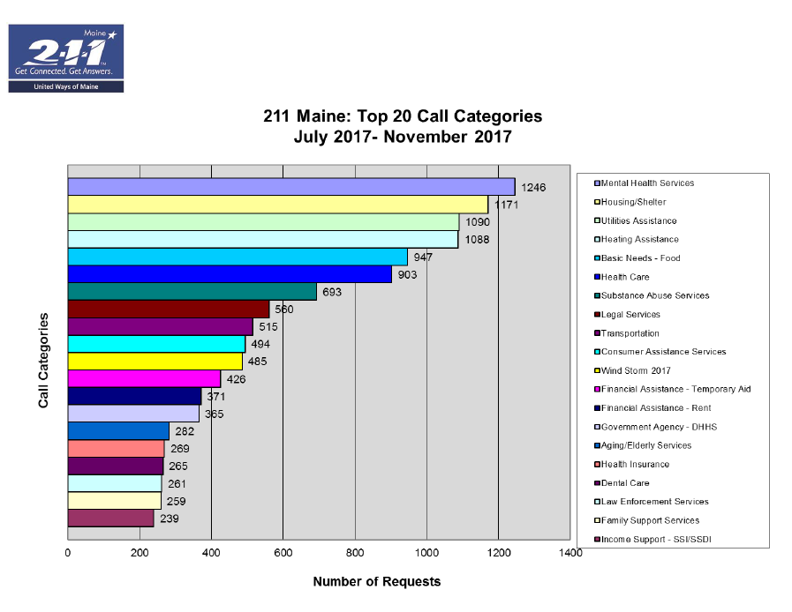

Slide 8
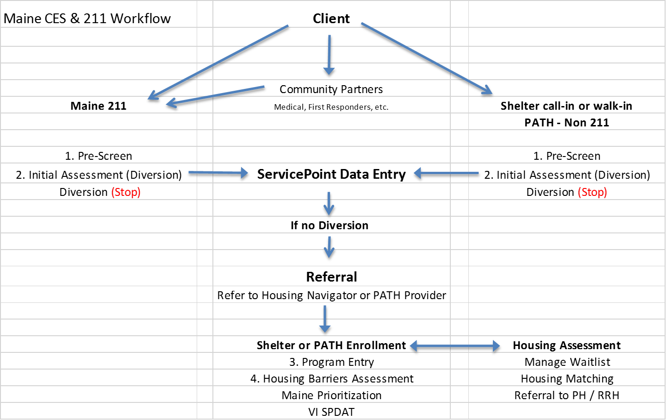
Maine CES & 211 Workflow

Slide 10
Eligibility Criteria
In Process! Example Only
Shelter requires/accepts Individuals and/or families who are:
Shelter: | Sobriety Required? | Must be able to Live Independently? | Must have stable Emotional/Mental Health (not in crisis)? | Accepts clients with open or outstanding warrants for arrest? | Accepts Sex Offenders? | Accepts Emancipated HOH under 18? | Accepts Felony Convictions? | Resideny Restrictions? | Accepts single males | Accepts Single Females | Accepts Households with children | Accepts Youth | Continuous Residency? (No unauthorized overnights) | Peronal Transportation Required?
Rumford Group Homes | √ | √ | √ |  |  |  |  | √ |  | √ | √ |  | √
PCHC Hope House |  |  |  | √ | √ | NA | √ |  | √ | √
HOME Inc. (Inc. Emmaus) | √ | √ |  | √ |  | √ |  |  | √ | √ | √ |  | √
Bread of Life | √ | √ | √ | √ |  | √ | √ |  | √ | √ | √ |  | √
Bangor Area Homeless Shelter |  | √ |  | √ | √ | NA | √ |  | √ | √
York County Shelter Programs Inc. | √ | √ | √ | √ |  | √ | √ | √ | √ | √ | √ |  | √
Western Maine Homeless outreach | √ | √ |  | √ |  | √ | √ |  | √ | √ | √ |  | √
Homeless Services of Aroostook | √ | √ |  |  |  | √ |  |  | √ | √ | √ |  | √
Knox County Homeless Coalition | √ | √ | √ | √ |  | √ | √ |  | √ | √ | √ |  | √
Shaw House | √ | √ | √ | √ | √ | √ | √ |  |  |  |  | √
RCAM | √ | √ | √ |  |  | √ | √ |  |  |  | √ |  | √ | √
Tedford | √ | √ | √ | √ |  | √ | √ |  | √ | √ | √ |  | √
Preble St Florence House |  |  |  | √ | √ | NA | √ |  |  | √
Joe Kresler |  |  | √ | √ |  | NA | √ |  |  |  |  | √
City of Portland Oxford |  |  |  | √ |  | NA | √ |  | √ | √
City of Portland Family | √ | √ | √ | √ |  | √ | √ |  |  |  | √ |  | √
Milestone |  |  |  | √ | √ | NA | √ |  | √
New Beginnings | √ | √ | √ | √ |  | √ | √ |  |  |  |  | √ | √
Mid Maine Homeless Shelter | √ | √ | √ | √ |  | √ | √ |  | √ | √ | √ |  | √

Slide 11
Common Assessment Tool
Preferred Method
VI-SPDAT is our common assessment tool
Endorsed by the CoC and a results based model
We have all of the VI/F/TAY tools you could possibly have
If you don’t agree with the VI score – provide supporting documentation
The VI-SPDAT is the entry point to the by-name-lists
When do we use it?
Generally between 14 – 30 days into shelter stay
Immediately if unsheltered (PATH)

Slide 12
Will be updated for 2017

Slide 13
2. Phased Assessment
Assessment Requirements P & P R
Additional Consideration to Requirements
Provider Concerns
The Right Amount of Information
Combining Assessment and Eligibility Determination

Slide 14
3. Prioritization
Prioritization Requirements P & P R
Determining a level
Managing the Priority List
Using the List to fill vacancies

Slide 15
Prioritization
HUD has determined that an effective coordinated entry process ensures that people with the greatest needs receive priority for any type of housing and homeless assistance available in the CoC, including PSH, Rapid Rehousing (RRH), and other interventions.

Slide 16
HUD Prioritization for PSH Beds
Chronically homeless* households “Chronic= LOT/ episode & with a disability”
HH w/ a disability* & long periods of episodic* homelessness & severe service needs*
HH w/ a disability & no service needs
HH w a disability from TH
SINGLE PRIORITIZED LIST & NOT BASED ON DISABILITY TYPE BUT ON SEVERITY OF NEED

Slide 17
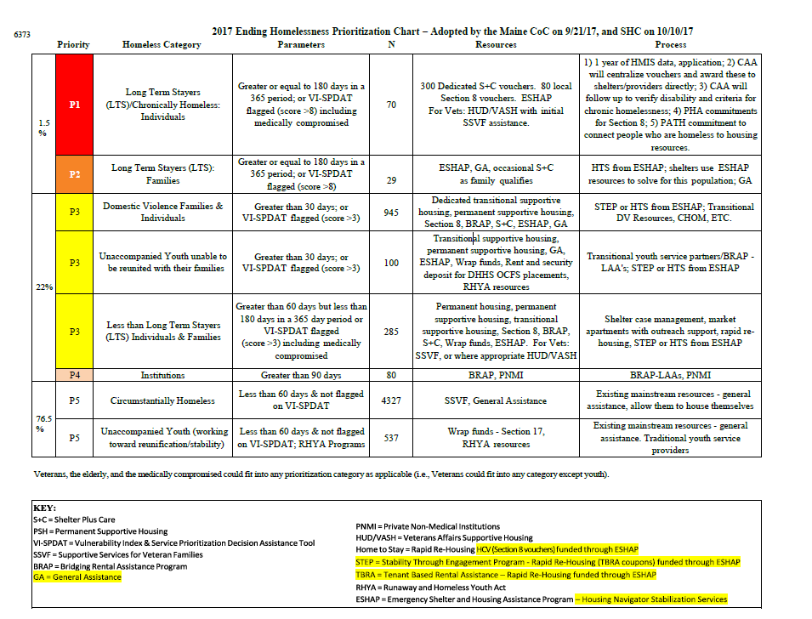

Slide 18
4. Housing Referral & Follow up
Referral Requirements P & P R
Eligibility Screening and determination
Participating Project List
Referral Rejection Protocols
Data Management and Efficiency Tracking
"Warm Handoff" Referrals
Considerations for Subpopulation
Lack of housing or Services Concerns
Preference and Circumstance Based Incompatibilities

Slide 19
Key Reference Documents
Questions?
CoC Program interim rule
Coordinated Entry Notice
Coordinated Entry Policy Brief
ESG Program interim rule
2014 Prioritization Notice / 2016 Prioritization Notice
Assessment Tools (Expert Convening's Report)
Contacts:
Cindy Namer cnamer@mainehousing.org
Leah Bruns lbruns@mainehousing.org

