Slide 1
Maine Bureau of Veterans’ Services
Ending Veteran Homelessness in ME
Adria Horn
Director, BVS
October 25, 2016

Slide 2
Purpose
The purpose of this briefing is to provide a situational update on the current state of veteran homelessness activities in the State of Maine. This briefing is a fundamental basis to inform strategic planning efforts across the full spectrum of stakeholders and partners throughout the State.
Ending veteran homelessness requires assistance by everyone participating and not participating in the Continuums of Care.

Slide 3
CoCs, Stakeholders & Partners
Maine State Housing Authority
Bureau of Veterans’ Services
Veterans’ Administration
Housing & Urban Development
Volunteers of America
Preble Street Shelter
Bread of Life Ministries
Veterans’ Inc (SSVF)
Easter Seals (HVRP)
Catholic Charities (PIT)
Community Housing of Maine
Veterans of Foreign Wars
American Legion
Disabled American Veterans
AMVETs
ME Department of Labor
Garry Owen House
Elks
Betsy Ann Ross House of Hope
ME Veterans Project
United Veterans of Maine
United Veteran Farmers of Maine
State of Maine (DOL/DHHS/BMV/BVS/DOC)

Slide 4
Stakeholders & Partners
Who else needs to be here?
Who else needs to know?

Slide 5
Specified Tasks
Develop strategic plan regarding homelessness among veterans.
1) Develop a baseline for homeless in the State from which improvements can be measured. In determining the baseline, the SHC is not required to use the federal definition of homelessness and may include levels of housing instability or ranges of homelessness.
2) Develops a method of measuring homelessness among veterans in the State to demonstrated whether efforts to reduce the number of homeless veterans in the State have been successful
3) Identifies specific processes for improving communication among agencies that provide services to veterans, including services unrelated to homelessness, that will facilitate identification of veterans in need of housing assistance or veterans who may be at risk of homelessness and maximize resources available to address homelessness among veterans
4) Develops a framework and timeline for determining progress of communication and coordination efforts targeting homelessness among veterans and the effectiveness of those efforts in reducing homelessness among veterans
Sec. B-4. 30-A MRSA Para 5048, sub para 9

Slide 6
Essential Tasks
The Director of the Maine Bureau of Veterans Services shall periodically report to the council regarding the progress of implementing the strategies described in this subsection. Beginning February 1, 2018, the Director shall report annually to the Joint Standing Committee of the Legislature having jurisdiction over veterans affairs on the implementation of the strategic plan. The report must include, but is not limited to, the effect of the strategic plan on homelessness among veterans based on the measurements required to be established by this subsection.
*By February 15, 2017, the SHC shall develop an initial Strategic Plan
*By March 1, 2017, the Director of the Maine Bureau of Veterans’ Services shall present the strategic plan [to the Legislature].
Sec. B-5/B-6. 30-A MRSA

Slide 7
Facts
Veteran Homelessness in Maine has decreased every year since 2012
Federal resources are tied to counts of LITERALLY homeless veterans
PIT Annual Survey only counts veterans who self-identify as veterans
Non-CoC Groups are not using HMIS or Coordinated Entry
Maine organizations getting federal grants to address veteran homeless:
Veterans Inc Easter Seals ME Preble Street Bread of Life Ministries VOA
6) State of Maine does not currently provide additional funding specifically for
Homeless veterans
7) There are limited family shelters in Maine
8) The are two CoCs in Maine and several organizations contributing to addressing
Veteran homelessness that are NOT in either CoC.
9) Portland CoC and MHVAC expects to submit a Mayor’s Challenge application to
the USICH in November 2016

Slide 8
Assumptions
Non CoC groups and stakeholders can participate in HMIS and Coordinated Entry
Ending veteran homelessness in Maine is possible
Community partnership is required to functionally end veteran homelessness
Landlords are not incentivized to participate in ending veteran homelessness
Families and female veterans are reluctant to engage in traditional homeless shelters
If a veteran is not literally homeless, there are no homeless resources available to him/her
Law enforcement, park rangers, and others are potential points of entry to identifying homeless veterans but not engaged enough

Slide 9
Veteran Statistics
Maine | <20 | 20-24 | 25-29 | 30-34 | 35-39 | 40-44 | 45-49 | 50-54 | 55-59 | 60-64 | 65-69 | 70-74 | 75-79 | 80-84 | 85+ | Grand Total
All | 33 | 1,395 | 3,437 | 4,592 | 5,368 | 6,904 | 8,653 | 11,785 | 12,536 | 12,536 | 19,854 | 12,571 | 9,361 | 9,121 | 9,086 | 127,234
Female | 7 | 175 | 475 | 692 | 825 | 936 | 1,054 | 1,458 | 1,358 | 933 | 600 | 432 | 224 | 378 | 524 | 10,071
Male | 27 | 1,220 | 2,962 | 3,901 | 4,543 | 5,968 | 7,599 | 10,328 | 11,178 | 11,604 | 19,254 | 12,139 | 9,137 | 8,742 | 8,562 | 117,163

Slide 10
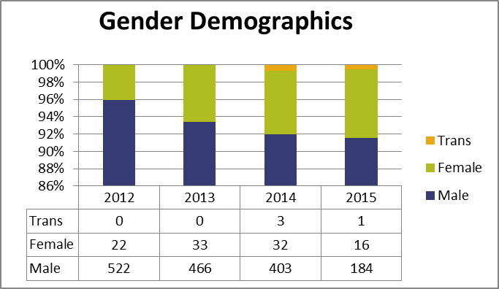
2015 Shelter Statistics
• 46% reduction in veteran homelessness in Maine from 2014 to 2015
• 90% of homeless veterans are found in Cumberland, Penobscot and Kennebec Counties of which Cumberland County represented 60% of this number
• 57% decrease in chronically homeless veterans
• 48% decrease in veterans with disabilities
Veteran numbers continued to drop in 2015 (46%). There were 201 homeless veterans accessing shelters in Maine. Both male and female veterans were down significantly.
Age Breakdown:
18-30: 10 (5%)
31-45: 53 (26%)
46-64: 129 (64%
65+: 10 (5%)

Slide 11
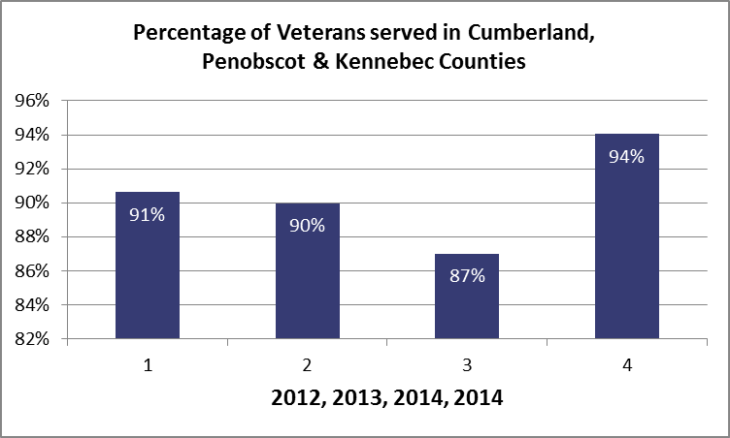
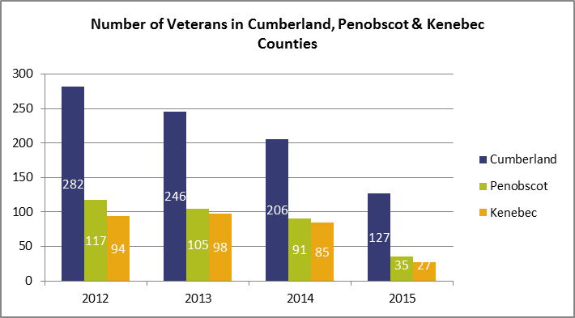
The vast majority of homeless veterans are located in Cumberland, Penobscot and Kennebec counties.
When broken down to unduplicated clients, Cumberland County is identified as having the majority of veterans amongst the top three counties (54%). This also represents a 27% decrease in homeless veterans in Cumberland County.

Slide 12
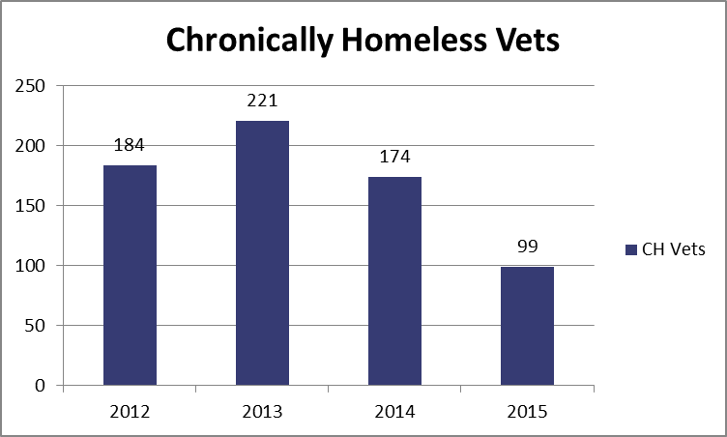
After a jump in Chronically Homeless veterans from 2012 to 2013, there is still a steady decrease in the number of chronically homeless veterans in Maine from 2014 and 2015. This progress is a direct correlation of veteran initiative programs such as Veterans Affairs Supportive Housing (VASH) and Supportive Services for Veterans Families (SSVF) which provide services to veterans, but also to the most chronic and vulnerable homeless veterans as a whole.

Slide 13
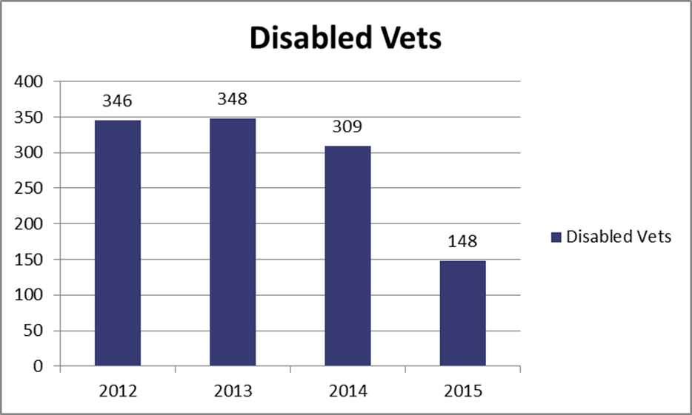
There was a 48% decrease in the number of disabled homeless veterans in Maine from 2014 to 2015. Again, this is likely a direct result of targeting services to both veterans and the most chronic and vulnerable homeless people in general.

Slide 14
Can you/will you come on October 25th to the Augusta Armory from 9 to 3pm for a strategic planning session?
Who else needs to be at that planning event?
What else does everyone need to know about ending veteran homelessness in Maine?
Please inform or correct information on these slides and send to adria.horn@maine.gov

