Slide 1
2016 Emergency Shelter & Housing Assistance Program
Information Meeting
October 20, 2015

Slide 2
Overview
Funding Components & Formula
Eligible Applicants
Eligible Activities
Program Requirements
Outcomes & Performance Measures
Application Process
Timeline

Slide 3
Funding Sources
Emergency Solutions Grant (ESG)
State General Fund
State HOME (Real Estate Transfer Tax)
Stability Through Engagement (STEP)
Housing Choice Vouchers (HCV)

Slide 4
Funding Components
Shelter Operating Share - assist agencies with the operational costs of emergency shelters that are fixed facilities.
Stabilization Share - assist with the staffing costs of emergency shelters and emergency homeless providers related to all the activities that contribute to clients obtaining and maintaining permanent housing.
Performance Share - compensate emergency shelter and emergency homeless providers based on outcomes and performance.
Rental Subsidies - first come first serve basis to program participants in the form of short-term and permanent rental subsidies.

Slide 5
Funding Allocation
Shelter Operating Share
40% of the Funding Formula Allocation
Emergency Shelters will receive a percentage equal to the Emergency Shelter’s Bed Capacity divided by a number equal to the total Bed Capacity available statewide for the calendar year.
Agencies will receive scheduled payments on a quarterly basis.

Slide 6
Funding Allocation
Stabilization Share
40% of the Funding Formula Allocation
Agencies providing staffing for LTS, Housing First, Rapid Re-housing and/or Housing Stabilization services operated by the agency will be eligible to receive a percentage equal to the agency’s number of Clients Assessed and Stabilized, divided by the total number of Clients Assessed and Stabilized statewide in the previous quarter.
Agencies are reimbursed on a quarterly basis.

Slide 7
Funding Allocation
Performance Share
20% of the Funding Formula Allocation
Percentage of funding for each performance measure that they meet.
Percentage of funding a provider receives for each performance measure met will be equal to the number of clients served by the provider divided by the total number of clients served by all of the providers that meet the respective performance measures.
Agencies will receive a performance based payment on a semi-annual basis.

Slide 8
The chart below illustrates how $60,000 would be distributed among 4 hypothetical shelters serving the number of clients and meeting program outcomes or performance measures as outlined below
 |  |  | $20,000 |  |  | $20,000 |  |  | $20,000 | $60,000
Shelter | # Clients Served | % Clients | Program Outcome or Performance Measure #1 | # Clients Served | % Clients | Program Outcome or Performance Measure #2 | # Clients Served | % Clients | Program Outcome or Performance Measure #3
ABC | 50 | 5.88% | $1,176 | 50 | 6.67% | $1,333 | 50 | 33.33% | $6,667 | $9,176
LMN | 500 | 58.82% | $11,765 | 500 | 66.67% | $13,333 | 0 | 0.00% | $0 | $25,098
EFG | 100 | 11.76% | $2,353 | 0 | 0.00% | $0 | 100 | 66.67% | $13,333 | $15,686
XYZ | 200 | 23.53% | $4,706 | 200 | 26.67% | $5,333 | 0 | 0.00% | $0 | $10,039
 | 850 | 100.00% | $20,000 | 750 | 100.00% | $20,000 | 150 | 100.00% | $20,000 | $60,000

Slide 9
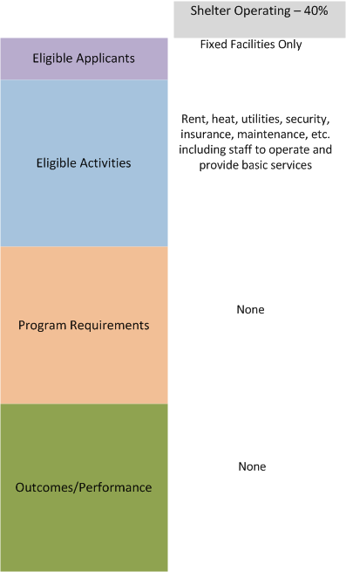

Slide 10
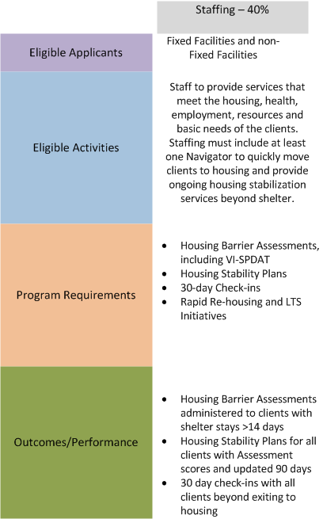

Slide 11
Staffing & Navigator Services
At least one staff (or portion of staff) designated and trained to complete navigator services.
Navigator services include activities that help program participants to move from homelessness to appropriate housing opportunities quickly and efficiently while providing ongoing housing stabilization services for up to 12 months based on their individual needs
Specific knowledge and training on how to access STEP and HCV rental subsidies for clients.
Staffing & Navigators services include, but are not limited to; conducting comprehensive assessments of clients, identifying and prioritizing housing needs, creating housing stability plans, linkages with income and employment resources, assistance with basic needs assisting with housing search and placement, and following clients beyond shelter to ensure housing stability.

Slide 12
Staffing & Navigator Services
Assist clients to apply, search and secure appropriate rental housing.
Assist clients to select permanent housing options based upon their unique needs, preferences and financial resources.
Recruit landlords that will provide housing opportunities for people experiencing homelessness.
Address potential barriers to client or landlord participation such as the type of rental assistance or tenant qualifications.

Slide 13
Staffing & Navigator Services
Develop Housing Stabilization Plans and make appropriate and time-limited services available to allow participants to stabilize in permanent housing.
Assist participants in addressing issues that may impede access to housing (budgeting, credit history, legal issues, etc.).
Connect participants to resources to help them to achieve success in their Housing Stability Plans.
Monitor participants’ progress implementing their Housing Stability Plans.

Slide 14
Program Requirements Housing Barrier Assessments
Determine eligibility of clients who are homeless for greater than 14 days.
Administer a Housing Barrier Assessment which includes the Vulnerability Index-Service Prioritization and Decision Assistance Tool (VI-SPDAT) to determine resources and tailor appropriate services.
Three separate versions of VI-SPDAT; Single, Family or Teen

Slide 15
VI-SPDAT Example
Approximately 15 minutes to administer
120 clients per year; 97% > 14 Days
116 @ 15 min = 29 staff hrs
29 staff hrs/52 weeks = .6 hrs per week
2,200 clients per year; 50% > 14 Days
1,100 clients @ 15 min = 275 staff hrs
275 staff hrs/52 weeks = 5.3 hrs per week

Slide 16
Program Requirements Housing Stability Plans
Develop Housing Stability Plans for clients with VI-SPDAT scores greater than 3.
Assist participants in addressing issues that may impede access to housing (budgeting, credit history, legal issues, etc.).
Connect participants to resources to help them succeed in their Housing Stability Plans.
Monitor participants’ progress implementing their Housing Stability Plans, updated 90 days.

Slide 17
Program Requirements Follow-up beyond shelter
Assess, arrange, coordinate, and monitor the delivery of individualized services with check-ins at least once every 30 days.
Continue to assist clients up to 12 months during the period the program participant is living in permanent housing.
Provide these services for ALL types of housing exits, regardless of subsidy.

Slide 18
Stabilization Share Program Outcomes Matrix
Program Outcomes | Benchmark for Funding
Housing Barrier Assessment, including VI SPDAT | 100% of clients assessed with shelter stays greater than 14 days
Housing Stability Plans | 100% for all clients with Assessment scores greater than 3
30 Day Check-ins and Follow-up beyond shelter | 100% 30 day check-ins with all clients, including beyond exiting to housing

Slide 19
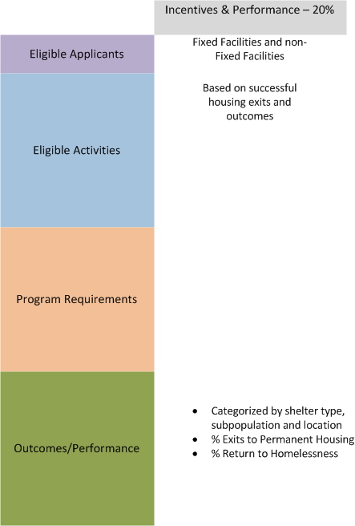

Slide 20
Performance Measures Matrix for the Performance Share
Performance Measures | Low Barrier Shelter Benchmark | Single Adult Shelter Benchmark | Family Shelter Benchmark | Teen Shelter Benchmark | Domestic Violence Shelter Benchmark
Average rate of households exiting to Permanent Housing. | 5% - 20% | 30% or greater | 30% or greater | 30% or greater | 30% or greater
Return to Homelessness within 6 months for those who previously exited to Permanent Housing. | 15% or less | 15% or less | 15% or less | 15% or less | 15% or less

Slide 21
Reporting
Collect data in HMIS (or comparable database for DV providers)
Check monthly data quality reports
Submit quarterly Certification Reports for funding…..
Program Outcomes
Performance Measures
Maintain client files for ESG monitoring requirements

Slide 22
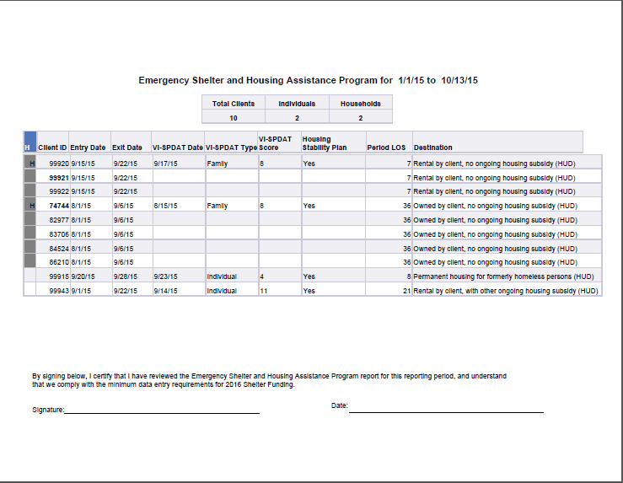

Slide 23
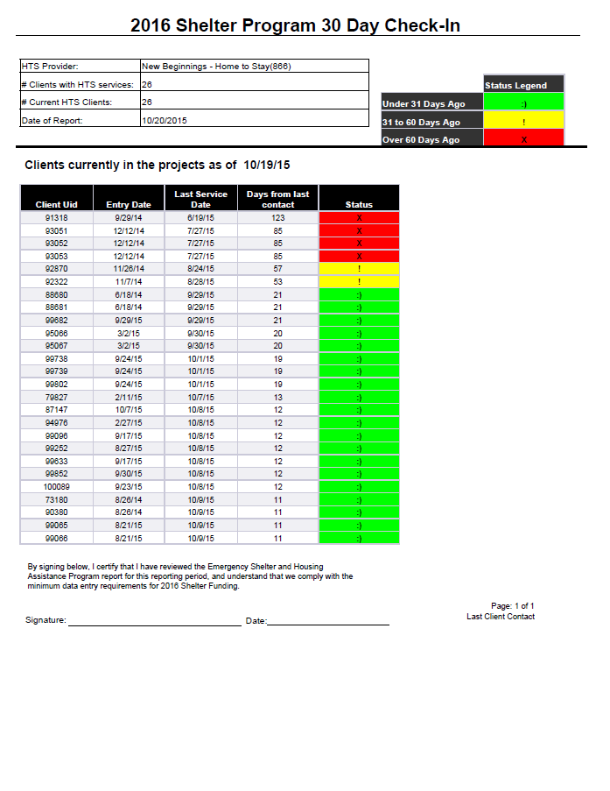

Slide 24
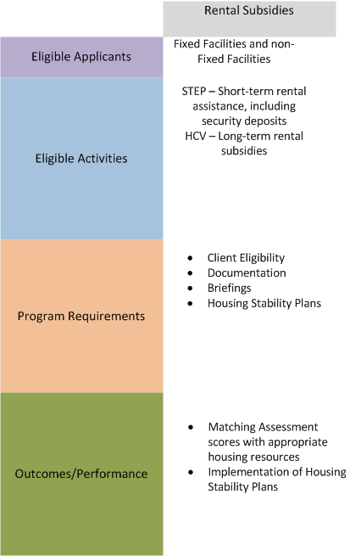

Slide 26
Application & Timeline
Applicants must submit a completed application along with the required attachments by uploading their application to the MaineHousing secure ShareFile website at the following link: https://mainehousing.sharefile.com.
Application Timeline
Task | Date
Deadline for Completed Applications | November 16, 2015
Award Notification to Grantees | November 23, 2015
Navigator Trainings in Augusta | December 3, 2015 & December 4, 2015
Executed Grant Agreement | December 23, 2015
Program Year | January 1, 2016 – December 31, 2016

Slide 27
Questions?????
If you have questions as you prepare your Application, please e-mail SHLTAPP@mainehousing.org .
Uploading and submitting your Application and any supporting documents is simple. Just click on the following secure link: Upload and Submit Application. Applications must be uploaded as a single document.

