Slide 1
Maine Statewide Homeless Council Re-Design Update
Corporation for Supportive Housing
October 13, 2020

Slide 2
IMPROVING LIVES

Slide 3
Today’s Agenda
Focus Group THEMES
Begin to Understand System Flow
Overview of Interactive Resource Mapping
Dive into the Regional Structure
Reaching Consensus

Slide 4
Goals and Decision Points
Meeting Goal:
Share updates on regional focus groups and data collection
Preview Resource Mapping
Gain consensus on regional design and structure
Decision Points:
Confirm and add to regional themes
Understand Distinct Role of the Regional Design
Define the regions

Slide 5
Data Collection
Quantitative
Adminstrative Systems Data
Homeless Management Informaiton System (HMIS)
HUD Stella Tool
2020 HIC Report
ESG Utilization Report
MaineHousing
2018 Census Data
Qualitative
50+ stakeholder interviews
Shelter and Service Providers
Corrections and Justice
Tribal Representatives
Health care
4 Regional Focus Groups
Rural
Portland
Lewiston/Auburn
Bangor

Slide 6
Portland Focus Group:​
Emerging themes:​
Other municipalities helping with solutions​
Shelters being a short term experience​
Partnerships with landlords ​
Increasing diversion as a model​
Stronger General Assistance system​
Landlord mitigation funds ​
Collaboration within a region​
Including partners in the conversation who may not always be in the social services conversation (police, fire, neighbors, parks and rec, etc.)
Bangor Focus Group: ​
Emerging themes:​
Lack of housing​ stock
Buy in from other communities and engagement from non-service center communities​
Shelters = short term ​
Partnerships with landlords ​
Integration with coordinated entry​ ​
Coordinating with local mental health providers
Triage and diversion​
Provider capacity and training

Slide 7
Lewiston and Augusta Focus Group:​
Emerging themes:​
Need for a low barrier shelter in Lewiston (or other suitable intervention).​
Lack of housing stock in the community​
Landlords are willing to work with providers but units cannot pass inspection​
Permanent supportive housing is key to success​
Increased money for services and funds to build permanent supportive housing​
High need, high risk mental health needs​
Better collaboration with other local agencies and shared goals
Rural Service Provider Focus Group:​
​Emerging themes:​
Client centered care​
Access to resources locally​
Transportation​
Town by town governing system​
Partnering with local agencies to keep people local​
Incentives for landlords​
Focusing on the human experience​
Ordinances in rural areas that make multi-housing options challenging​
Non-traditional resources (elderly volunteers)

Slide 8
Common Themes from Focus Groups
Rural/urban divide and importance of regionalization
Increase use of cross system data
Triage and Diversion are priorities
Lack of quality, affordable and supportive housing stock
Intensive, community based SU and MH services
Training and fidelity to best practices, housing first, and quality of interventions
Desire to integrate with Coordinated Entry
Landlord outreach, navigation, education and improved landlord mitigation fund
Impact of COVID 19 highlights need for integration with mainstream services
Replicate and scale successful, local innovations (long term stayers, FQHC partnerships)
"move system from having a bed for the night to how to I get my legs under my feet"
"how do people self-identify... need to have options where people live and what to be served."
"thinking long term... PSH is the key."
Other themes to add?

Slide 9
Understanding System Flow
From 211 to permanent housing

Slide 10
Statewide Homeless System Inventory
 | Emergency Shelter | Transitional Housing | SRO | OPH | HUD - COC Rapid Rehousing | Supportive Housing | VASH
 | Crisis Response Bed with Services | Specialized Program (Youth, DV, respite) | Single Room Occupancy | Single Site/DV | Rental Assistance with Services, Averages 2 years | Rental Subsidy and Intensive Services | HUD-Veterans Affairs Supportive Housing
Data Source | 2020 HIC posted | 2020 HIC posted | 2020 HIC posted | 2020 HIC posted | 2020 HIC posted (246 STEP/63 TBRA) | 2020 HIC posted | Maine Housing
Statewide Inventory | 1418 | 1092 | 15 | 114 | 309 | 2404 | 130
Bed/Unit Utilization | 64% | 66% | 100% | 86% | 100% | 77% | 82%

Slide 11
Inventory and Utilization by Region
SHC Region | Public Health District | Counties | Total # of Housing Related Calls | 2019 Clients Served in Shelter | Total ESG Shelter Beds | Average Shelter Utilization | # of PSH Units | # of TH Units | # of OPH
I | District 1 | York | 81 | 331 | 53 | 78.6% | 231 | 81 | 0
 | District 2 | Cumberland | 193 | 3748 | 510 | 83.5% | 537 | 40 | 0
II | District 3 | Androscoggin | 61 | 102 | 22 | 67.6% | 50 | 64 | 0
 |  | Franklin | 11 | 81 | 16 | 64.5% | 0 | 0 | 0
 |  | Oxford | 36 | 227 | 44 | 71.5% | 27 | 0 | 0
 | District 4 | Knox | 13 | 72 | 22 | 87.3% | 12 | 0 | 7
 |  | Lincoln | 2 | 0 | 0 | 0.0% | 0 | 0 | 0
 |  | Sagadahoc | 13 | 0 | 0 | 0.0% | 26 | 0 | 0
 |  | Waldo | 8 | 0 | 0 | 0.0% | 0 | 13 | 0
 | District 5 | Kennebec | 99 | 593 | 103 | 92.7% | 69 | 16 | 38
 |  | Somerset | 25 | 0 | 0 | 0.0% | 15 | 6 | 0
III | District 6 | Penobscot | 71 | 990 | 135 | 83.7% | 329 | 80 | 0
 |  | Piscataquis | 4 | 0 | 0 | 0.0% | 0 | 10 | 0
 | District 7 | Hancock | 13 | 224 | 57 | 64.8% | 21 | 34 | 0
 |  | Washington | 5 | 0 | 0 | 0.0% | 0 | 0 | 0
 | District 8 | Aroostook | 11 | 162 | 47 | 31.1% | 0 | 70 | 0
 | Scattered Site (Mostly BRAP) |  |  |  |  |  | 667 | 1079
Notes:
Data Sources: 2020 Housing Inventory Count, HMIS, 211, US Census Data

Slide 12
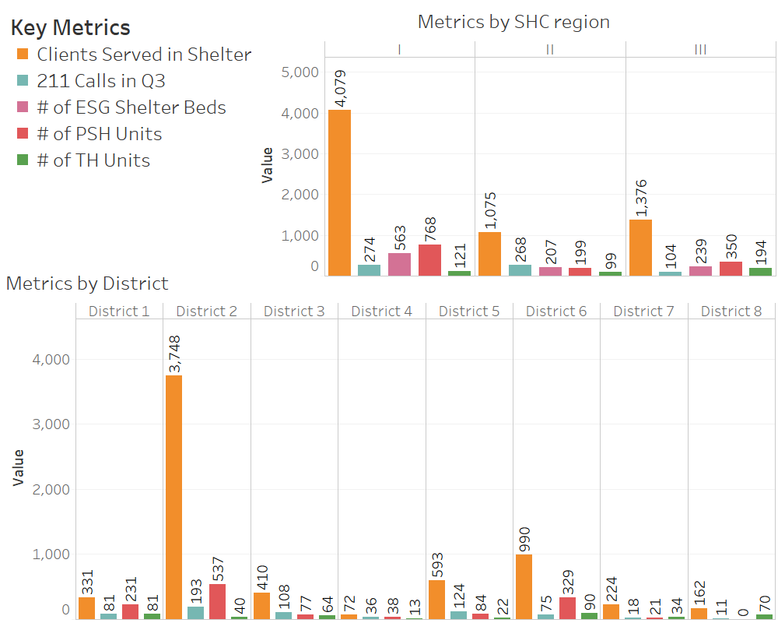

Slide 13
Understanding In-flow
6,064 calls in September 2020
248 Housing Search
154 Rental Assistance Payment
110 Food Pantries
90 RAP – COVID
76 Homeless Motel Vouchers
76 Community Shelters
63 General Relief
3,217 housing calls in Q3 2020
396 Community Shelter
First Time Homeless
6,927 entered HMIS between 1/1/19 and 8/1/2020
74% were homeless for the first time.

Slide 14
Path to Permanent Housing
6,476 Households in HMIS
78% (5,065) enter Emergency Shelter → 15% of these households move to permanent housing from shelter
13% (841) enter Transitional Housing → 4% of these households move to permanent housing
6% (388) enter Permanent Supportive Housing Directly
3% (194)are served by Rapid Re-Housing
Notes:
Stella shows where folks are going once they enter into HMIS. This is important because it speaks to the intervention options available to households experiencing homelessness.

Slide 15
Returns to Homelessness for those Placed in PH (2 year)
EXITING FROM
ES
TH
16% return to homelessness within 2 years.
PH
14% return to homelessness within 2 years
SH
17% return to homelessness within 2 years
0% of Households returned to homelessness
Across all interventions, 17% of households (469) return to homelessness within 2 years in Maine.
Notes:
HMIS exit data tells us where folks are going once they leave shelter and how long they stay or return to homelessness. This speaks to the effectiveness of each intervention.

Slide 16
Interactive Resource Mapping

Slide 17
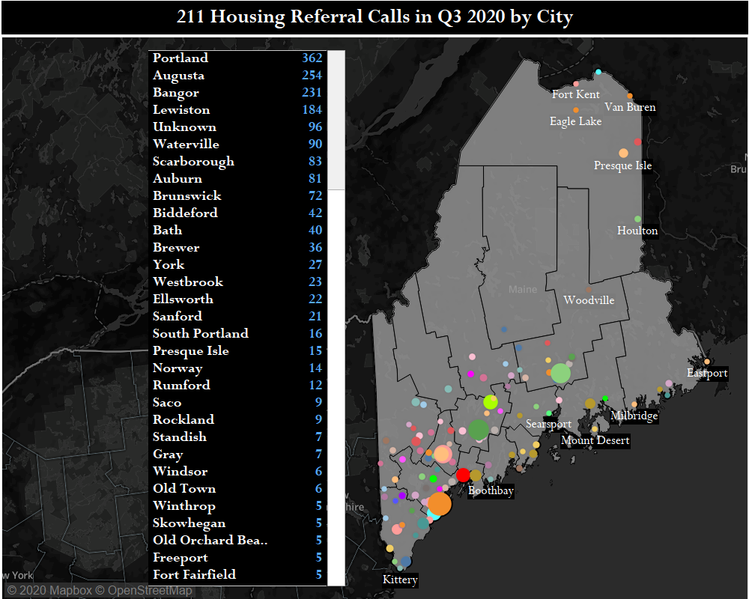
Maine 211 Housing Referrals in Q3 of 2020 (by city)

Slide 18
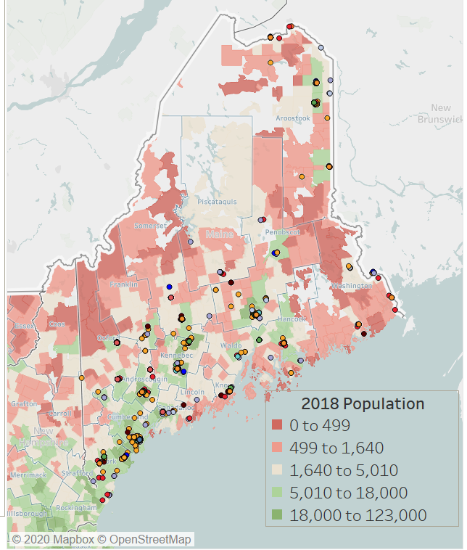
2018 Population density and distribution of resources.

Slide 19
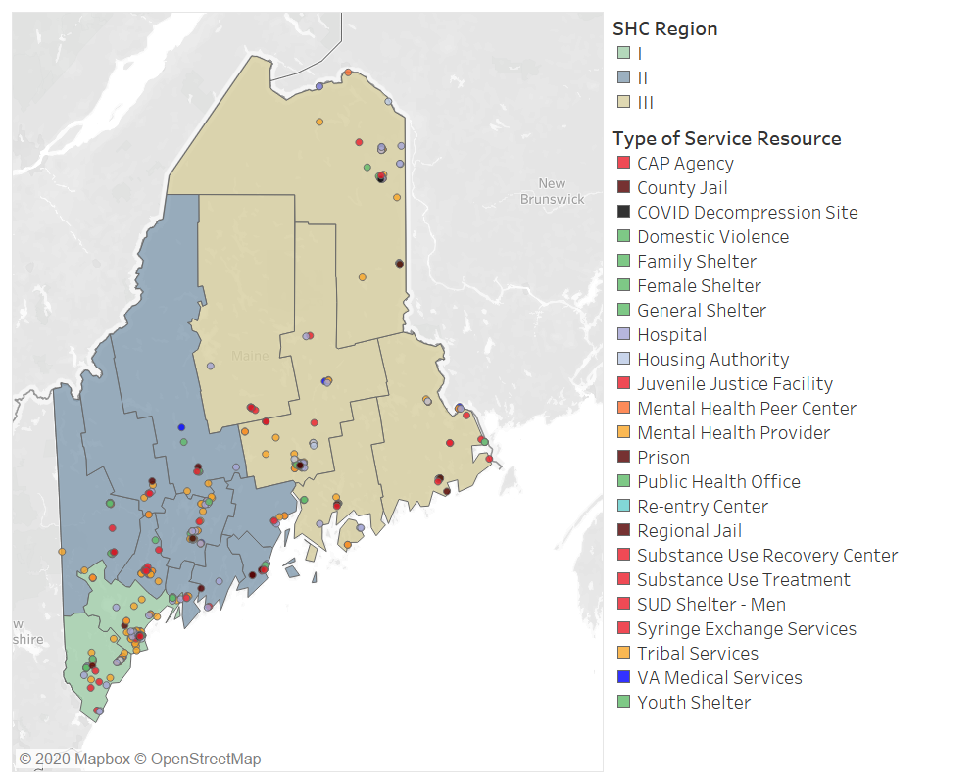
Current Statewide Homeless Council Regions and distribution of resources.

Slide 20
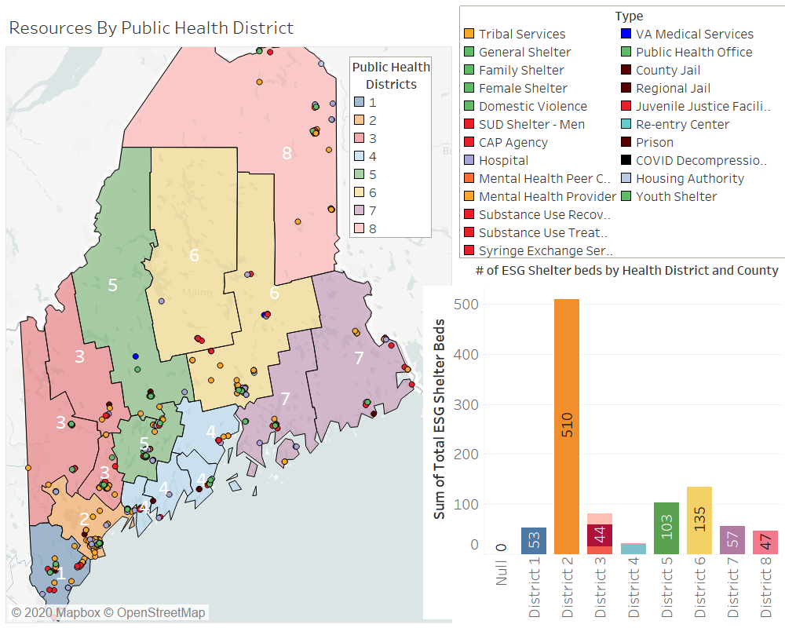
Maine Public Health Districts and distribution of resources.

Slide 21
Dive into Regional Approach

Slide 22
Facilitate implementation of coordinated entry
Central triage and intake
Housing Matching and Prioritization
Develop Innovation
Support Quality
Other ideas?
The role of the regions

Slide 23
Criteria for Regional Design
Data – population, inflow and resource mapping
Culture – where do people identify
Capacity – How can we best staff and resource the system

Slide 24
Defining the Maine Homeless System Design Regions

Slide 25
Next Steps
1. Deep Dive with Regions and Regional Working Group
Identify Leads and Partners
Regional Data Dashboards
System Mapping Exercise
Local Recommendations
2. Convene Affordable and Supportive Housing Working Group
3. Peer to Peer Learning on Areas of Interest
CT Diversion Program
DE SRAP or CO or IN Statewide Design
Beacon Integrated Utilization Data

